Slide 1
Check Point 2012 Appliances
Rami Rauanmaa Sr. Security Engineer
Check Point Software Technologies

Slide 2
Today’s IT Security Challenges
Growing Security Threats
Increased Demand in Network Performance
Simple + Effective = Secured

Slide 3
Cybercrime Trends for 2012
44%
35%
32%
33%
32%
SQL
Injections
APTs
Botnet
DDoS
DDoS
65% Businesses Experienced Attacks
Average $214,000 of Damage Per Attack
Ponemon Institute, May 2012

Slide 4
More Security, Additional Power
FW & VPN Software Blades
IPS Software Blade
Application Control Software Blade
Identity Awareness Software Blade
Antivirus Software Blade
URL Filtering Software Blade
DLP Software Blade
Anti-Bot
Software Blade
Security Appliance
The Security You Want
The Performance You Need

Slide 5
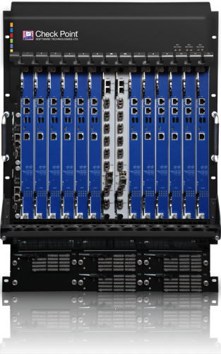
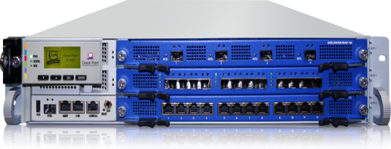
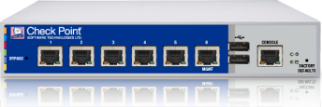
The New Security Appliances
61000 System &
21000 Appliance
New Models for the Entire Range
12000 Appliances
(3 Models)
4000 Appliances
(4 Models)
2200 Appliance
Ultra High-End
Datacenter Grade
Enterprise Grade
Small Office – Desktop

Slide 6
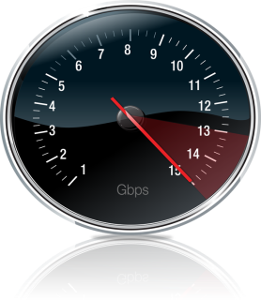
2012 Appliances From Check Point
NEW FEATURES & PERFORMANCE
Performance
Check Point R75
Check Point R75
CONSOLIDATE SECURITY
Optimized for Software Blades
Security
ANY BUSINESS AND ENVIRONMENT
Scalability

Slide 7
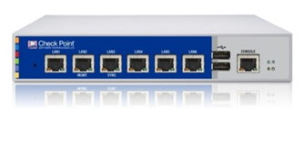
2012 Appliance Models
The Small Office – Desktop Model
3 Gbps firewall throughput
Less than $4,000
Check Point 2200 Appliance
Enterprise Grade
3 to 11 Gbps firewall throughput
2 to 6 Gbps IPS throughput
Check Point 4000 Appliances
(4 Models)
Data Center Grade
15 to 30 Gbps firewall throughput
Hot-swap power supply and HDD
Check Point 12000 Appliances (3 Models)
Ultra Data Center Protection
50 to 110* Gbps firewall throughput
High availability and serviceability
Ultra-low <5µs latency*
Check Point 21000 Appliances
(2 Models)
* With optional Security Acceleration Module
Notes:
7
7
7
7
7
7

Slide 8
Filled with New Features…
©2011 Check Point Software Technologies Ltd. | [PROTECTED] – All rights reserved |
8

Slide 9
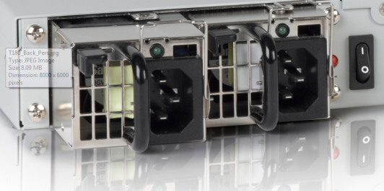
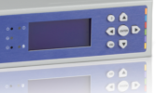
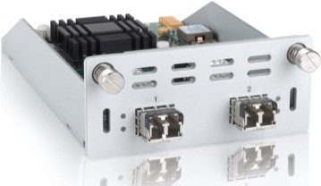
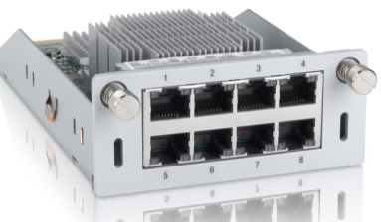
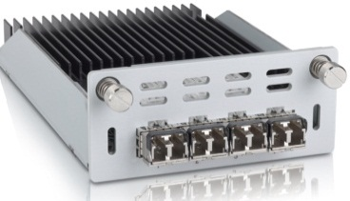
Check Point 4800: Enterprise-Grade, High-End Features
Hot-swappable redundant power supplies
True Serviceability with Rich Connectivity
Variety of network interface expansions
Same cards for 4000 and 12000 appliances
Copper and fiber (1GE / 10GE)
Out-of-band management (LOM )
8x1GE onboard ports
Graphic LCD display

Slide 10
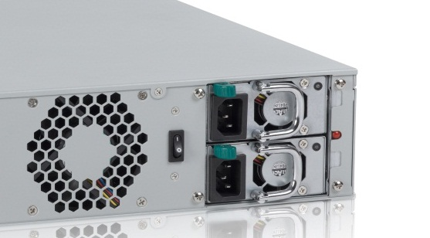
The New Hardware: Check Point 12600
Hot-swappable power supply and hard drive
Designed for The Datacenter
3 slots for network expansion
Copper and fiber (1GE / 10GE)
Up to 24 1GE ports/ 12 10GE ports
Out-of-band management (LOM )
Graphic LCD display

Slide 11
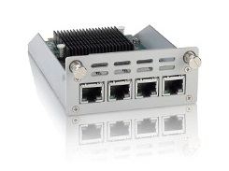
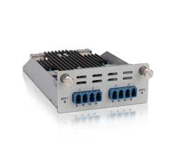
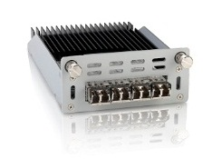
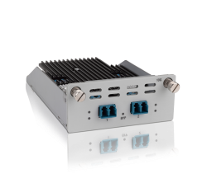
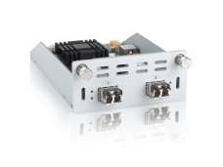
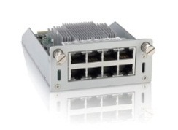
A Broad Range of IO Options (4000 & 12000)
4 x 10/100/1000BaseT (All Models)
4 x 1GbE copper or fiber Fail-Open (All Models)
4 x 1000BaseF (All Models)
2 x 10GBaseF Fail-Open (4800 and higher)
2 x 10GBaseF (4800 and higher)
8 x 10/100/1000BaseT (4800 and higher)
4 x 10GBaseF (12200 and higher)

Slide 12
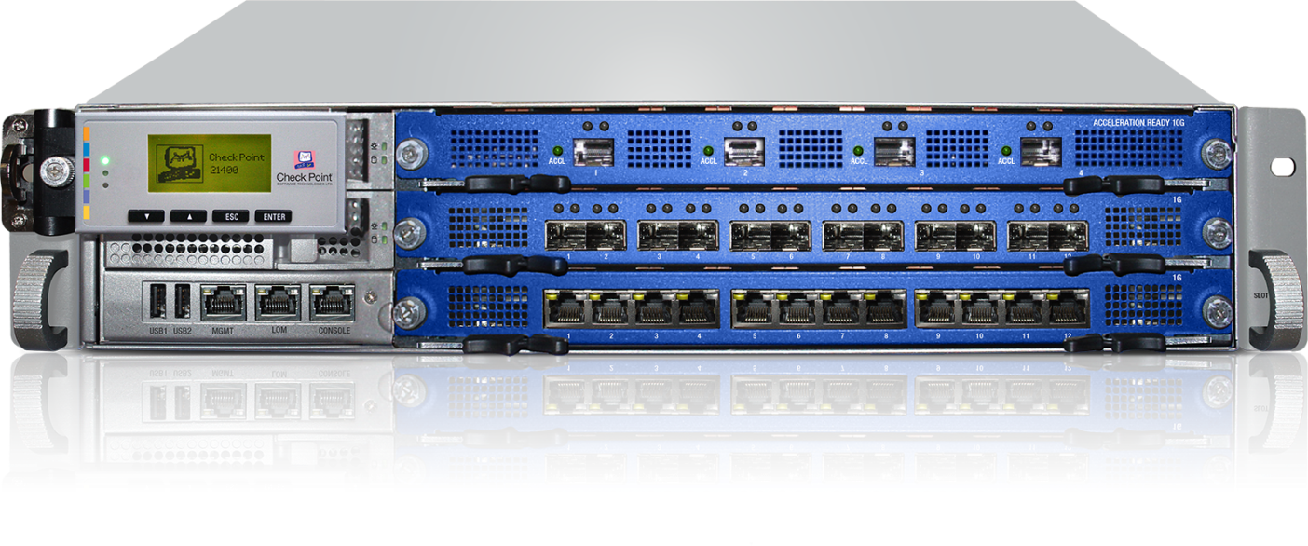
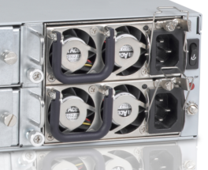
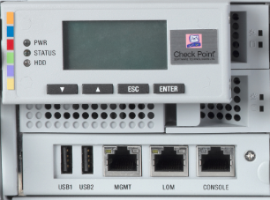
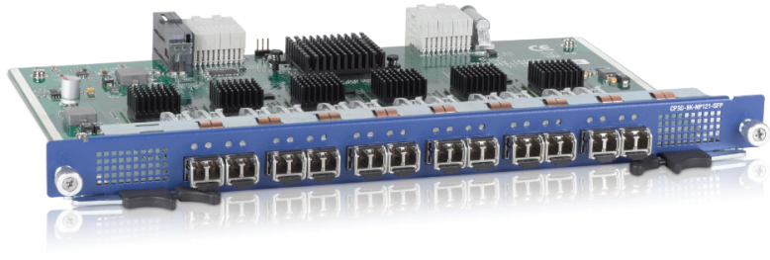
21400 Hardware
Hot-swap redundant power supply
Ultra High End Performance
Hot-Swap redundant hard drives & fans
Out-of-band management (LOM)
Graphic LCD display
3 slots for network expansions
Copper and fiber (1GE / 10GE)
Up to 37x1GE or 12x10GbE

Slide 13
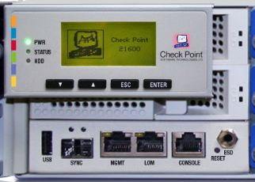
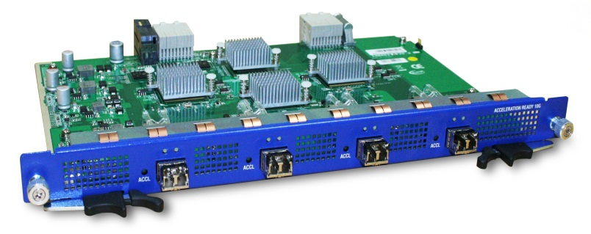
21600 Hardware
New
Hot-swap redundant power supply
Best Performance in Its Class
Hot-Swap redundant hard drives & fans
Out-of-band management (LOM)
Graphic LCD display
10GbE Sync Port
Network expansion (warm-swap)
Copper & fiber (1, 10 & 40 GbE)
Up to 37x1GbE, 13x10GbE
New!
New!

Slide 14
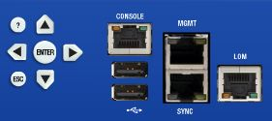
Lights-Out Management (LOM)
Included in models 4800 and above
Main Functionalities
Power control - start appliance after shutdown
Virtual KVM – full remote access to the console
Virtual Media – ability for remote installation
Last fault screen
Hardware monitoring
SNMP

Slide 15
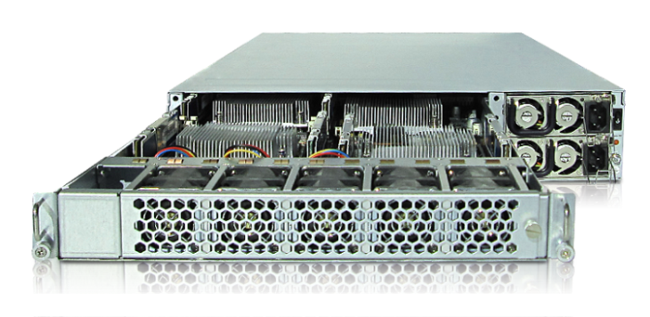
Boosting Performance with Security Acceleration Module
110 Gbps firewall throughput
Ultra low sub 5µs latency
5x VPN throughput to 37 Gbps
3x session rate with 300,000* connections per second
9x forwarding rate with 60 million packets per second
SecurityCoreTM Technology
with 108 cores
Performance boost to 3,300 SPU
* With Memory Upgrade & GAiA OS

Slide 16
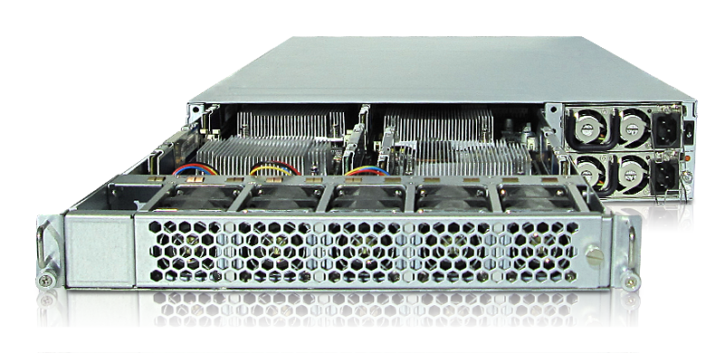
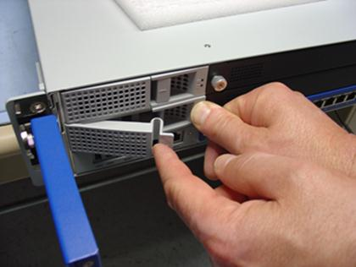
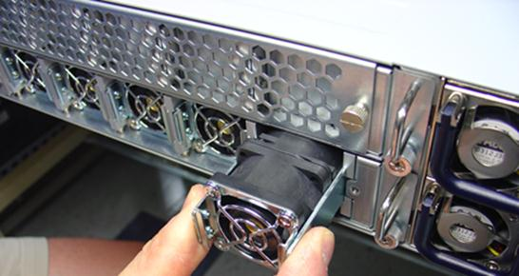
21000 Serviceability
Redundant disks, Redundant N+1 fans
Removable Motherboard for Ease of Maintenance

Slide 17
How About Performance?
©2011 Check Point Software Technologies Ltd. | [PROTECTED] – All rights reserved |
17

Slide 18
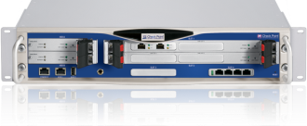
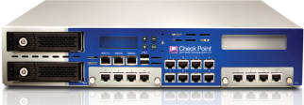
IP, Power-1 & UTM-1 Appliance Lines
SecurityPower
IP Series
Power-1
1006
SPU
UTM-1
670
SPU
596
SPU
298
SPU
101
SPU
101
SPU
101
SPU
50
SPU
50
SPU
UTM-1 130
UTM-1 270
UTM-1 570
UTM-1 1070
UTM-1 2070
Power-1 5070
Power-1 9070
UTM-1 3070
IP 1280

Slide 19
The New Appliances
3X MORE PERFORMANCE !
1861
SPU
2012 Models
12000
1046
SPU
1006
SPU
4000
670
SPU
738
SPU
596
SPU
2200
623
SPU
298
SPU
374
SPU
114
SPU
223
SPU
101
SPU
114
SPU
50
SPU
101
SPU
101
SPU
50
SPU
2200
4200
4400
4600
4800
Power-1 5070
12600
UTM-1 130
UTM-1 270
UTM-1 570
UTM-1 1070
UTM-1 2070
UTM-1 3070
12200
12400
Power-1 9070
IP 1280

Slide 20
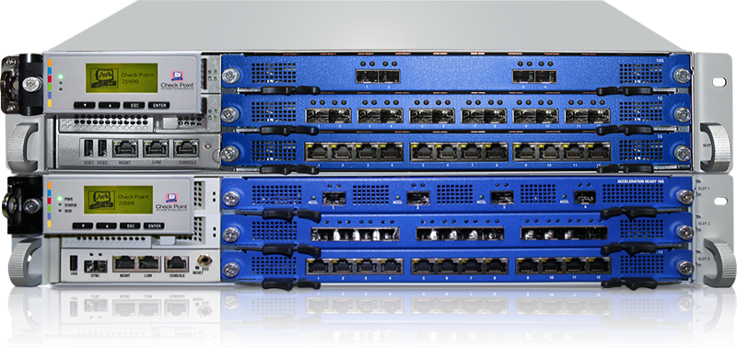
Check Point 21000 SecurityPower
3300*
SPU
Check Point 21000 Appliances
2900*
SPU
1861
SPU
1046
SPU
623
SPU
738
SPU
223
SPU
374
SPU
114
SPU
114
SPU
2200
4200
4400
4600
4800
12200
12400
12600
21400
21600
* With Security Acceleration Module

Slide 21
2012 Appliances Firewall Throughput
3X STRONGER PERFORMANCE
120-
100-
80-
60-
40-
20-
9-
6-
3-
30-
20-
10-
12600 Appliance
21600 Appliance*
4600 Appliance
X3.7
Gbps
X2.9
X3.0
Gbps
Gbps
UTM-1 1070
IP 1280
Power-1
11000
* With Security Acceleration Module
Notes:
21
21

Slide 22
More Capacity…
Connection Capacity
3-
2-
1-
0-
Over 5 million concurrent connections*
12200 Appliance
x3
Million
UTM-1
3070
* With Memory Upgrade & GAiA OS
Session
Rate
Up to 300K connections per second
300-
200-
100-
0-
21400 Appliance*
x3
Conn/Sec (k)
Power-1
11000
* With Security Acceleration Module

Slide 23
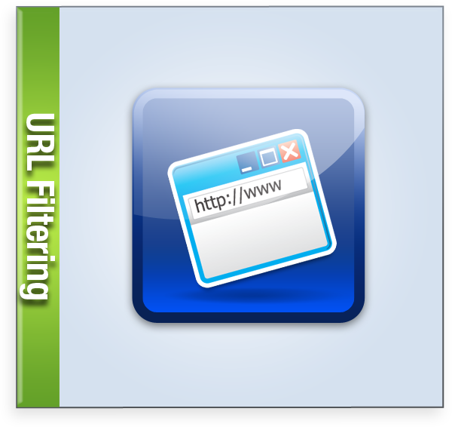
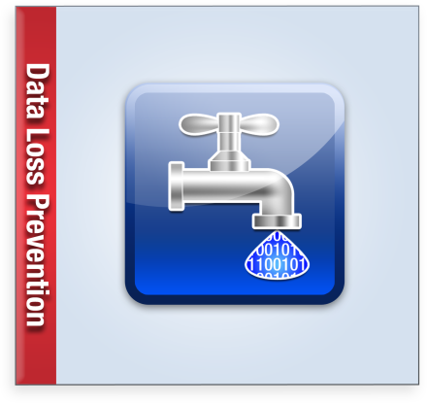
Enhanced Security Across All Software Blades
Better!
Better!
Check Point is
RAISING THE BAR…
Better!
BetTER!
Better!

Slide 24
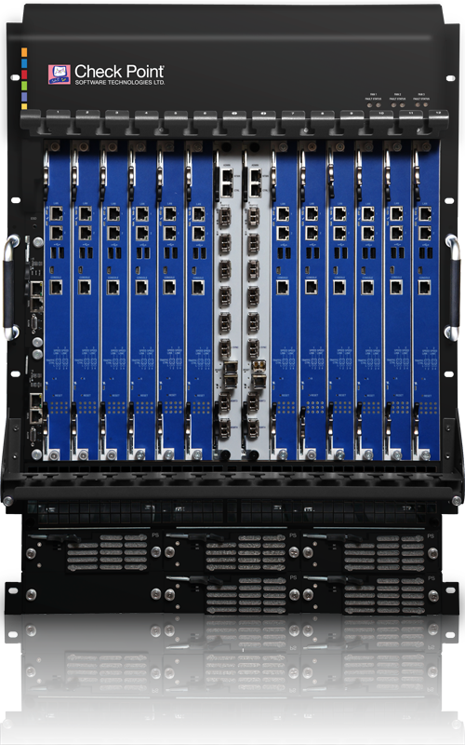
Check Point 61000
Securing The
Most Demanding Networks
Ready For Over 1 Terabit Per Second
Ready For Over 1 Terabit Per Second

Slide 25
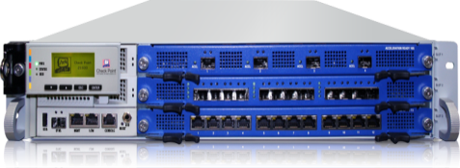
Appliance SecurityPower Values
14,600
SPU
21000
3300*
SPU
12000
2900*
SPU
4000
61000
2000
1861
SPU
1046
SPU
623
SPU
738
SPU
374
SPU
114
SPU
114
SPU
2200
4200
4400
4800
12200
12400
12600
21400
21600
61000
* With Security Acceleration Module

Slide 26
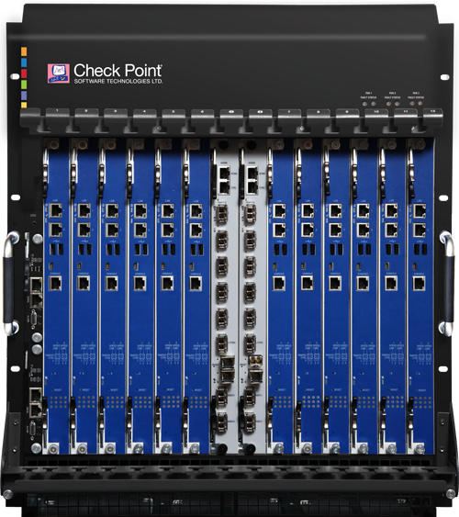
More SecurityPower in a Single Solution
Power-1 11000
61000
x12

Slide 27
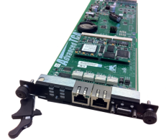
Check Point 61000 Never Stops!
Scaling Security
Security Gateway Modules
2003 SecurityPower
20Gbps firewall throughput
x12
Scaling Networking
Security Switch Modules
Redundancy Power supplies, fans and management modules
SSM60
Fast Networking
6x10GbE
SSM160
Ultrafast Networking
16x10GbE / 2x40GbE
x2

Slide 28
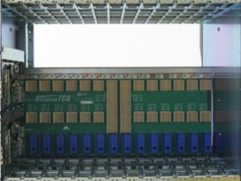
Seamless Growth
The Only Solution That Acts as One Gateway…
First Blade installation
in less than 30 minutes
1
Seamlessly add new Security
Gateway Modules (SGMs)
2
2

Slide 29
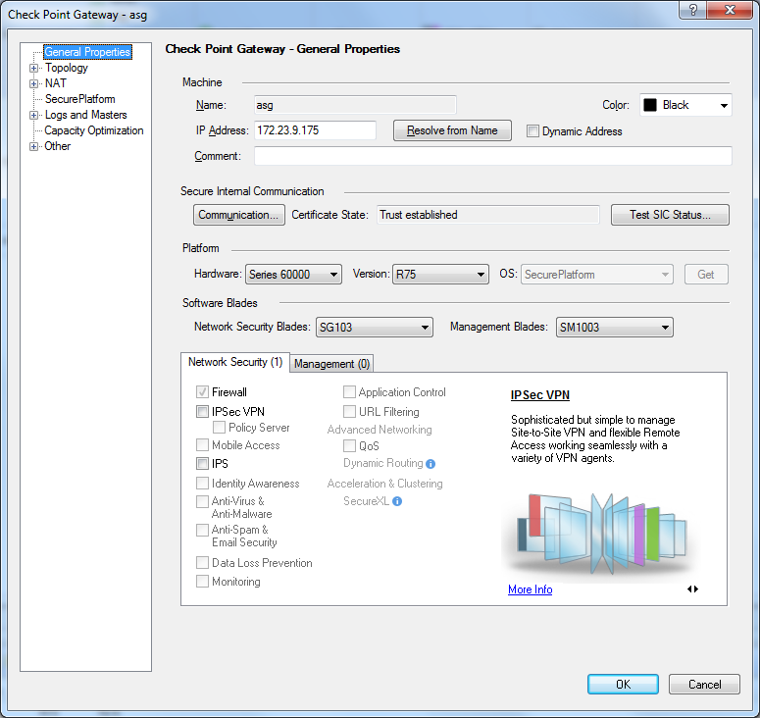
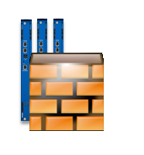
Easy Administration
Single Object in the
SmartConsole product family
2
3

Slide 30
Cross Chassis High Availability
Connect two 61000 units for maximum high availability

Slide 31
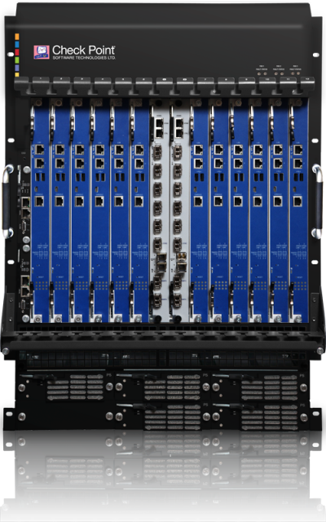
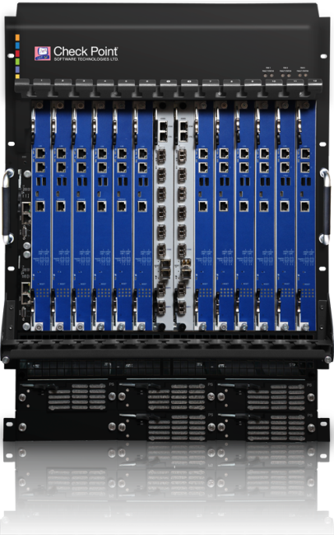
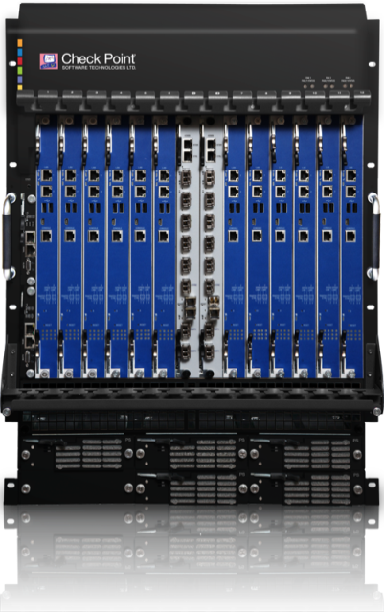
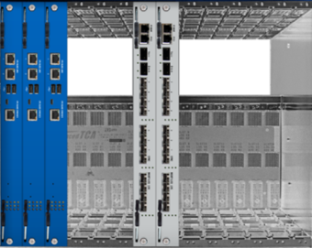
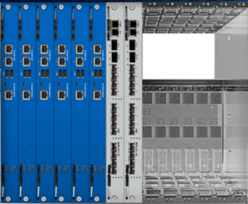
Scalable Solution
Platform to Grow…
Boost Performance
From 12x10GbE to 32x10GbE
Plug and Play
5 Hardware Blades
8 Hardware Blades
14 Hardware Blades

Slide 32
61000 – The Platform For the Future
Over 1Tbps
Single Firewall
Same Chassis
400Gbps
200Gbps
2012
2011
Firewall Throughput

Slide 33
Integrated Solutions
©2011 Check Point Software Technologies Ltd. | [PROTECTED] – All rights reserved |
33

Slide 34
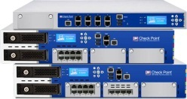
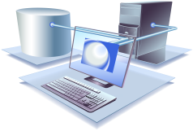
Threat Prevention Appliances
Fight against advanced threats and malware attacks with integrated threat-prevention solution
AVAILABLE
NOW !
4800, 12200, 12400 and 12600 appliances
Antivirus
Pre- and post- infection protection
Powered by ThreatCloud™

Slide 35
Check Point Takes Best Approach to Secure Web Access!
Check Point Secure Web Gateway
Standalone appliance with Web Control, Anti-Virus, Analysis and Reporting
WWW

Slide 36
Check Point Secure Web Gateway
List Price | $12,000 | $19,000 | $32,000 | $56,800 | $74,500
Renewal | $2,800 | $2,800 | $6,100 | $10,000 | $11,200
3 Years TCO | $17,600 | $24,600 | $44,200 | $76,800 | $96,900
SWG-4400
SWG-4600
SWG-4800
SWG-12400
SWG-12600
(< 250 users)
(< 500 users)
(< 1,000 users)
(< 5,000 users)
(< 10,000 users)

Slide 37
Variety of Models –
For Any Deployment Size!
SWG-12600
SWG-12400
SWG-4800
X-Large
(< 10,000 users)
SWG-4600
Large
(< 5,000 users)
SWG-4400
Medium
(< 1,000 users)
Small
(< 500 users)
Branch
(< 250 users)

Slide 38
What’s New in R75.40VS
Next Generation Virtual System:
Can run any Software Blades on any Check Point Appliance
All Software Blades on Every Virtual System
Simplify and Consolidate
Boosting Performance
VSLS
Check Point

Slide 39
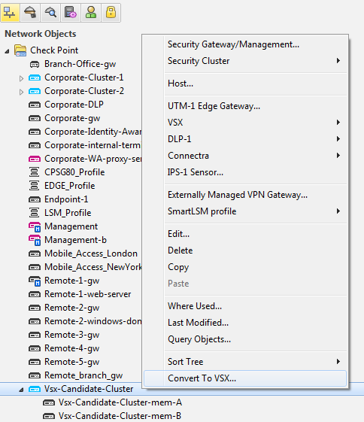
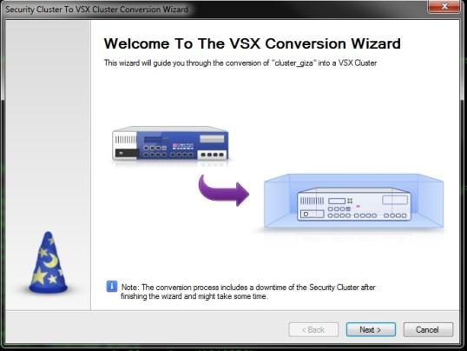
One-Click Virtualization – Enable VSs

Slide 40
Virtual Systems Architecture – User Mode
VS
VS
VS
cpd
cpd
cpd
fwd
fwd
fwd
vpnd
vpnd
vpnd
fwk
fwk
fwk
UM
KM
Firewall dispatcher
fwk process is the firewall kernel code compiled in user mode. It is responsible for all the traffic inspection that is not done in the PPack same as firewall kernel driver
PPack virtualized
NIC
NIC

Slide 41
R75.40VS Virtual System Licensing
Free VS
License
Software Blades
VS
License
Security Gateway
VSs x1
VS
License
VSs x3
VS
License
VSs x10
+
+
VS
License
VSs x25
VSs x50
Virtual System packages are licensed the same for all appliances & open servers
Virtual System 3 VS package is available only for small gateways*
Offering one complementary Virtual System**
Software Blades are priced per gateway regardless number of Virtual Systems
Software Blades apply to any/all Virtual Systems running on the gateway
Software Blades pricing and SKUs are unchanged (same as with ‘physical’ GWs)
* Available for: 2200, 4200, 4400, 4600 and Open servers with less than 4 cores
** Available for: 4800, 12200, 12400, 12600, 21400, Power-9000, Power-11000, IP-1280, IP-2450 and open servers with 4 cores or more

Slide 42
Consolidated Management
©2011 Check Point Software Technologies Ltd. | [PROTECTED] – All rights reserved |
42

Slide 43
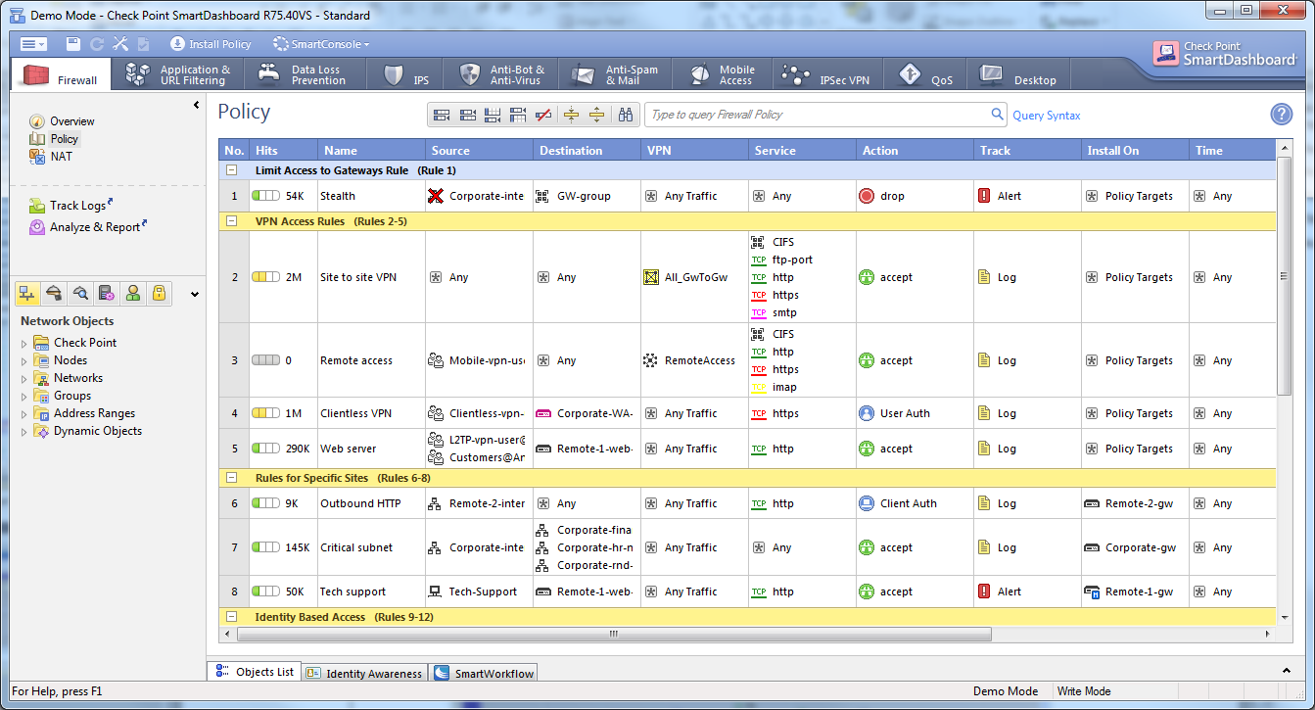
Centrally Managed
Network Security Management
Single Unified Console for All Security Functions
ONE PLACE
Control All Security Functions

Slide 44
Easy Security Status View
Security Status Overview
Real-time Synopsis
Trending Analysis

Slide 45
Check Point Appliances— Securing Any Environment
Network Perimeter
Branch Office Solution
Internal Networks
Data Center & Cloud Security

Slide 46
Introducing Check Point DDoS Protector™
Block Denial of Service Attacks Within Seconds!

Slide 47
Today’s Attacks Are More Sophisticated
More DDoS attacks today than ever before
More damage with application attacks
No need to flood network bandwidth

Slide 48
Multi-Vectored DDoS Attacks
Network Flood
Server Flood
Application
Low & Slow Attacks
High volume of packets
High rate of new sessions
Web / DNS connection-based attacks
Advanced attack techniques

Slide 49
DDoS Protector Product Line
Enterprise Grade
Up to 3 Gbps throughput
2M concurrent sessions
1 Mpps max. DDoS flood attack rate
Datacenter Grade
Up to 12 Gbps throughput
4M concurrent sessions
10 Mpps max. DDoS flood attack rate
7 models to choose from
1GbE copper and 10GbE fiber connections
Low latency

Slide 50
Appliance Specifications
Model | DP 506 | DP 1006 | DP 2006 | DP 3006 | DP 4412 | DP 8412 | DP 12412
Capacity | 0.5Gbps | 1Gbps | 2Gbps | 3Gbps | 4GBps | 8Gbps | 12Gbps
Max Concurrent Sessions | 2 Million |  |  |  | 4 Million
Max DDoS Flood Attack Protection Rate | 1 Million packets per second |  |  |  | 10 Million packets per second
Latency | <60 micro seconds
Real-Time Signatures | Detect and protect against attacks in less than 18 seconds

Slide 51
Step-by-step Examples of Attacks
More Disruptive with Fewer Packets
Attack Vectors
Start HTTP(S) Get
Set fragment flag to slow server reply
Keep connection alive
Never complete request
Partial HTTP Requests
Spoof recursive DNS queries aimed at target (send to many public DNS servers)
Public DNS servers forward queries to target
Target replies many bytes to bad IP addresses
Recursive DNS Spoofing
Wildcard search with hidden function/bug
Outputs large amounts of data (Gigabytes)
Set fragment flag to slow server reply
Attempt to send all data to “clients”
Application Exploits

Slide 52
Services Unavailable
Crashes Servers and Services
Attack Damage
Server unable to make new connections
Server will run low on memory
All server responses slow
Server and services might crash
Partial HTTP Requests
Target DNS servers will be very busy
Will disrupt domain name resolution
Will have browsing and email issues
Recursive DNS Spoofing
Services can crash
Processor 100% utilized
Disk 100% utilized
All server responses slow
Application Exploits

Slide 53
Attackers Use Multi-Layer DDoS
Simultaneous Attack Vectors
Network
Large-volume network flood attacks
Server
SYN flood attack
“Low and slow” DoS attacks
(e.g., Socket stress)
Application
Application vulnerability
High and slow
application DoS attacks
Web attacks:
brute force login locked
1 successful attack vector = No service

Slide 54
On-the-Fly Signature Creation
Protect Applications and Services Automatically
Inputs
Network
Servers
Clients
DoS and DDoS
Public
Network
Application Level Threats
Zero-Minute
Malware Propagation
Behavioral Analysis
Inbound
Traffic
Real-Time
Signature
Inspection Module
Abnormal Activity Detection
Closed
Feedback
Outbound
Traffic
Real-Time
Signature
Generation
Optimize Signature
Remove When Attack is Over
Enterprise
Network

Slide 55
HTTP Challenge / Response Diagram
Attack Detection
Real-Time
Signature Created
“Light”
Challenge Action
“Strong”
Challenge Action
Select
Rate-Limit
?
?
X
X
TCP Challenge
302 Redirect
Challenge
Java Script
Challenge
RT Signature
Blocking
Behavioral Real-Time
Signature Technology
Challenge/Response Technology
Real-Time Signature Blocking
Closed Feedback and Action Escalation

Slide 56
Tänan !

