Slide 1
Check Point Appliances
“Expanding your business “
Stallion Seminar November 10th
Michael Amselem
EMEA Sales Director Appliances Solutions
Notes:
Virtualization is a hot topic
Virtualization – when applied to security – is different.
It is not simply a matter of virtualizing security functionality on a VMWare platform or a Xen base
It has different properties and different requirements
Setting the Stage:
Drivers and issues are different
The market-leading VSX solution addresses the requirements of high-density security services – using virtualization as one key underlying technology.
In 5 years we have the benefit of many lessons learned.

Slide 2

Agenda
Check Point appliances –Vision-
Products line
IP integration
Support
Q&A

Slide 3
One
Vision
Notes:
3

Slide 4
Vision for Check Point security gateways
Scalable, configurable security gateway with a single architecture to simplify deployment, operation, and maintenance of network security.
To support this advanced architecture, Check Point will continue to innovate performance and functional advancements to ensure that our customers get best performance and best security at lowest operating cost.

Slide 5
Appliances
Concept &Products
Total Security Appliances developed, manufactured and supported by Check Point
Notes:
5

Slide 6

The Check Point Expanded Appliance Ecosystem
Check Point offers a turnkey appliance for every business need
Powerful hardware platforms
Flexible Software Blade architecture
Expanded lines of turnkey solutions that scale as you grow your business

Slide 7









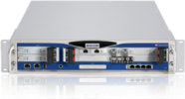

A menu of gateway options
Custom
blade
configuration
Pre-defined
System
UTM-1
appliances
IP
appliances
Power-1
appliances
Software
blades
Pre- defined system
2, 3 or
6 blades
Pre- defined system
2, 3 or 5 blades
Pre- defined system
5 blades
Hardware
platform
Open Choice
Open Choice

Slide 8

Customize your gateway security
Gateway blade
firewall
Gateway blade
VPN
Gateway blade
acceleration & clustering
Gateway blade
advanced networking
Gateway blade
web security
Gateway blade
voice over IP
gatewayblade
IPS
gatewayblade
URL filtering
gatewayblade
anti-virus & anti-malware
Security perpetual blade
gatewayblade
anti-spam & email security
Security service blade

Slide 9
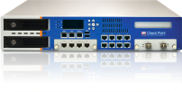
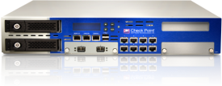












Check Point Appliance Line
Power-1 11085
Small office or branch
SMB to medium branch
Enterprise perimeter / core / large branch
Power-1 11075
Power-1 11065
Power-1 9075
VSX-1 9090
IP2450
Power-1 5075
VSX-1 9070
IP690
VSX-1 3070
UTM-1 3076
IP1280
IP560
FW throughput (Gbps)
UTM-1 2076
IP390
Smart -1 150
UTM-1 1076
Smart -1 50
IP290
UTM-1 576
Smart – 1 25
Power-1
IP150
Check Point
IP Appliance
UTM-1 272
Smart -1 5
UTM-1 132
UTM-1
UTM-1 Edge
List price

Slide 10
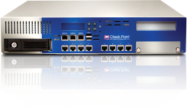
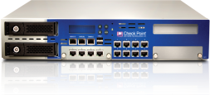
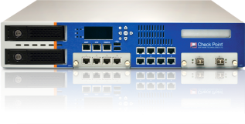

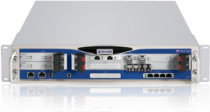







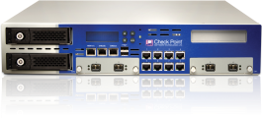


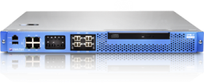
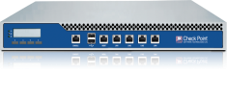
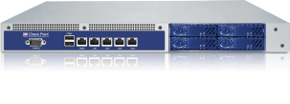
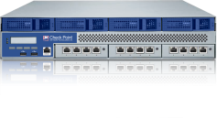
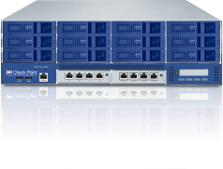
Check Point Appliance Lines
Greater choice for turnkey deployment of
Check Point’s award-winning security software
Industry Enterprise Leading Firewall/VPN/IPS
Power-1
“All in one” UTM solutions
from 100 –up to 1,500 users
UTM-1
Highly scalable and modular solutions for complex networks*
IP Appliance
Complete SSL VPN solution
Connectra
Consolidate and virtualizes hundreds of physical gateways into a single env.
VSX-1
Dedicated IDS/IPS appliance
IPS-1
Dedicated Management Appliances
Smart-1
Hardware and Software - separate

Slide 11
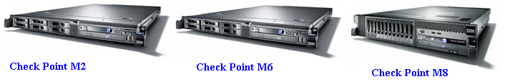
IAS Value Proposition
A Check Point Product- Reduces Risk
Single Point of Fulfillment
Single Point of Support
Highly Flexible and Pre-Integrated
High-Performance Platforms
Highly Competitive Pricing
Trade In Credit for Existing Licenses

Slide 12
Integrated Appliance Solution Base Unit Specifications
 | M2 | M6 | M8
Software Edition | NGX R65/R70 MS (2.6) | NGX R65/R70 Power (2.6) | NGX R65/R70 Power (2.6)
GigE Ports | 4/10 | 10/10 | 14/18
Firewall Throughput | 7 Gbps | 16 Gbps | 20 Gbps
VPN Throughput | 2.4 Gbps | 3 Gbps | 4 Gbps
Max Connection Rate | 45,000 | 65,000 | 105,000
IPS Default | 5 Gbps | 7.5 Gbps | 10.5 Gbps
Concurrent Sessions | 1.2 Million | 1.2 Million | 1.2 Million
VLANs | 256 | 256 | 256
Storage Capacity | 2 X 73 GB (6 max) | 2 X 73 GB (6 max) | 2 X 73 GB (12 max)
Security Acceleration | Yes | Yes | Yes

Slide 13
Performances/
Product line
You can have all :
- More security
- More performance
-More platforms to choose
Notes:
13

Slide 14
More Performance AND More Security
Check Point:
Enhanced security and improved performance
Performance
  Throughput
  Connections
  Application
Intermediate scenario:
Performance improvement
offset by enhanced security
The standard scenario:
Security enhancement
drains performance
Security complexity increasing
over time
Notes:
14

Slide 15
CoreXL: the multi-core layer
First security solution
for open multi-core processors
More performance with new protections
Near-linear scalability:
- more servers
- more cores
- more power
Core
with
VPN-1
Core
with
VPN-1
Core
with
VPN-1
Core
with
VPN-1
Core
with
VPN-1
Core
with
VPN-1
Core
with
VPN-1
Memory
Intelligent
load sharing
NIC
NIC

Slide 16
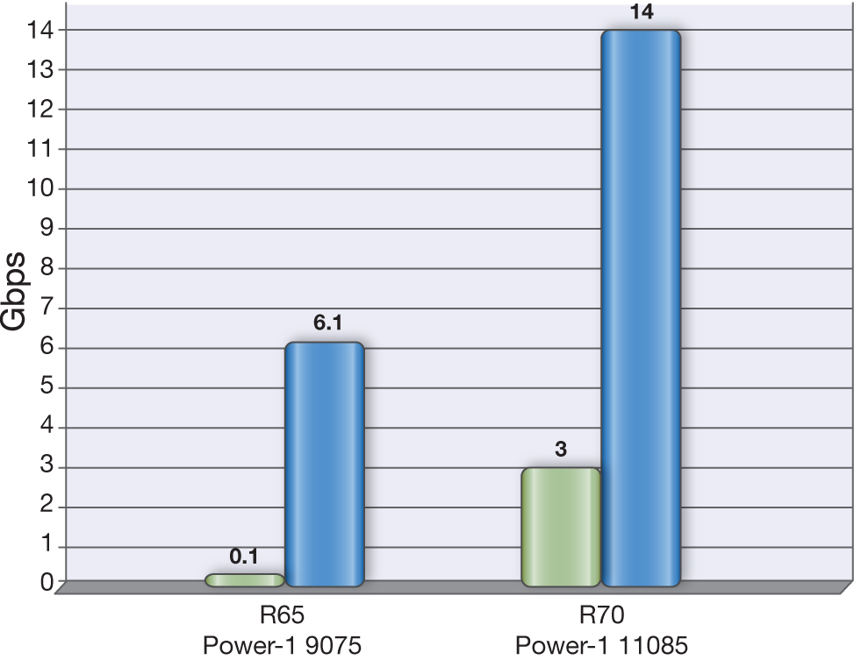
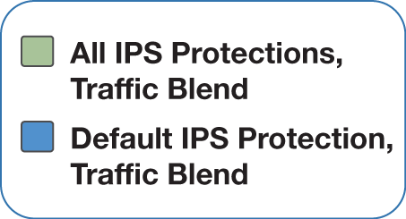
Improved Core Performance
All IPS Protections: Best security with very good performance
x30

Slide 17


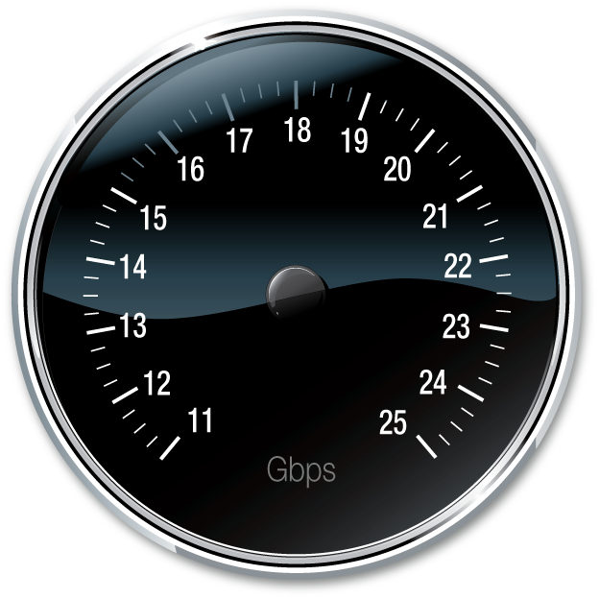
Achieve the Performance You Need
Notes:
Purchase the 11065 and upgrade as more performance is needed
Simple and flexible field performance upgradability

Slide 18
Nokia=
CHKP
Notes:
18

Slide 19



Joining forces in IT security
12 years of successful partnership
A joint future as the leader in
security Appliances

Slide 20



Clear synergies
ONE INTEGRATED APPLIANCE
ONE SECURITY SOLUTION
EXTENDED GLOBAL 24/7
SUPPORT INFRASTRUCTURE
LOWER TCO TO CUSTOMERS
MORE VALUE TO PARTNERS

Slide 21
Clear customer benefits
1 SKU
More appliances to choose from
Better TCO (trade-in, support rate, free IPS)
V A L U E
Integrated solutions with software blades
An extended global infrastructure with onsite support
The basis: all commitments/SLAs honored

Slide 22
Integration Goals
Market Leading Security Appliances
  Unrivaled performance
  Best OS
  ***Combination of SPLAT and IPSO
Unified management and provisioning
  Policy and device configuration
  SMART, Horizon and Voyager

Slide 23
SPLAT
IPSO
Notes:
23

Slide 24
Integrated OS
UTM – Integrated OS will run all UTM capabilities, HW agnostic
HW monitoring and Health check as part of the management consul
Clustering - combination of VRRP and cluster XL capabilities, more options to choose from.
Performance – combination of Core XL and HW capabilities (ADP)
Advance Networking and routing, using best of bread and proven capabilities

Slide 25
Check Point Integrated OS
Best of SPLAT and IPSO:
Advanced Appliance Functionality
Rich UTM capabilities
Hardware monitoring and health check
Clustering with ClusterXL and VRRP
High-performance & hardware acceleration
Advanced networking and routing
Extensive open server support

Slide 26
Horizon
Manager
Provisioning
Notes:
26

Slide 27

Integrated Provisioning
Command Line
Next level of Command Line management using Voyager capabilities
Scalability
Support more then 1000 gateways
Web UI
Simple and intuitive UI, no need for expert level
Admin right
Granular admin right per profile
Openness
Ability to add more external tools

Slide 28
Check Point Integrated OS
Best of SPLAT and IPSO:
Robust Device Management and Configuration
Large-scale provisioning
Advanced command line
Simplified WebUI operations
Granular OS administrator roles
Management tools extensibility

Slide 29
Recap
Today
Tomorrow
UTM-1, Power-1 & IP Appliance:
The most comprehensive appliance line
Integrated OS: Feature-rich and carrier-class networking capabilities
Unified provisioning software: Process simplification and deployment speed
Extended appliance range with immediate availability and support continuity

Slide 30
One
Support
Notes:
30

Slide 31
1
integrated
customer
experience
worldwide
Notes:
31

Slide 32



24/7 support for the most critical environments
OTTAWA
TAC
STOCKHOLM
Endpoint
Award-winning support
Always-on 24 X 7 coverage
Best-in-class electronic support tools
World-wide material inventory
DALLAS
TAC
TEL AVIV
TAC
TOKYO
TAC
+75 people

Slide 33
Our promise to you
one
interface
extended
capability
more
value

Slide 34
SLAs improved with new services
NEW EXTENDED SLA
NOKIA SLA
Better SLA’s :
- Rapid RMA
24x7 Chat service
Remote access diagnostic
Large On site SLA
Enhanced Diamond and
TAM support
CHECK POINT SLA

Slide 35
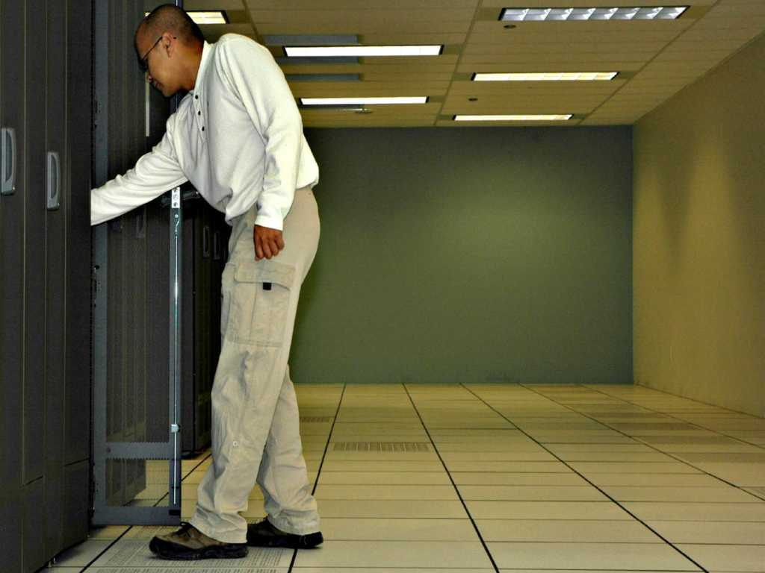
Onsite support
250 locations worldwide
Currently supporting customers
as large as 20,000 appliances
Services by Check Point certified engineers
RMA delivery - & installation
Restore from Backup*
SLA upgrades to “onsite” available for UTM-1, IP and Power-1 appliances
* assuming backup

Slide 36
A full range of support programs
BY OUR PARTNERS – CES*
FROM CHECK POINT - EBS
Co-standard
Co-standard
Next business day onsite
Standard
Standard
Next business day onsite
5X12
NEW
NEW
Co-premium
Co-premium
4 hours onsite
Premium
Premium
4 hours onsite
7X24
NEW
Remote
only
Next business
day onsite
Remote
only
4 hours
onsite

Slide 37

Diamond +
Diamond
Designated TAC Engineer,
On Going SR handling with R&D priority
4-20 days onsite
*on top of Premium
TAM
Technical Account Management
Designated local PS expert
Proactive Support – planning installations,
upgrades, tuning
40 offsite days + 6 onsite days

Slide 38
Better
TCO
Notes:
38

Slide 39
IP prices lower than previous components
CP Software
IP Appliance
New appliance
IP appliances price is less then HW+SW
24.0
43.0
16.0
29.5
13.0
60.0
13.0
40.0
13.0
30.0
7.5
16.5
5.0
4.0
7.0
2.0
IP150
IP152
IP290
IP292
IP390
IP393
IP560
IP563
IP690
IP695
IP1280
IP1285
IP2450
IP2455

Slide 40

Special trade-in for Nokia customers
70%
of software value
(up to maximum of 25% of new product)
+
$ 1000

Slide 41
Trade-in enables refresh at competitive price
Refresh scenario, $, 000
Purchas price higher
TCO lower
53.6
54.6
44.8
Hardware/
appliance
4 year
support

Slide 42
A promise of more value to customers
lower support rate
PERCENTAGE
lower support TCO
IN DOLLARS

Slide 43
Lower support rates
% of list price
Example: co-standard
Hardware by Nokia
%
Check Point software
%
All new rates are lower then Nokia and Check Point, % and $
New appliance by Check Point
%
Example: Premium
Hardware by Nokia
%
Check Point software
35 %
%
New appliance by Check Point
%

Slide 44
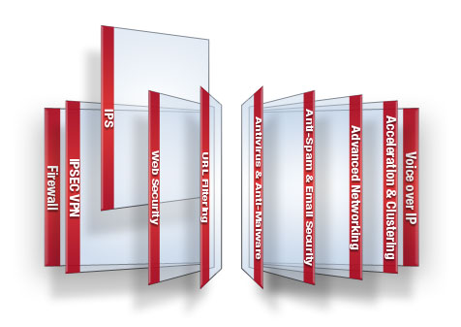

Free IPS software blade
FREE FOR 1 YEAR
New IPS engine
2,000 threats
Pre-emptive, accurate protection
Simple management
Rich monitoring tools
Up to 10Gbps
$ 3,000 value

Slide 45
One
Warranty/Life Cycle
Notes:
45

Slide 46
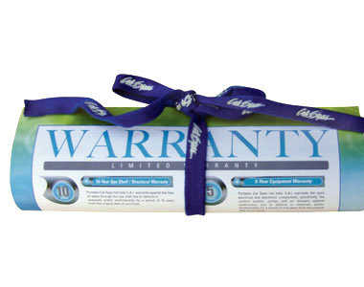
Warranty
Combine warranty for all Appliances
All Appliances under support are under warranty
No need for extended warranty payments
1 year warranty with every appliance

Slide 47
Appliance Life cycle policy
New replacment appliance announcement
New replacment appliances Announcement
(3 months before End of Sale)
End of Engineering Support
End of Support
Appliance
Launch
Years
0
1
2
3
4
5
Technical
Assistance
Center (TAC)
Full TAC support
Software/
Operating
System
Maintenance
releases/
bug fixes*
Latest version
of software
fully supported
Fixes/upgrades**
Hardware
RMA for same or comparable part/ unit
*Fixes may require software upgrades
**New software releases may require a hardware upgrade

Slide 48
Value for partners and customers
ONE QUALITY APPLIANCE
ONE SECURITY SOLUTION
EXTENDED GLOBAL 24/7
SUPPORT INFRASTRUCTURE
LOWER TCO TO CUSTOMERS
MORE VALUE TO PARTNERS

Slide 49

Q & A
Notes:
49

Slide 50
Thank You!

