Slide 1
How to REDUCE BUSINESS RISK by Implementing VULNERBILITY MANAGEMENT Process?
Edvinas Pranculis MM, CISA, CISM
Regional Account Manager – Eastern Europe & Central Asia

Slide 2
“If you KNOW YOURSELF, but NOT THE ENEMY,
for every victory gained, you will suffer a defeat.”
Sun Tzu “Art of War”, 6th century BC
Notes:
It is duty of system administrators and network security professionals to guard their infrastructure against exploits by knowing the enemy – the malicious hacker, who seek to use that very infrastructure for illegal activities.

Slide 3
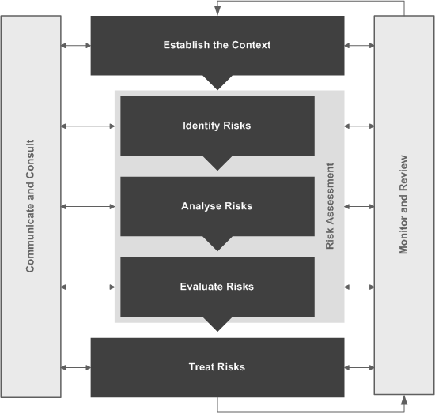
Risk Management
How to treat risk?
  Transfer
  Accept
  Mitigate
  Avoid
  Contain
AS/NZS 4360:2004

Slide 4
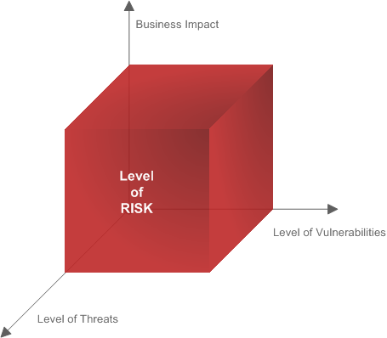
Risk mitigation
How to mitigate risk?
  Reduce Level of Threats
  Reduce Level of Vulnerabilities
  Reduce Business Impact
  (Asset Value)
  Detect
  Recover
EFFECTIVENESS
Level of Risk = f (BI, LoT, LoV)

Slide 5
Ateityje ideti apie Hacktivism
Vulnerabilities on network are GOLD to cyber criminals:
Provide unauthorized entry to networks
Can expose confidential information, fuel stolen identities, violate privacy laws, or paralyze operations
Exposure is extreme for networks with vulnerable devices connected by IP
  Sources of Vulnerabilities
    Programming errors
    Unintentional mistakes
    Intentional malware software
    Improper system configurations
    Remote users sidestepping perimeter security
    Rising attacks through viewing popular websites
    Flaws in algorithms
    etc.

Slide 6
Know your enemy!
Vulnerabilities on network are GOLD to cyber criminals:
  Unauthorized entry
  Exposure of confidential information
  Privacy and law violation
  Paralyzed operations
  Reputation

Slide 7
“The hacker is an interesting entity. Hackers seek knowledge and are not afraid of solving problems or tapping into their brainpower. Hackers are sometimes stubborn, always clever, curious and intelligent, and constantly learning. They are thinkers who like to be challenged. Most often good hackers are also good programmers… never use exploits unless they know exactly what the code they’re executing is doing. Most of the time they only use exploits which they have written themselves…”
Quote from internet
KNOW THE ENEMY

Slide 8
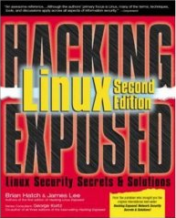
“the countermeasure that will protect you,
should a hacker scan your machines with a scanner,
is to scan your own systems first…
…make sure to address any problems and
then a scan by a hacker will give him no edgе”
Hacking Linux Exposed
KNOW YOURSELF

Slide 9
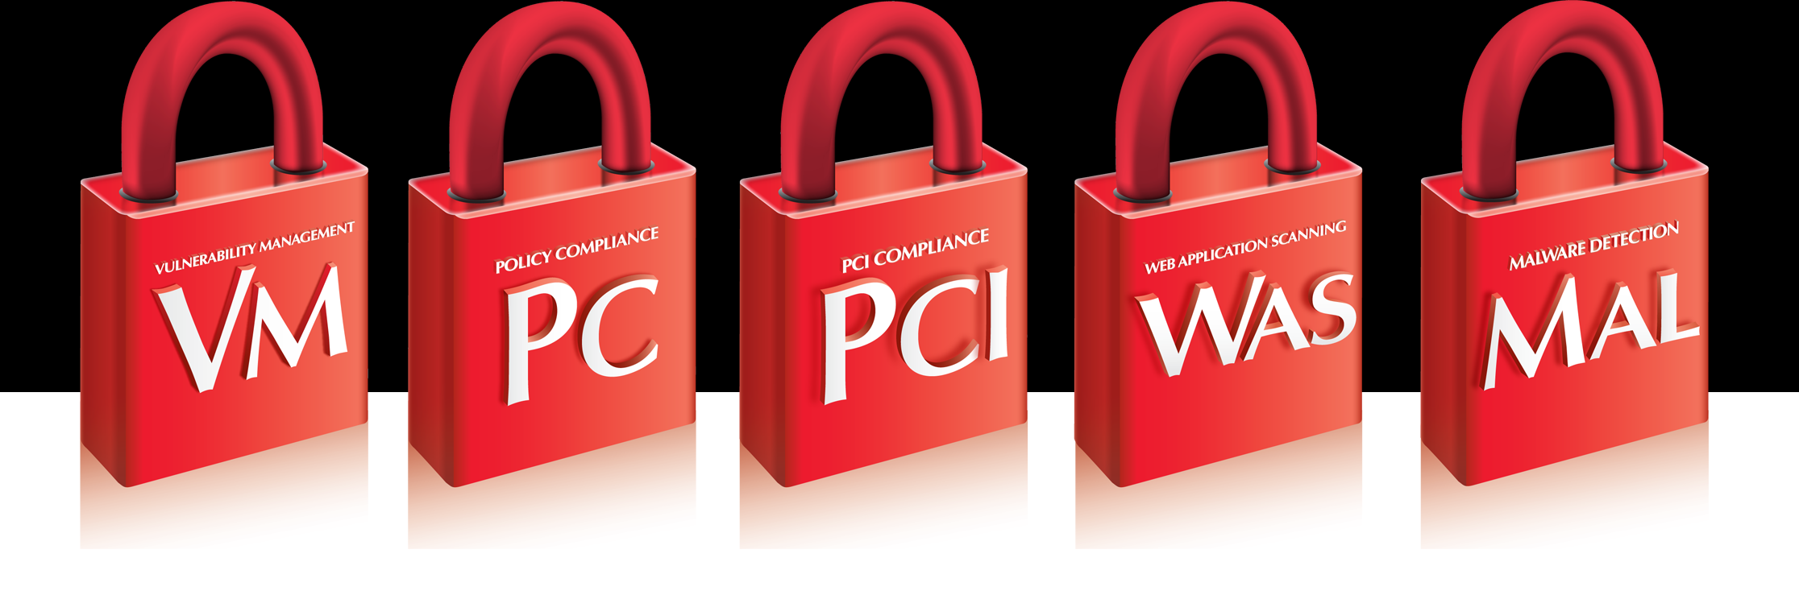

QualysGuard Suite
Vulnerability Management
Policy Compliance
PCI Compliance
Web Application Scanning
Malware Detection
Seal “GO SECURE”
NO SOFTWARE TO INSTALL & MAINTAIN

Slide 10
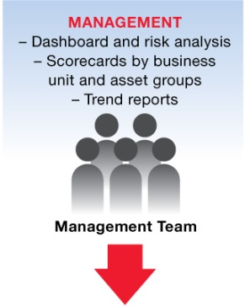
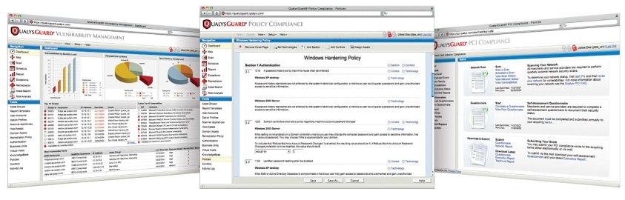
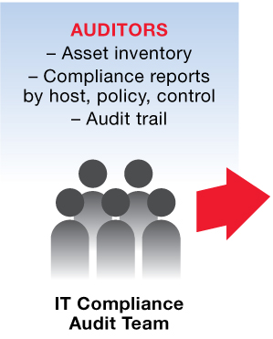
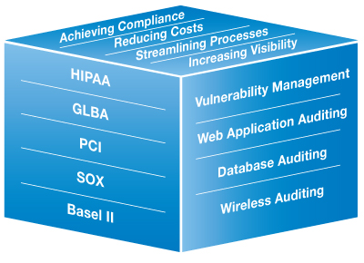
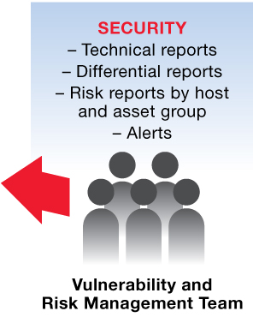
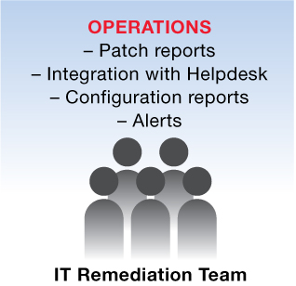

Reporting
Communicate and consult
And Delivering it as a Service
    The Security + Compliance Conundrum
    Leveraging CobIT, ISO, ITIL and NIST Security & Compliance Frameworks

Slide 11
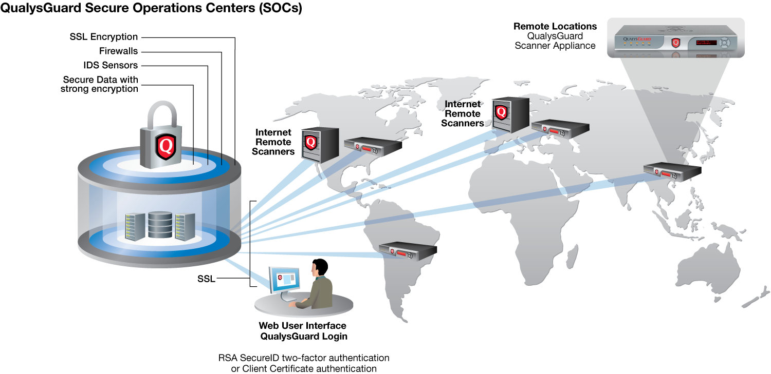
NO SOFTWARE TO INSTALL & MAINTAIN
Annual Volume of Scans
500+ million IP audits (scans & maps)
7 000+ scanner appliances worldwide
85+ countries
World's largest deployment
700 000+ unique IP addresses
220+ scanner appliances
52 countries

Slide 12
Slaidas apie AWARDS

Slide 13















































































Wall of Fame
Media
Energy/Utilities
Consumer Products
Health Care
Manufacturing
Education
Transportation
Government

Slide 14

















































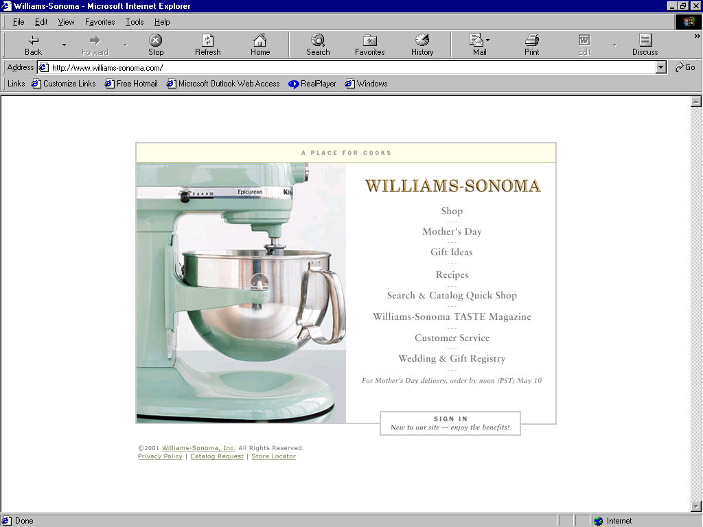






































Wall of Fame
Insurance
Financial Services
Financial Services
Chemical
Portals/Internet
Retail
Technology
Consulting

Slide 15














Strategic Partners
Media

Slide 16
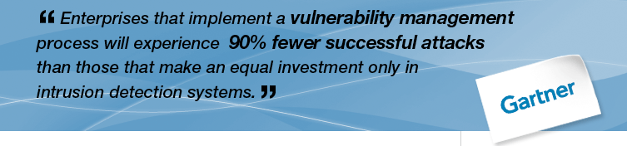
Vulnerability Management Benefits
It gives you control and visibility
to proactively manage
your network security effectively
and document compliance

Slide 17
“If you KNOW THE ENEMY and KNOW YOURSELF,
you need not fear the result of a hundred battles.”
Sun Tzu “Art of War”, 6th century BC

Slide 18
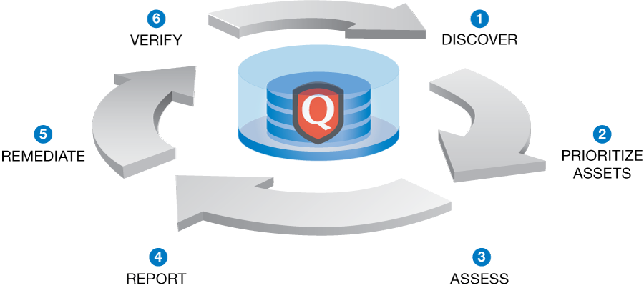
Vulnerability Management

