Slide 1

The Next Generation
Security Operations Center
Vassil Barsakov
Regional Manager, CEE & CIS
RSA, the Security Division of EMC

Slide 2






Threats are Evolving Rapidly
Petty criminals
Organized crime
Criminals
Organized, sophisticated supply chains (PII, financial services, retail)
Unsophisticated
Nation state actors
PII, government, defense industrial base, IP rich organizations
Anti-establishment vigilantes
Terrorists
Non-state actors
PII, Government,
critical infrastructure
“Hacktivists”
Targets of opportunity
Notes:
Keep in mind the world outside the gateway…this is the landscape.
We have criminals who are financially motivate. In this world, it’s about profit. You don’t have to be faster than the bear…just faster than the next guy. And it’s a numbers game.
Then we have the non-financially motivated, and in this world you do have to be faster than the bear. They have a mission and are willing to accept a loss financially to accept it (not unlimited, but still to lose money). They are sophisticated, organized and have multiple tools and their disposal, and they expect to get caught. If you find a trace of them, lock down…because it means they have a Plan B and a Plan C and they’re already underway.
These people use cloud computing. They have sophisticated R&D, supply chains and a corporate-like or even government structure. They are determined and well informed and well funded.

Slide 3
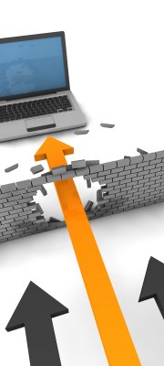
Characteristics of advanced threats
Single minded, determined and innovative
Target individuals over systems
Through reconnaissance will understand our processes, people & systems better than us
Will exploit ANY weakness
Countermeasures increase sophistication
Custom malware, NOT detectable by signatures
Are not in a hurry will take as long as it takes
Goal is long term & persistent access

Slide 4
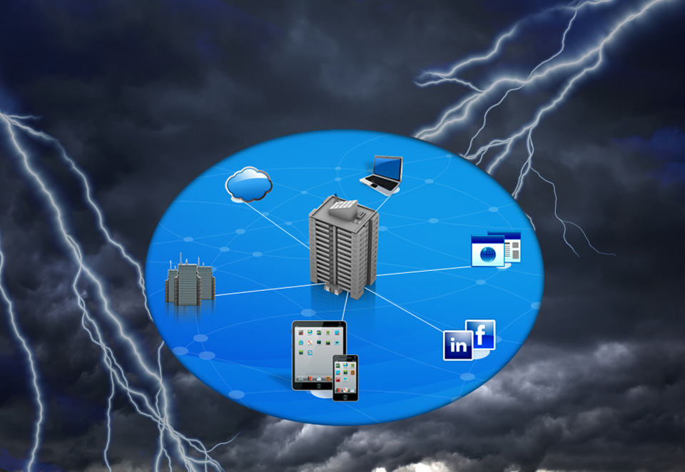












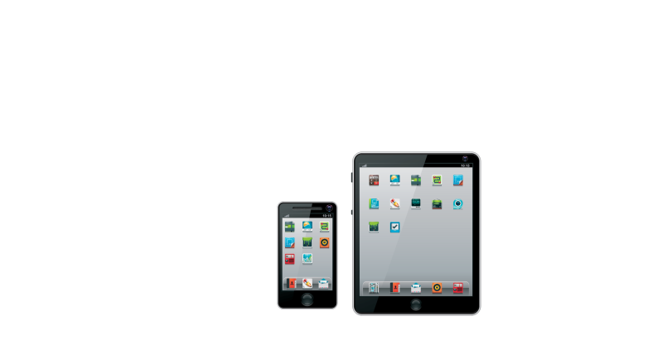


Business & IT are evolving rapidly too…
Notes:
This openness of computing is creating incredible new opportunities for collaboration, communication and innovation; but it’s also creating new vulnerabilities that cyber criminals, hacktivist groups and nation states have learned to exploit. Attacks are getting more sophisticated and targeted. They are moving way beyond identity and credit card theft – we’re now seeing nation states stealing intellectual property from businesses in order to gain economic advantage.

Slide 5


Traditional Security is Not Working
99% of breaches led to compromise within “days” or less with 85% leading to data exfiltration in the same time
85% of breaches took “weeks” or more to discover
Source: Verizon 2012 Data Breach Investigations Report
Notes:
GOAL: Clear evidence security is not working. Breaches lead to compromise much faster than companies can discover them.
NOTES: Fair to assume we have been breached. So the objective is to avoid critical informaiton to be comporomised, despite having a compromised network.

Slide 6
Transforming Security
address the pervasiveness of dynamic, focused adversaries
Advanced Threat
Agile
Definitive
Intelligent
Traditional Security
Signature-based
Perimeter oriented
Compliance Driven
Advanced
Security
Close the risk gap
Deliver new intelligence
Enable agility

Slide 7
Offense in Depth:
Reducing Attacker Free Time
Attacker
Surveillance
Attack
Begins
Target
Analysis
Attack
Set-up
Discovery/ Persistence
Leap Frog Attacks
Complete
Access
Probe
System
Intrusion
Cover-up
Starts
Cover-up
Complete
Maintain foothold
TIME
Detect earlier
ATTACKER FREE TIME
1
Need to collapse attacker free time
2
Need to collapse free time
TIME
Physical Security
Monitoring & Controls
Containment & Eradication
Impact Analysis
Response
Threat Analysis
Attack
Forecast
Incident
Reporting
Recovery
Defender
Discovery
System Reaction
Attack
Identified
Damage Identification
Source: NERC HILF Report, June 2010 (http://www.nerc.com/files/HILF.pdf)

Slide 8
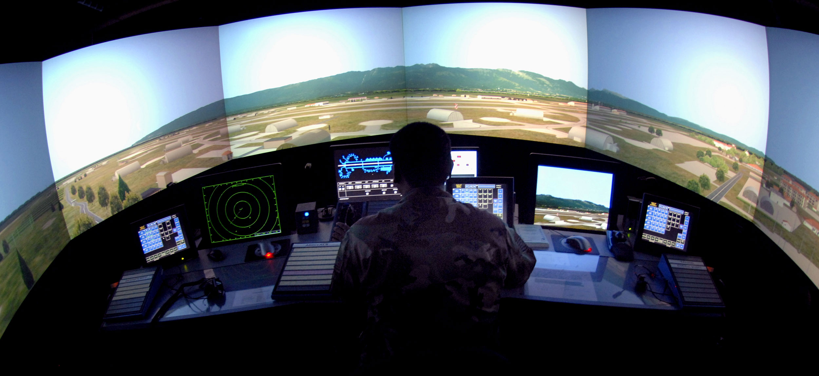
Notes:
Flights originating from all parts of the world…safely sharing airports…runways and airspace thanks to the monitoring and orchestration of air traffic control operations around the globe.
Think for a moment of all the inputs that an air traffic controller receives to manage the flights of numerous aircraft travelling at different airspeeds, altitudes and headings.
If those inputs were not correlated and if the air traffic controller had no system for distinguishing
the importance of
one from another.....
the results would be disastrous.

Slide 9

Notes:
To oversee large volumes of air travel, controllers leverage a system for managing flight traffic that has been refined over the past 50 years.
A system so sophisticated that on 9/11 operators were able to safely land 5,000 planes in just a few hours thanks to a complex mix of manpower, technology, procedure and judgment.
This brings us to so far largely neglected area of Incident Response
Our industry has no such similar system for securing information.......
A system that integrates people, process and individual security controls…
...a system that can be managed with the same kind of correlated, contextual and comprehensive view used to guarantee the safety of our airways.

Slide 10





Like air traffic control, NextGen SOCs require:
Comprehensive Visibility
“Analyze everything that’s happening in my infrastructure”
Agile Analytics
“Enable me to efficiently analyze and investigate potential threats”
Actionable Intelligence
“Help me identify targets, threats & incidents”
Optimize Incident Management
“Enable me to manage these incidents”
Notes:
So what do companies need to cope with advanced threats?
Well, first our customers are telling us they need comprehensive visibility – they need to capture and view everything that’s happening in their infrastructure. With advanced threats its difficult to tell ahead of time what they’re going to do, so in an ideal world they’d be able to see everything.
They’re telling us they need agile analytics. They need the capability to take a look at all this data – and its likely going to be a pretty large set of data - and with the minimum of manual amount of effort, analyze potential threats for their potential impact on the business, and do a more detailed investigation on those threats that pose the biggest problem to the business.
Customers are also telling us they need actionable intelligence - it’s great that we collect all this data and give them the tools to analyze it, but they really need to know what to look in this data for, they need to know how what current threats look like based upon the latest attacker activity, and what are the types of incidents they’ll need to follow up on.
Finally, customers are telling us that responding to an incident can be a complex affair, involving stakeholders across IT and and the business, and they need a a way to prioritize and track all the activities they’ll need to perform in order to respond quickly to an incident and minimize its impact on the business

Slide 11
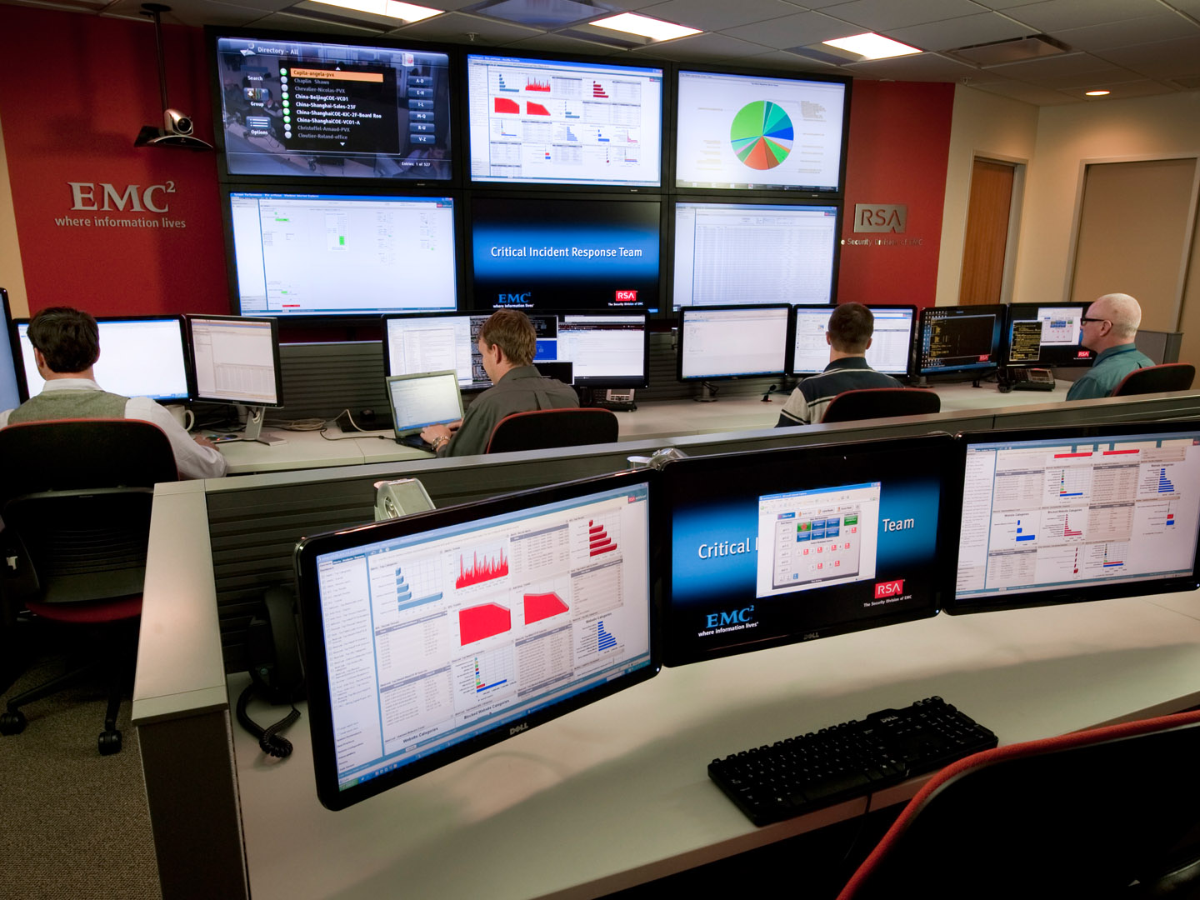
EMC Critical Incident Response Center, Bedford, MA

Slide 12
Dealing with a Big Data situation
    Capture and analysis of network traffic and log event data
    Indexing data for real-time analysis
    Covering layers 2 to 7
    Fusion of external threat intelligence from both public and private communities with internally captured network data
    Inclusion of other perimeter tools and infrastructure data

Slide 13
Security Analytics Example:
Ripping away the hay with automated queries
Start with all network traffic and logs
SHOW ME all downloads of executable content
(pdf, doc, exe, xls, jar etc)
SHOW ME files where file type
does not match extension
ALERT ME for sessions
to/from critical assets
No SIEM will let you do this!

Slide 14
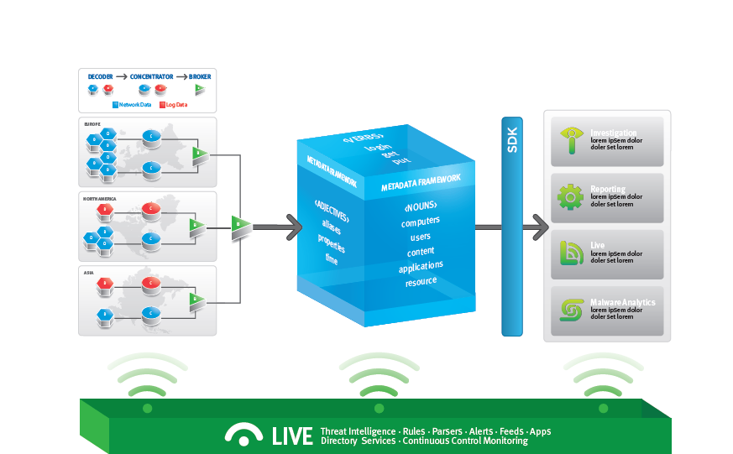
How does Security Analytics Get Deployed?
Infrastructure
Analytic Layer

Slide 15





Getting to the NextGen SOC
Recognize a new approach is needed
Focus on your high value assets
Examine the impact of people and processes
Quantify risks exposed through 3rd party vendors
Integrate advanced threat activity into overall security program.
¹ Suzanne Wildup, “The leaking vault: Five years of data breaches,” Digital Forensics Association. July 2010. Available online at http://www.digitalforensicsassociation.org/storage/The_Leaking_Vault-Five_Years_of_Data_Breaches.pdf.
Notes:
-- The financial impact of information breaches is growing: one 2011 study reported a median annualized cybercrime-related cost of $5.9 million, a 56 percent increase over the previous year.¹ As a result, companies are looking to new approaches to IT security.
Identification of the information assets that are critical to your business
Prioritization of the risks that need to be addressed to sustain your business
Intelligent decision-making on how to protect and manage critical assets
Long-term visibility into the changes in your risk profile
ISO 27000 holistic business approach to information security, covering everything from intellectual property to BCP, and Access Controls, while following OECD guidelines and federal and state regulatory standards.
Protection and preparedness for the changing threat landscape.

