Slide 1

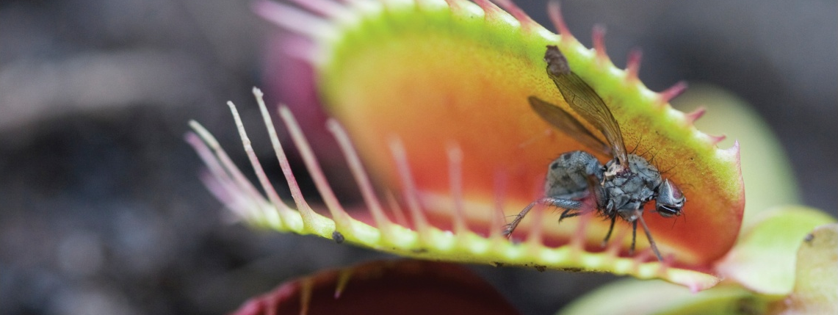
The Smartest Way to Protect
Websites and Web Apps from Attacks

Slide 2



Inconvenient Statistics
70%
Database
of ALL threats are at the Web application layer.
Port 80
App Server
Gartner
Port 80
73%
Network Perimeter
of organizations have been hacked in the past two years through insecure Web apps.
Ponemon Institute

Slide 3

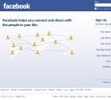

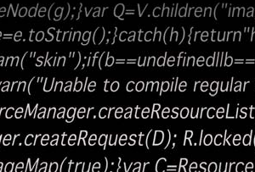
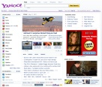

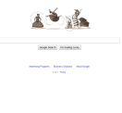
Hacker Threats
Scripts & Tool Exploits
Targeted Scans
Script Kiddie
Library Attacks
Targeted Scan
IP Scan
Generic scripts and tools against one site.
Script run against multiple sites seeking a specific vulnerability.
Targets a specific site for any vulnerability.
Botnet
Human Hacker
Advanced Persistent Threat (APT)
Script loaded onto a bot network to carry out attack.
Sophisticated, targeted attack (APT).
Low and slow to avoid detection.
JAN
JUNE
DEC

Slide 4
The Cost of an Attack
Ponemon Institute| Average breach costs $214 per record stolen
Sony Stolen Records | 100M
Theft
Revenue
Reputation
Sony Lawsuits| $1-2B
Sony Direct Costs | $171M
28 day network closure
Lost customers
Security improvements
Notes:
http://mashable.com/2011/05/22/psn-costs-infographic/

Slide 5
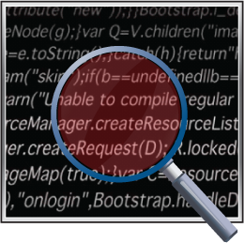
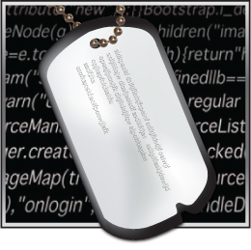
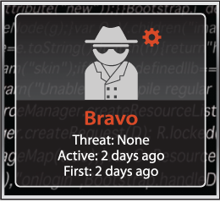

The Mykonos Advantage
Deception-based Security
Detect
Track
Profile
Respond
Deception Points - detect threats without false positives.
Track individual devices
Understand attacker’s capabilities and intent
Adaptive responses, including block, warn and deceive.

Slide 6



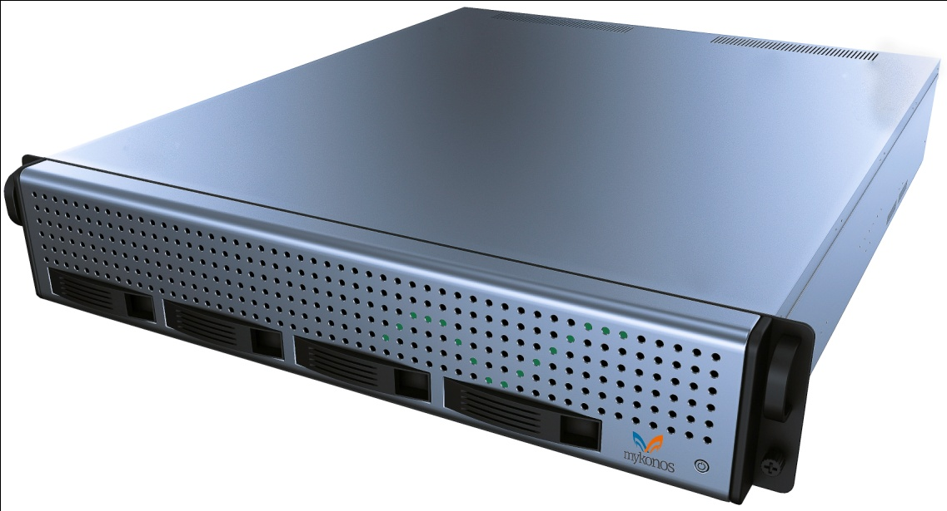
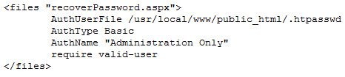
Detection by Deception
Tar Traps
Query String Parameters
Network Perimeter
Hidden Input Fields
Client
Firewall
App
Server
Database
Server Configuration

Slide 7

Track Attackers Beyond the IP
Track IP Address
Track Browser Attacks
Persistent Token
Capacity to persist in all browsers including various privacy control features.
Track Software and Script Attacks
Fingerprinting
HTTP communications.

Slide 8
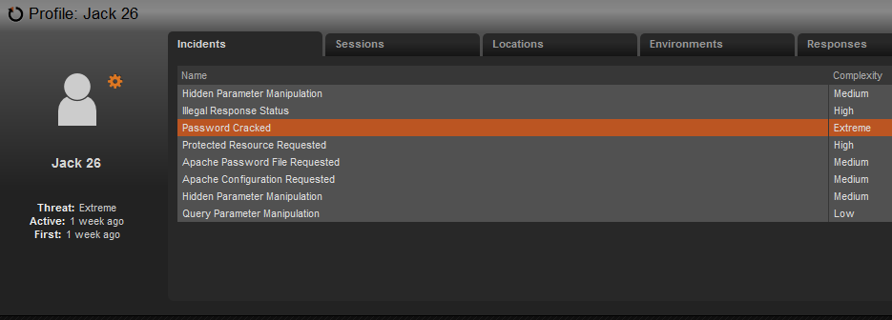
Smart Profile of Attacker
Every attacker assigned a name
Attacker threat level
Incident history

Slide 9
Respond and Deceive
Mykonos Responses | Human Hacker | Botnet | Targeted Scan | IP Scan | Scripts &Tools Exploits
Warn attacker | ●
Block user | ● | ● | ● | ● | ●
Force CAPTCHA | ● | ● | ● | ● | ●
Slow connection | ● | ● | ● | ● | ●
Simulate broken application | ● | ● | ● | ● | ●
Force log-out | ● | ● |  |  | ●
All responses are available for any type of threat. Highlighted responses are most appropriate for each type of threat.

Slide 10
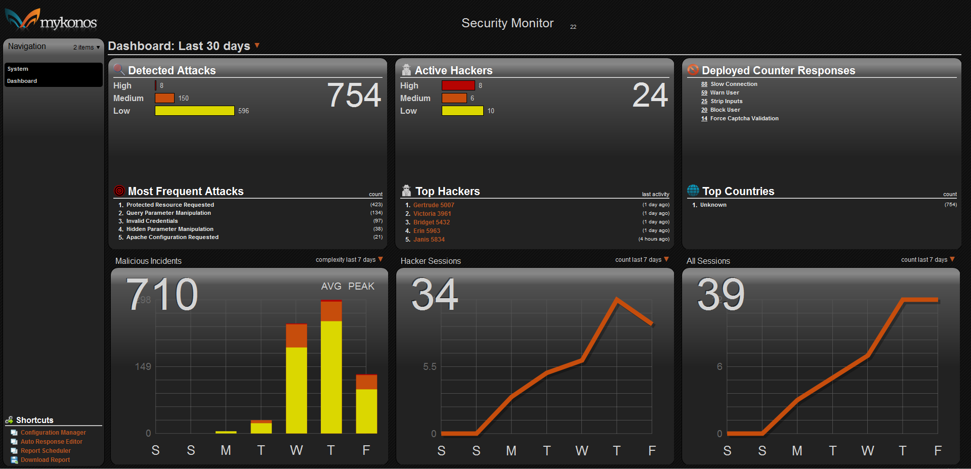
Security Administration
Web-based console
Real-time
On-demand threat information
SMTP alerting
Reporting (Pdf, HTML)
CLI for exporting data into SIEM tool

Slide 11

Unified Protection Across Platforms
Connective Tissue
Internal
App Server
Database
Virtualized
Cloud

Slide 12

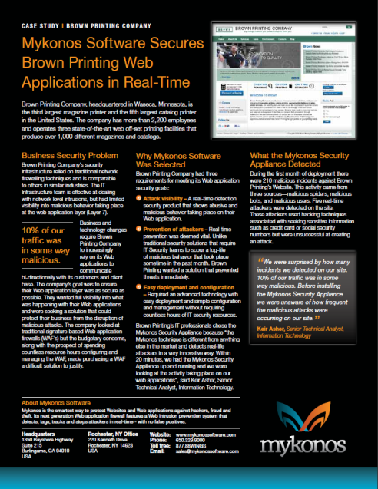
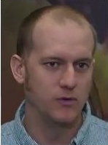





Case Study & Customers
“Within 20 minutes, ….we were looking at the activity taking place on our web applications.”
“10% of our traffic was…malicious.”
Keir Asher
Senior Technical Analyst
Brown Printing

Slide 13




“The smartest buy of the year for any organization with an online presence.”
1st Place Winner, Security Innovators Throwdown 2010
1st Place Information Security
Wall Street Journal Technology Innovation Awards 2011
SINET 16 Security Innovator 2011
2010 Cool Vendor
Application Security

