Slide 1
Palo Alto Networks
Markus Laaksonen
mlaaksonen@paloaltonetworks.com

Slide 2




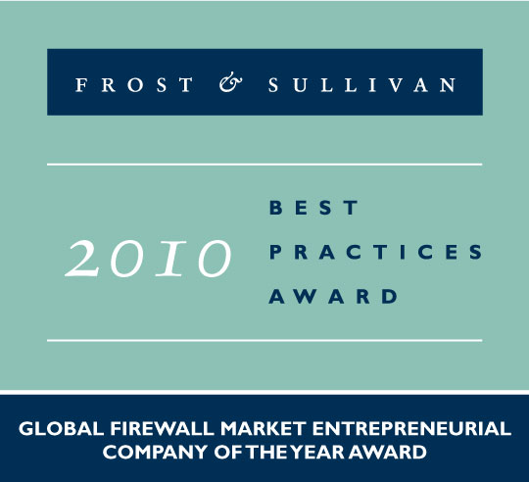


About Palo Alto Networks
Palo Alto Networks is the Network Security Company
World-class team with strong security and networking experience
  Founded in 2005 by security visionary Nir Zuk
  Top-tier investors
Builds next-generation firewalls that identify / control 1200+ applications
  Restores the firewall as the core of the enterprise network security infrastructure
  Innovations: App-ID™, User-ID™, Content-ID™
Global footprint: 3,500+ customers in 50+ countries, 24/7 support

Slide 3
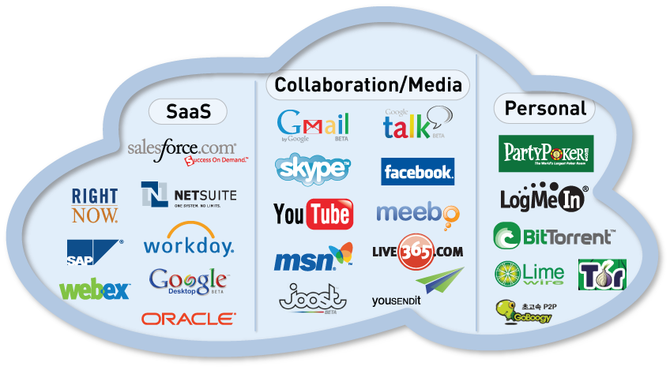
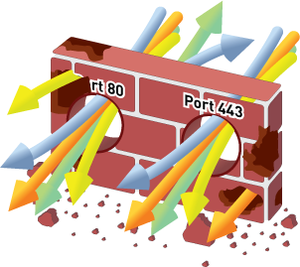
Applications Have Changed; Firewalls Have Not
The gateway at the trust
border is the right place to
enforce policy control
Sees all traffic
Defines trust boundary
BUT…applications have changed
Ports ≠ Applications
IP Addresses ≠ Users
Packets ≠ Content
Need to restore visibility and control in the firewall

Slide 4



Evasive Applications
FIREWALL
Port 5050
Blocked
Yahoo Messenger
PingFU - Proxy
Port 80
Open
BitTorrent Client
Port 6681
Blocked
Notes:
One category of applications that are difficult to track and control are those applications that change port as needed. These applications are known as “evasive applications.” In a traditional firewall, Yahoo messenger is defined as any TCP traffic destined for port 5050. In reality, if port 5050 is blocked, Yahoo messenger can automatically try other common ports, including port 80.
Other applications can be configured by the user to be evasive by using a non-standard port. The BitTorrent client traditionally uses a port of 6681 or greater. It is a simple procedure to force BitTorrent to use a common port like 80 instead.
There are a number of application proxies out there that will take well-behaved, fixed-port applications and tunnel them through any port the user wants.
The net result is that the destination port of any given connection has no bearing on the service or application that is generating the traffic.

Slide 5
Enterprise 2.0 Applications and Risks Widespread
Palo Alto Networks’ latest Application Usage & Risk Report highlights actual behavior of 1M+ users in 723 organizations
  Enterprise 2.0 applications continue to rise for both personal and business use.
  Tunneling and port hopping are common
  Bottom line: all had firewalls, most had IPS, proxies, & URL filtering – but none of these organizations could control what applications ran on their networks
Notes:
Google Docs and Calendar resource consumption* is up significantly
Google Talk Gadget shot up by 56% while Google Talk dropped 76%
Bandwidth consumed by Facebook, per organization, is a staggering 4.9 GB
Bandwidth consumed by Sharepoint and LinkedIn is up 14% and 48% respectively
67% of the applications use port 80, port 443, or hop ports
Many (190) are client–server
177 can tunnel other applications, a feature no longer reserved for SSL or SSH

Slide 6
Sharing: Browser-based Sharing Grows
Fileshareing Trend: Frequency of use and number of applications shifts towards browser-based, coming from P2P
Use of other filesharing applications (like FTP) remains steady
80 filesharing applications (23 P2P, 49 BB, 9 other) consuming 323 TB (24%)
Xunlei, 5th most popular P2P consumed 203 TB – 15% of overall BW
Business benefits: easier to move large files, central source of Linux binaries
Outbound risks: Data loss is the primary business risk
Inbound risks: Mariposa is propagated across P2P (and MSN)
Notes:
Sound bite/Keytakeaway: Massive amounts of data is leaving the network.
An average of 500GB is being transferred per organization – during only a 1 week period. (P2P=431GB, BBFS= 32GB, FTP = 51GB)
While BB FS has increased in popularity, the serious file movers are still wedded to P2P. P2P is still the app of choice for smart crooks.
Trends: P2P has been level at 80% or so since the Sept, 2009 report. Traditional mechanisms for moving files, like FTP, and those remained steady.
The inbound risks are traditional malware related while outbound is [massive] data leakage and illegal distribution of copyrighted materials.

Slide 7
Browser-based Filesharing: The Next P2P?
Excluding Xunlei, browser-based filesharing bandwidth is nearly 50% of P2P (22 TB vs 48 TB)
Several distinct use cases emerging
  Part of infrastructure: Box.Net
  Help get the job done: DocStoc, YouSendIt!
  Mass sharing for dummies: MegaUpload, MediaFire, RapidShare
Notes:
Sound bite/Keytakeaway: Is bb fs the next p2p?
In 2008, when we first began watching this class of application, the usage patterns were oriented towards tools for users to get something done. Box.net is targeted at collaborative environments with many distributed users. YouSendIt! allows me to send a big file. DocStoc allows you to find a document or form – rather than creating something from scratch.
Now, we are seeing a 3rd class – mass sharing for dummies. No client required, although some have toolbars, minimal configuration, they even provide credits for # of times you files are downloaded by others. These sites allow you to upload and then have that content indexed for others to find. Google based search engines allow you to find a wide range of content – including some of the latest movies still in theatres.
The frequency on the left side show one picture, while the bandwidth per organization consumed displays a very different picture. For accurate comparison, DocStoc and Skydrive consumed a paltry 17MB and 55MB per organization.

Slide 8
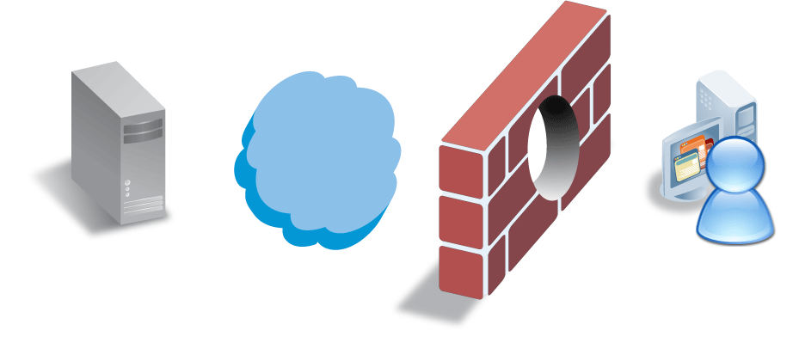
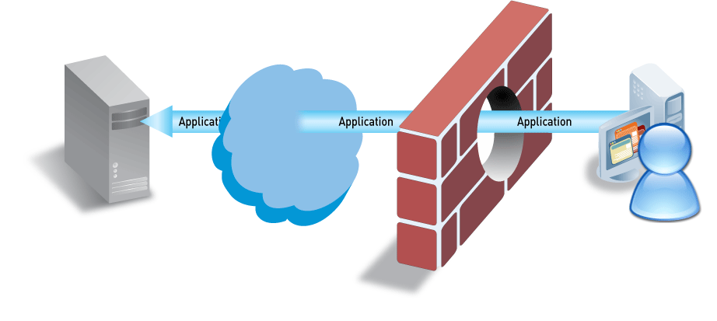
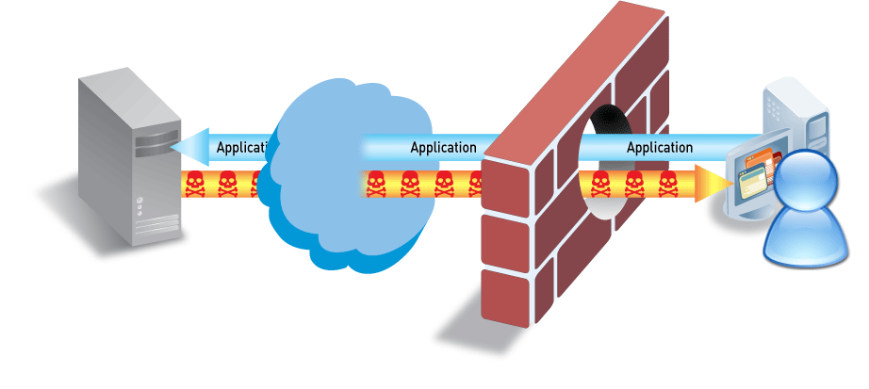
Applications Carry Risk
Applications can be “threats”
  P2P file sharing, tunneling applications, anonymizers, media/video
Applications carry threats
  SANS Top 20 Threats – majority are application-level threats
  Applications & application-level threats result in major breaches – Pfizer, VA, US Army

Slide 9
What the Stateful Firewall doesn’t see
Port hopping or port agnostic applications
  They don’t care on what port they flow
  The firewall can’t distinguish between legitimate or inappropriate use of the port/protocol
  The firewall can’t control the application
Tunneled applications (= evasion)
  A tunnel is built through an open port
  The real application is hidden in the tunnel
  It doesn’t even need to be an encrypted tunnel

Slide 10
The Business Problem
Web 2.0 or Enterprise 2.0 applications
  Use all the same port (80, 443)
  Some have business value, others don’t
The Stateful firewall can’t recognize them
  Only differentiator is the 5 tuple
    Source IP and port
    Destination IP and port
    Protocol

Slide 11
The Business Problem
As a result, there’s no control
  On the use of the application
    By the right user
      Only unidentified IP addresses are seen
    The legitimate application function
      Only the protocol/port is seen
  Application control can’t be implemented based on
    Function
      Maybe you want to allow WebEx, but not WebEx file and desktop sharing?
    QoS
      You can’t do that on port 80 or 443
    Routing
      Like regular web browsing should use a cheap DSL connection

Slide 12
The Firewall helpers
In order to address the shortcomings, enterprises have been adding firewall helpers in their network
  IPS
    To detect threats as well to block unwanted applications
  Proxy with or without a Web Filter
    To control web access, but only on standard ports
  Network AV
    To scan and prevent malware infections
  IM, QoS, …
    To address remaining issues

Slide 13


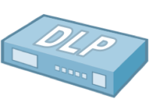







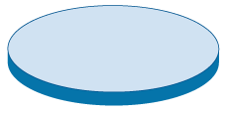

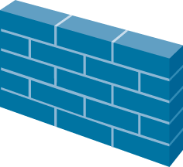
Technology Sprawl & Creep Are Not The Answer
Internet
“More stuff” doesn’t solve the problem
Firewall “helpers” have limited view of traffic
Complex and costly to buy and maintain
Putting all of this in the same box is just slow
Notes:
Network complexity increases
Transparent in-line for the IPS
Explicit or implicit for the Proxy, AV, ..
Management complexity
Get to learn many management interfaces
With an undermanned team
Often only good enough policies deployed
Visibility gone
Too many products with different log types
NO aggregate view
Unless one more solution is implemented, a SIEM

Slide 14
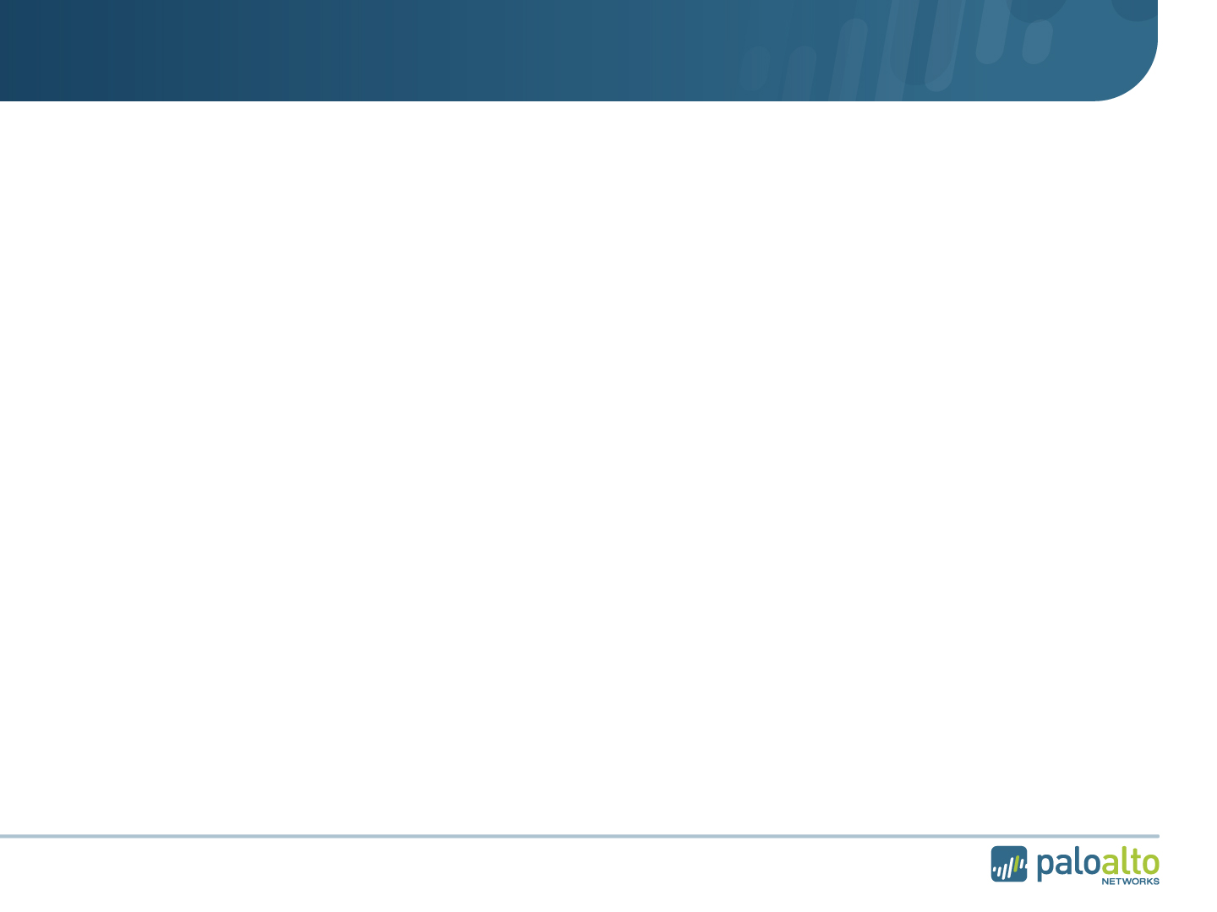
Traditional Multi-Pass Architectures are Slow
IPS Policy
AV Policy
URL Filtering Policy
IPS Signatures
AV Signatures
Firewall Policy
HTTP Decoder
IPS Decoder
AV Decoder & Proxy
Port/Protocol-based ID
Port/Protocol-based ID
Port/Protocol-based ID
Port/Protocol-based ID
L2/L3 Networking, HA, Config Management, Reporting
L2/L3 Networking, HA, Config Management, Reporting
L2/L3 Networking, HA, Config Management, Reporting
L2/L3 Networking, HA, Config Management, Reporting
Notes:
-Path of least resistance is taken
Build a solution with legacy security components
No real integration
Shared backplane
Often even ‘blades’ with isolated functionality
Foundation still is the legacy firewall
Requiring helpers...
Performance degradation, sometimes to 90% +
with ‘enhanced’ security turned on
hidas, pakko olla parempi tapa

Slide 15
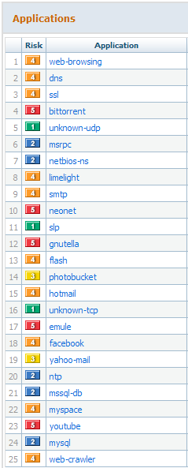
Traditional Systems Have Limited Understanding
Some port-based apps caught by firewalls (if they behave!!!)
Some web-based apps caught by URL filtering or proxy
Some evasive apps caught by an IPS
None give a comprehensive view of what is going on in the network

Slide 16
Why It Has To Be The Firewall
Path of least resistance - build it with legacy security boxes
Applications = threats
Can only see what you expressly look for
Firewall
IPS
Applications
Most difficult path - can’t be built with legacy security boxes
Applications = applications, threats = threats
Can see everything
Firewall
IPS
Applications
  Traffic decision is made at the firewall
  No application knowledge = bad decision
Notes:
16

Slide 17






















What You See…with non-firewalls
What You See with With A Firewall

Slide 18



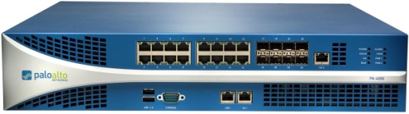

The Right Answer: Make the Firewall Do Its Job
New Requirements for the Firewall
1. Identify applications regardless of port, protocol, evasive tactic or SSL
2. Identify users regardless of IP address
3. Protect in real-time against threats embedded across applications
4. Fine-grained visibility and policy control over application access / functionality
5. Multi-gigabit, in-line deployment with no performance degradation

Slide 19
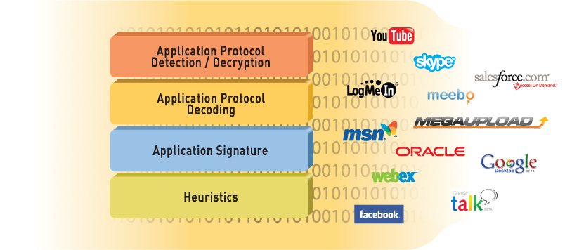
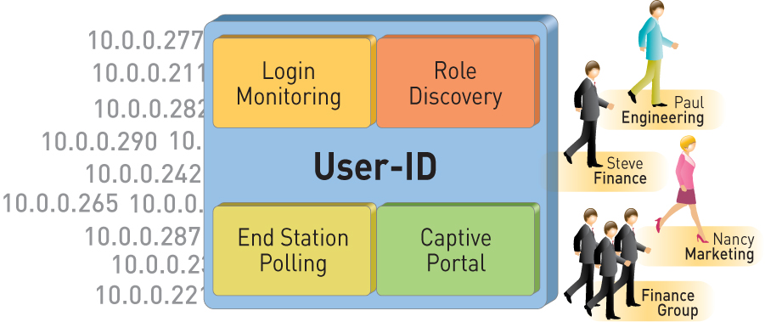
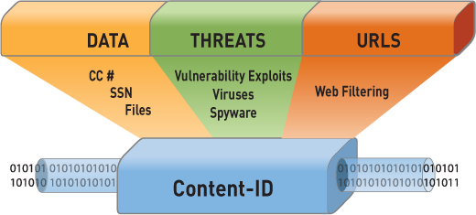
Identification Technologies Transform the Firewall
App-ID™
Identify the application
User-ID™
Identify the user
Content-ID™
Scan the content

Slide 20
App-ID: Comprehensive Application Visibility
Policy-based control more than 1200 applications distributed across five categories and 25 sub-categories
Balanced mix of business, internet and networking applications and networking protocols
3 - 5 new applications added weekly
App override and custom HTTP applications help address internal applications

Slide 21
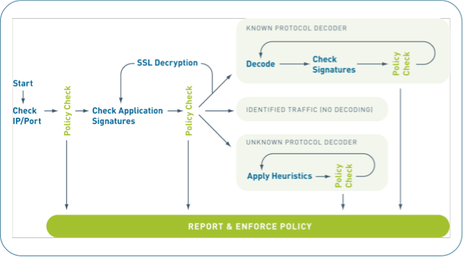

App-ID is Fundamentally Different
Always on, always the first action
Built-in intelligence
Sees all traffic across all ports
Scalable and extensible
Much more than just a signature….
© 2010 Palo Alto Networks. Proprietary and Confidential.
Page
Notes:
App-ID is smart = it automatically uses what ever mechanisms required to ID the traffic
App-ID is always on = no need to set policies on what to look for (outside of any-any-allow)
App-ID sees all traffic across all ports = no need to configure which port to look at for each application
App-ID is scalable = can add, new ID mechanisms to address changes in application landscape
aina päällä,
vähä sama ku statefull muuri, mut me tehään apps.
ei pelkkä signature, heuristiikkaa, skype, torrent,
all ports, all the trafic, all the time

Slide 22
User-ID: Enterprise Directory Integration
Users no longer defined solely by IP address
  Leverage existing Active Directory infrastructure without complex agent rollout
  Identify Citrix users and tie policies to user and group, not just the IP address
Understand user application and threat behavior based on actual AD username, not just IP
Manage and enforce policy based on user and/or AD group
Investigate security incidents, generate custom reports
Notes:
22
22
Unobtrusive deployment: Unlike traditional firewalls that require re-authentication, the Palo Alto Networks agent works seamlessly
No change to the Active Directory (AD) server or the user PCs
The user identification agent is deployed on a windows workstation or on the AD server
Multiple agents can be deployed; one agent can communicate with multiple devices

Slide 23
Content-ID: Real-Time Content Scanning
Detect and block a wide range of threats, limit unauthorized data transfer and control non-work related web surfing
Stream-based, not file-based, for real-time performance
  Uniform signature engine scans for broad range of threats in single pass
  Vulnerability exploits (IPS), viruses, and spyware (both downloads and phone-home)
Block transfer of sensitive data and file transfers by type
  Looks for CC # and SSN patterns
  Looks into file to determine type – not extension based
Web filtering enabled via fully integrated URL database
  Local 20M URL database (76 categories) maximizes performance (1,000’s URLs/sec)
  Dynamic DB adapts to local, regional, or industry focused surfing patterns
Notes:
23
23
23

Slide 24
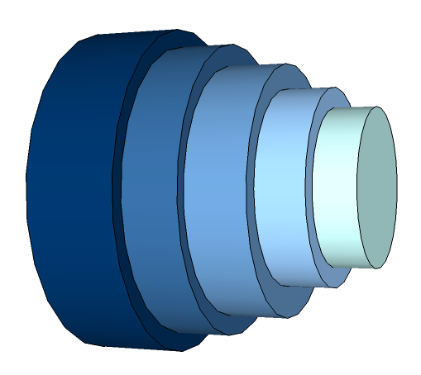

How the ID Technologies Work Together
What is the traffic and is it allowed? (App-ID) | Allowed for this specific user or group? (User ID) | What risks or threats are in the traffic? (Content ID)
Inbound
Full cycle threat prevention
Intrusion prevention
Malware blocking
Anti-virus control
URL site blocking
Encrypted and compressed files
Port Number
SSL
HTTP
GMail
Google Talk
Outbound
Data leakage control
Credit card numbers
Custom data strings
Document file types

Slide 25
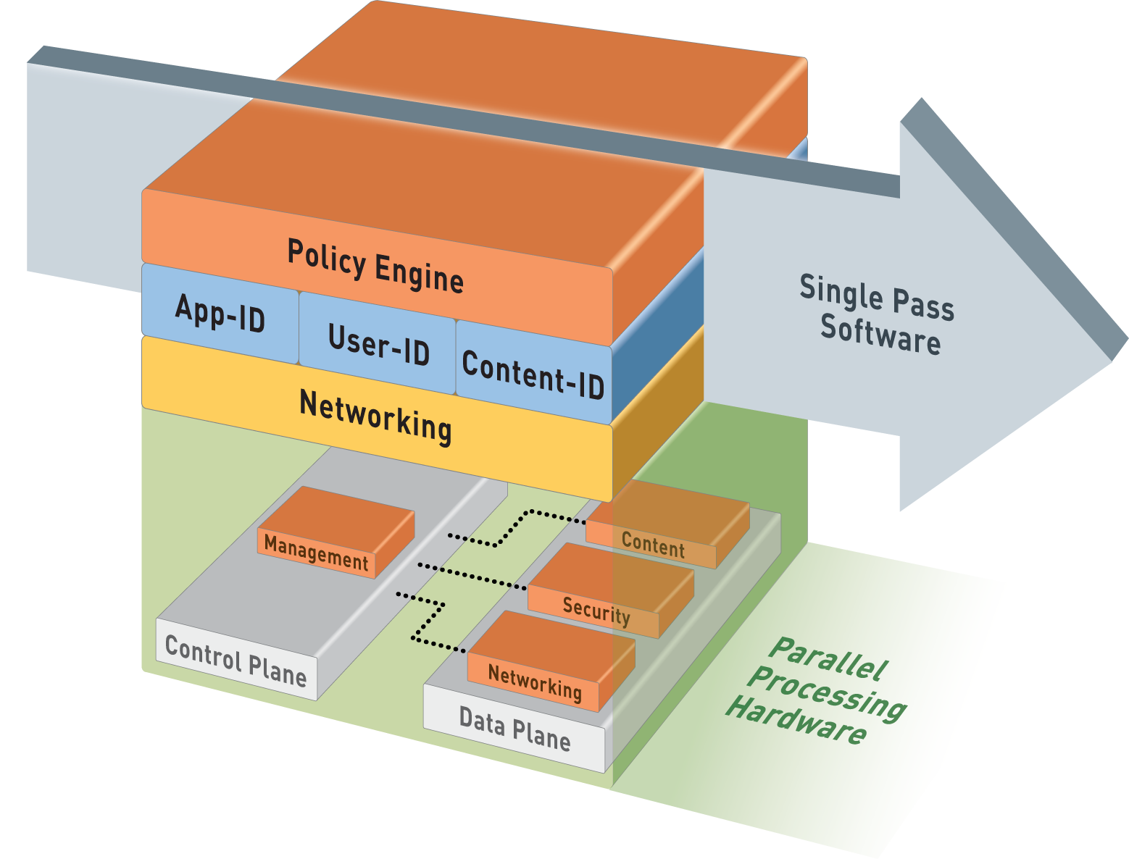
Single-Pass Parallel Processing™ (SP3) Architecture
Single Pass
Operations once per packet
  Traffic classification (app identification)
  User/group mapping
  Content scanning – threats, URLs, confidential data
One policy
Parallel Processing
Function-specific parallel processing hardware engines
Separate data/control planes
Up to 20Gbps, Low Latency

Slide 26
‘Secrets’ of the real NGFW
Parallel processing versus serial processing
  No dedicated engines per security feature
  Consistent syntax for all threat capabilities
App and User awareness at policy decision point
  Only allow those application you want to
    For well known users
  Actively reduce the threat vector
    Mariposa can’t behave as a trusted application
      Seen as Unkown-UDP
      Would have passed the traditional firewall
        Where single UDP packets, on an allowed port, will pass
    False positives are heavily reduced by tight application control

Slide 27
‘Secrets’ of the real NGFW – Cont.
Powerful Network Processors
  Cabable of handling ‘traditional’ firewall features
    Routing, NAT, QoS, …
Enhanced hardware
  Powerful and Optimized Security Processors
    No regular ‘data center’ processors
    Very high core density
    Very flexible
      No fixed iterations like with ASICs
    SSL, IPSec, Decompression Acceleration
Fast, but multi-purpose Content Scanning Engines
  Supporting consistent inspection syntax

Slide 28
In Other Words
Next-Generation Application Control and Threat Prevention Looks Like…

Slide 29









Full, Comprehensive Network Security
Clean the allowed traffic of all threats in a single pass
Only allow the
apps you need
Traffic limited to approved business use cases based on App and User
Attack surface reduced by orders of magnitude
Complete threat library with no blind spots
  Bi-directional inspection
  Scans inside of SSL
  Scans inside compressed files
  Scans inside proxies and tunnels
The ever-expanding universe of applications, services and threats

Slide 30






Your Control With a Firewall

Slide 31
Firewall Remake – Real World Use
A remake, not inventing the wheel again
  Firewall’s are intended to enforce a ‘positive’ policy
    Facebook & Twitter posting are allowed for marketing people
    Facebook reading is allowed for known users
    Engineers have access to source code if PC has disk encryption on
    Apps that can tunnel other apps are not allowed at all
    Web-Browsing is allowed via the DSL line (with full threat scanning)
    SSL decryption is required for none financial and medical sites
    Enterprise Web 2.0 apps can be accessed via the MPLS cloud
    IM and WebEx are allowed, but without file or desktop sharing
    Streaming media is allowed, but rate limited to 256Kbps
    Remote access SSL-VPN traffic must be controlled by application
    …

Slide 32




















Transforming The Perimeter and Datacenter
Perimeter
Internet Datacenter
Enterprise Datacenter
Same Next-Generation Firewall, Different Benefits…
Notes:
Perimeter:
Application visibility and control
Threat prevention for allowed application traffic
Unified policy based on applications, users, and content
Datacenter
High-performance firewalling and threat prevention; simple deployment
Segmentation by application and user
Identification/control of rogue applications

Slide 33
PAN-OS

Slide 34





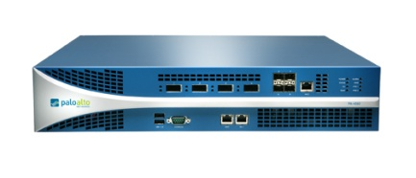


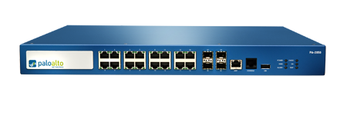
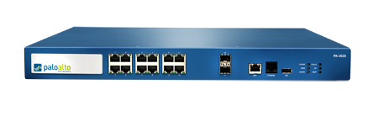
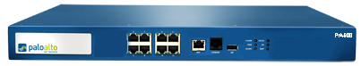
PAN-OS Core Firewall Features
Visibility and control of applications, users and content complement core firewall features
PA-5060
Strong networking foundation
  Dynamic routing (BGP, OSPF, RIPv2)
  Tap mode – connect to SPAN port
  Virtual wire (“Layer 1”) for true transparent in-line deployment
  L2/L3 switching foundation
  Policy-based forwarding
  IPv6 support
VPN
  Site-to-site IPSec VPN
  SSL VPN
QoS traffic shaping
  Max/guaranteed and priority
  By user, app, interface, zone, & more
  Real-time bandwidth monitor
Zone-based architecture
  All interfaces assigned to security zones for policy enforcement
High Availability
  Active/active, active/passive
  Configuration and session synchronization
  Path, link, and HA monitoring
Virtual Systems
  Establish multiple virtual firewalls in a single device (PA-5000, PA-4000, and PA-2000 Series)
Simple, flexible management
  CLI, Web, Panorama, SNMP, Syslog
PA-5050
PA-5020
PA-4060
PA-4050
PA-4020
PA-2050
PA-2020
PA-500
Notes:
34
34

Slide 35








Site-to-Site and Remote Access VPN
Site-to-site VPN connectivity
Remote user connectivity
Secure connectivity
  Standards-based site-to-site IPSec VPN
  SSL VPN for remote access
Policy-based visibility and control over applications, users and content for all VPN traffic
Included as features in PAN-OS at no extra charge

Slide 36
Traffic Shaping Expands Policy Control Options
Traffic shaping policies ensure business applications are not bandwidth starved
  Guaranteed and maximum bandwidth settings
  Flexible priority assignments, hardware accelerated queuing
  Apply traffic shaping policies by application, user, source, destination, interface, IPSec VPN tunnel and more
Enables more effective deployment of appropriate application usage policies
Included as a feature in PAN-OS at no extra charge

Slide 37
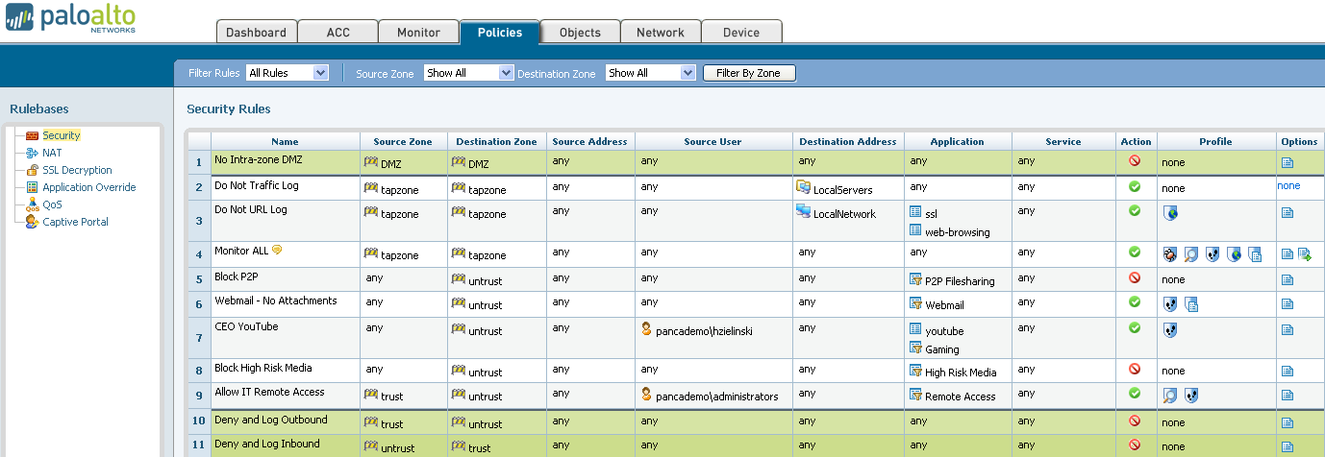
Flexible Policy Control Responses
Intuitive policy editor enables appropriate usage policies with flexible policy responses
Allow or deny individual application usage | Allow but apply IPS, scan for viruses, spyware
Control applications by category, subcategory, technology or characteristic | Apply traffic shaping (guaranteed, priority, maximum)
Decrypt and inspect SSL | Allow for certain users or groups within AD
Allow or block certain application functions | Control excessive web surfing
Allow based on schedule | Look for and alert or block file or data transfer

Slide 38
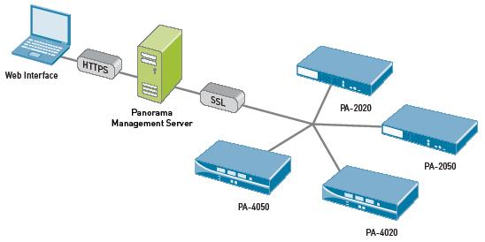
Enterprise Device and Policy Management
Intuitive and flexible management
  CLI, Web, Panorama, SNMP, Syslog
  Role-based administration enables delegation of tasks to appropriate person
Panorama central management application
  Shared policies enable consistent application control policies
  Consolidated management, logging, and monitoring of Palo Alto Networks devices
  Consistent web interface between Panorama and device UI
  Network-wide ACC/monitoring views, log collection, and reporting
All interfaces work on current configuration, avoiding sync issues
Notes:
38
38
Intuitive and flexible management options
CLI, Web and Panorama central management application
SNMP, Syslog
Panorama central management application
Panorama is a central management application enabling consolidated management, logging, and monitoring of Palo Alto Networks devices
Consistent web interface with device, simplifying learning curve and obviating need for client software installation
Provides network-wide ACC/monitoring views, log collection, and reporting
All management interfaces work with latest config, avoiding out of sync issues common with multi-level management
Automated Updates
Automatic install or staging of updates
App-ID signatures
Threat signatures
Software maintenance releases
Zero-downtime upgrading of signatures and maintenance releases

Slide 39

Palo Alto Networks Next-Gen Firewalls
PA-5060
20 Gbps FW/10 Gbps threat prevention/4,000,000 sessions
4 SFP+ (10 Gig), 8 SFP (1 Gig), 12 copper gigabit
PA-5050
10 Gbps FW/5 Gbps threat prevention/2,000,000 sessions
4 SFP+ (10 Gig), 8 SFP (1 Gig), 12 copper gigabit
PA-5020
5 Gbps FW/2 Gbps threat prevention/1,000,000 sessions
8 SFP, 12 copper gigabit
PA-4060
10 Gbps FW/5 Gbps threat prevention/2,000,000 sessions
4 XFP (10 Gig), 4 SFP (1 Gig)
PA-4050
10 Gbps FW/5 Gbps threat prevention/2,000,000 sessions
8 SFP, 16 copper gigabit
PA-4020
2 Gbps FW/2 Gbps threat prevention/500,000 sessions
8 SFP, 16 copper gigabit
PA-2050
1 Gbps FW/500 Mbps threat prevention/250,000 sessions
4 SFP, 16 copper gigabit
PA-2020
500 Mbps FW/200 Mbps threat prevention/125,000 sessions
2 SFP, 12 copper gigabit
PA-500
250 Mbps FW/100 Mbps threat prevention/50,000 sessions
8 copper gigabit
Notes:
39

Slide 40







Flexible Deployment Options
Visibility
Transparent In-Line
Firewall Replacement
Application, user and content visibility without inline deployment
IPS with app visibility & control
Consolidation of IPS & URL filtering
Firewall replacement with app visibility & control
Firewall + IPS
Firewall + IPS + URL filtering

Slide 41
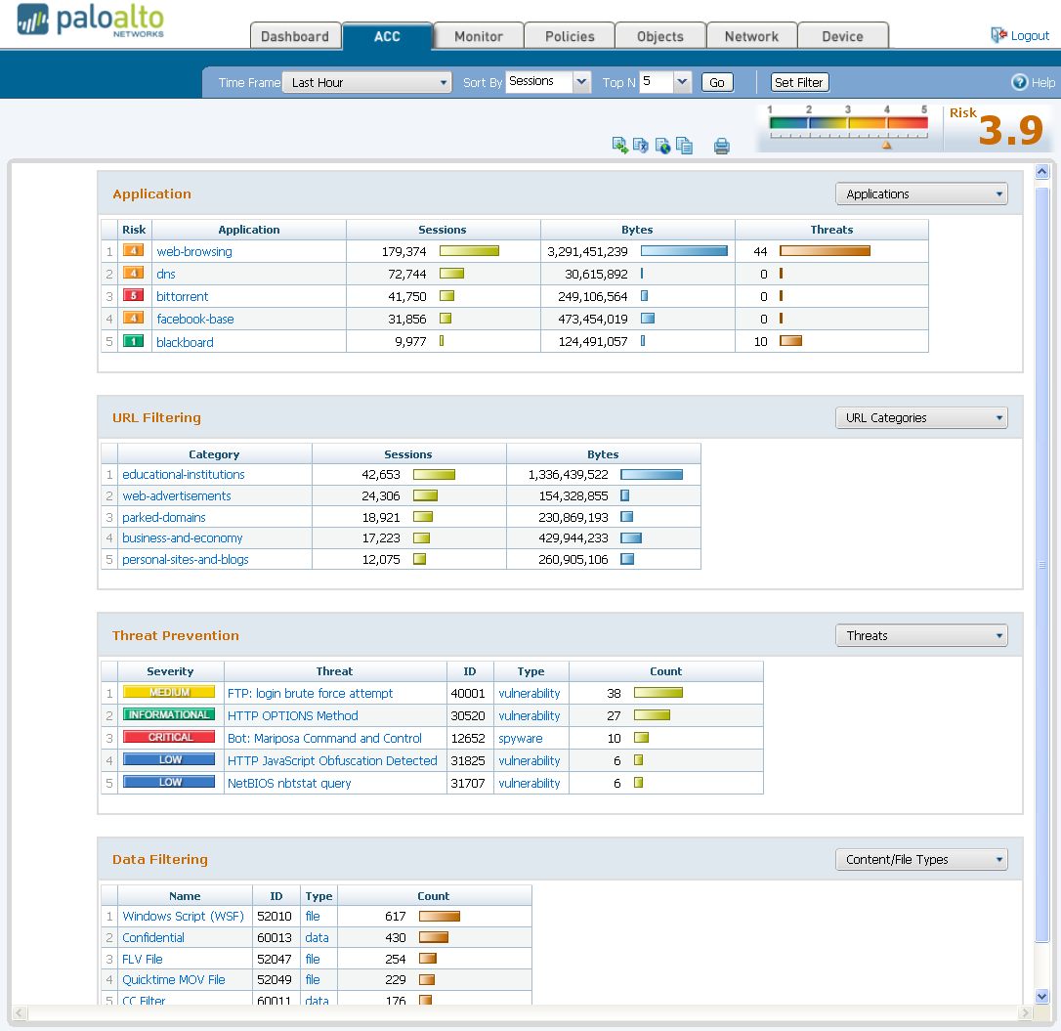
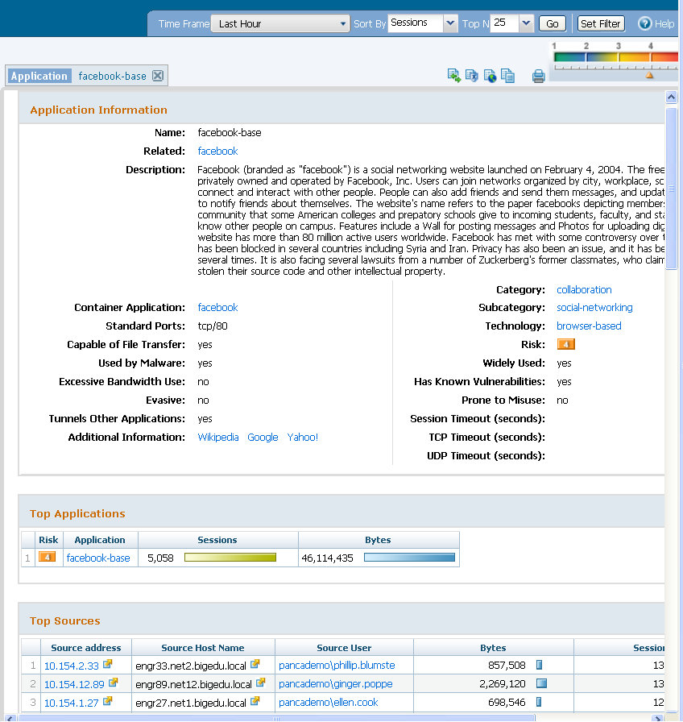
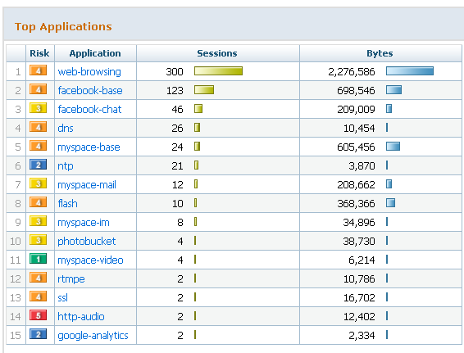
Comprehensive View of Applications, Users & Content
Application Command Center (ACC)
  View applications, URLs, threats, data filtering activity
Add/remove filters to achieve desired result
Filter on Facebook-base
Filter on Facebook-base
and user cook
Remove Facebook to
expand view of cook

Slide 42
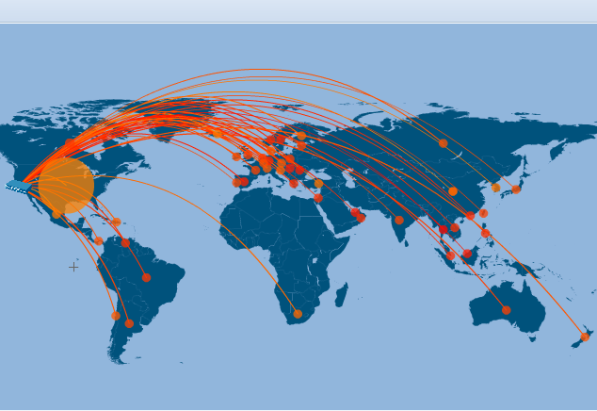
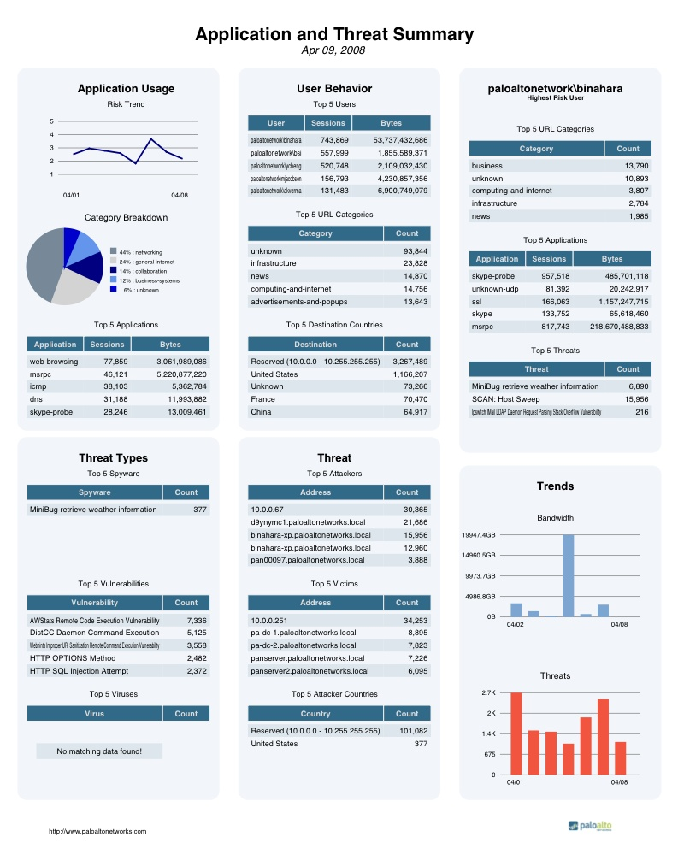
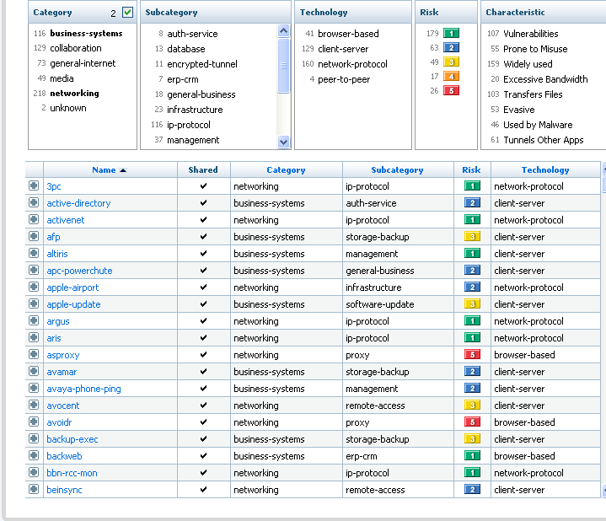
Enables Visibility Into Applications, Users, and Content

Slide 43
Management

Slide 44
Administrators and Scopes
Administrative accounts have scopes where their rights apply
  Device level accounts have rights over the entire device
  VSYS level accounts have rights over a specific virtual system
Administrators can be authenticated locally or through RADIUS
Administrators actions are logged in the configuration and system logs
Notes:
Access to the Palo Alto Networks firewall interface requires an administrative account. The administrator accounts can be authenticated locally on the device or they can be sent to a RADIUS server. Each account can be defined with a scope where its rights apply. These scopes are either for the entire device, or for a specific virtual system.
When an administrator logs into the device, each event, along with the administrators name, is captured in the system log. Any changes that the administrator makes are recorded in the configuration log.

Slide 45
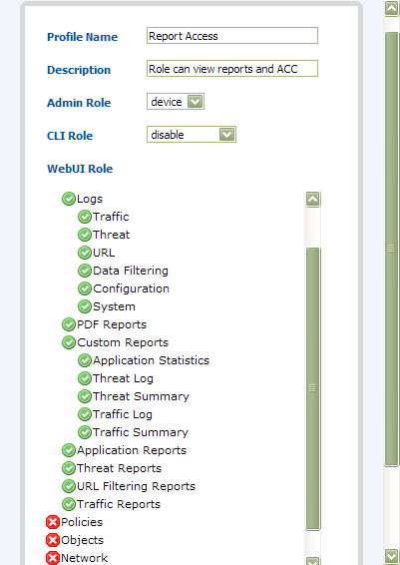
Role Based Administration
Built-in roles:
  Superuser
  Device Admin
  Read-Only Device Admin
  Vsys Admin
  Read-Only Vsys Admin
User Defined
  Based on job function
  Can be vsys or device wide
  Enable, Read-Only and Deny
Notes:
Administrators can be given rights using the built in options or by creating new administrative roles. The built in options are:
Superuser – All access to all options of all virtual systems.
Device Admin (also read only device admin) – Full access to the device except for creation of virtual systems and administrative accounts.
VSYS Admin (also read only VSYS admin) – Full access to a specific virtual system.
To provide a more granular level of control, additional roles can be created by the user. Levels of Enable, Read-Only and Deny can be applied to most sections defined by nodes on the left-hand navigation tree. The role can also be constrained to a virtual system or applied to the device as a whole.
In the example above, a role is created with access to reports but not to any of the configuration sections of the device.

Slide 46
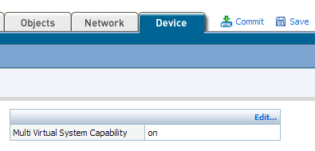


Virtual Systems
Provides administrative management boundaries
VSYS admins can only change objects tagged with their VSYS ID
Notes:
PANOS provides a function for limiting the scope of administrative control. By enabling and creating Virtual Systems (VSYS) a device administrator can dictate which objects given groups of VSYS administrators have access to.
Virtual systems do not attempt to virtualize every aspect of the firewall. They represent administrative boundaries. Device administrators must create the objects and assign them to virtual systems. Virtual systems are supported in the 4000 and 2000 series of Palo Alto Networks firewalls.

Slide 47
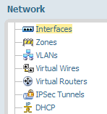
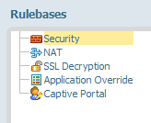
Dividing Access Control
VSYS – By object
RBA – By Task
Zone
VR / Vwire / VLAN
Interface
Tabs and Nodes
3 Levels of access
  No Access
  Read Only
  Read - Write
VSYS A
User Vwire
E1/3
E1/4
Inbound zone
Outbound zone
VSYS B
Default VR
E1/5
E1/6
Internet zone
LAN zone
Notes:
By combining Virtual Systems and Role Based Administration very detailed delegated administrative controls can be put into place. A VSYS administrator in VSYS A with RBA access to security policy would only be able to write policy from the Inbound virtual wire zone to the Outbound virtual wire zone. An administrator in VSYS B with the same RBA role would be able to write security policy from the Internet L3 zone to the LAN L3 zone.
Creation of the virtual routers, virtual wires and VLAN objects, is the job of the device administrator. The virtual systems should not be looked at as a virtual Palo Alto Networks appliance, but rather as a virtual security configuration, with fully segmented security policy, configuration commit and reporting.

Slide 48
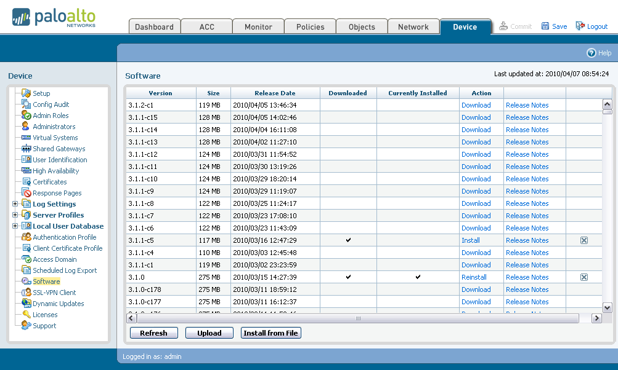
Upgrade PAN-OS
Check for New Software
Install Imported Software
Import Software
Notes:
48
Under the Device tab, click Software to open the Software Updates page.
To view a description of the changes in a release, click Release Notes on the same row as the release.
To install a new release:
Click Download next to the release to be installed in the Action column.
When the download is complete, a checkmark is displayed in the Downloaded column and the Action column will change to Install.
To install a downloaded release, click Install next to the release in the Action column.
OAN-OS can also be installed from a file located on the administrators computer. The “Import” and “Install Form File” buttons can be used to transfer a file to the device and then install it respectively.

Slide 49
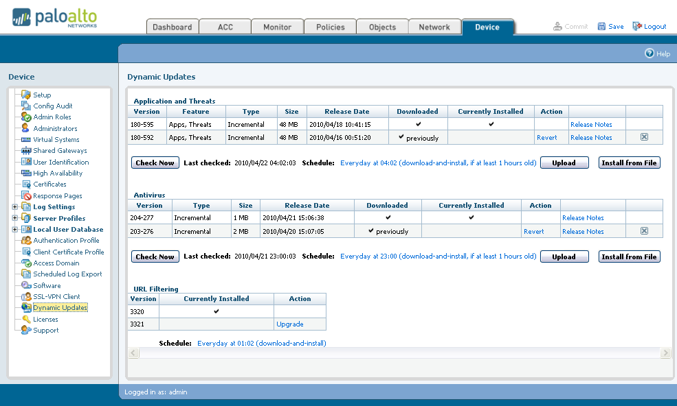
Update Applications, Threats, and Antivirus
Schedule and Check for New Content
Import Content
Install Imported Content
Schedule URL Update
Notes:
49
Under the Device tab, click Dynamic Updates to open the update page.
Click Check Now to view the latest threat and application definition updates available from Palo Alto Networks.
To view a description of an update, click Release Notes next to the update.
To install a new update:
Click Download in the Action column.
When the download is complete, a checkmark is displayed in the Downloaded column and the Action column will show Install.
To install a downloaded content update, click Install next to the update in the Action column.
If you have the most recent dynamic updates the Action column will be blank and both the Downloaded and Currently Installed columns will have check marks. The check and installation can be automated using the schedule option. Additionally applications and threats can be manually loaded onto the device in the same method as PAN-OS.

Slide 50
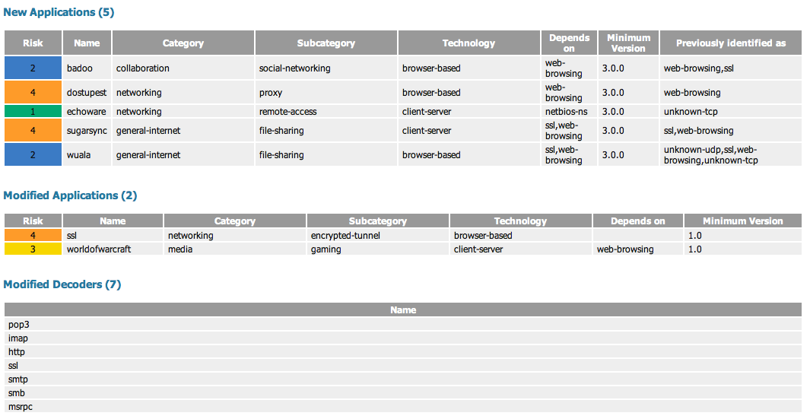
Weekly Content Update

Slide 51
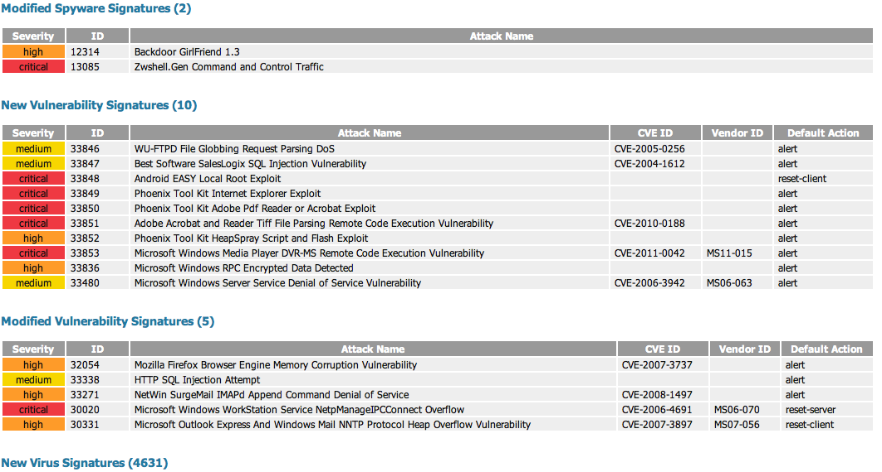
Weekly Content Update

Slide 52
Panorama 4.0
Revolution

Slide 53
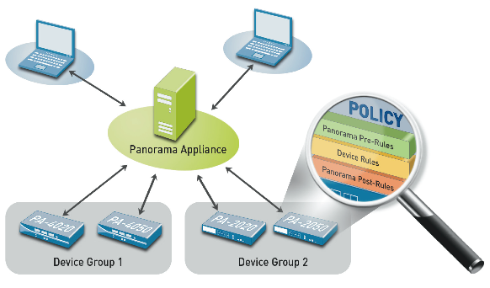
Centralized Visibility, Control and Management
Centralized policy management
Simplifying firewall deployments and updates
Centralized logging and reporting
Log Storage and High Availability
Notes:
53
53
Panorama central management application
Panorama is a central management application enabling consolidated management, logging, and monitoring of Palo Alto Networks devices
Consistent web interface with device, simplifying learning curve and obviating need for client software installation
Provides network-wide ACC/monitoring views, log collection, and reporting
All management interfaces work with latest config, avoiding out of sync issues common with multi-level management
Automated Updates
Automatic install or staging of updates
App-ID signatures
Threat signatures
Software maintenance releases
Zero-downtime upgrading of signatures and maintenance releases

Slide 54
No HA – Local Storage
Exactly like the 3.1 solution
  2 TB storage
  1 virtual appliance
Primary Manager and Log collector

Slide 55
No HA – NFS Storage
Extensible storage
  1 NFS Server
  1 virtual appliance
  Logs stored externally
Primary Manager and Log collector
NFS Mount

Slide 56
HA – Local Storage
Full redundancy
  2 TB storage
  2 virtual appliances
  Devices log to both Primary and Secondary Panorama by default
Primary Manager and Log collector
Secondary Manager and Log collector

Slide 57
HA – NFS Storage
Full redundancy and extended storage
  1 NFS Server
  2 virtual appliances
  Devices log to Primary only
  Admin may convert secondary to primary for log collection
Primary Manager and Log collector
Secondary Manager and Log collector
Shared NFS Mount

Slide 58
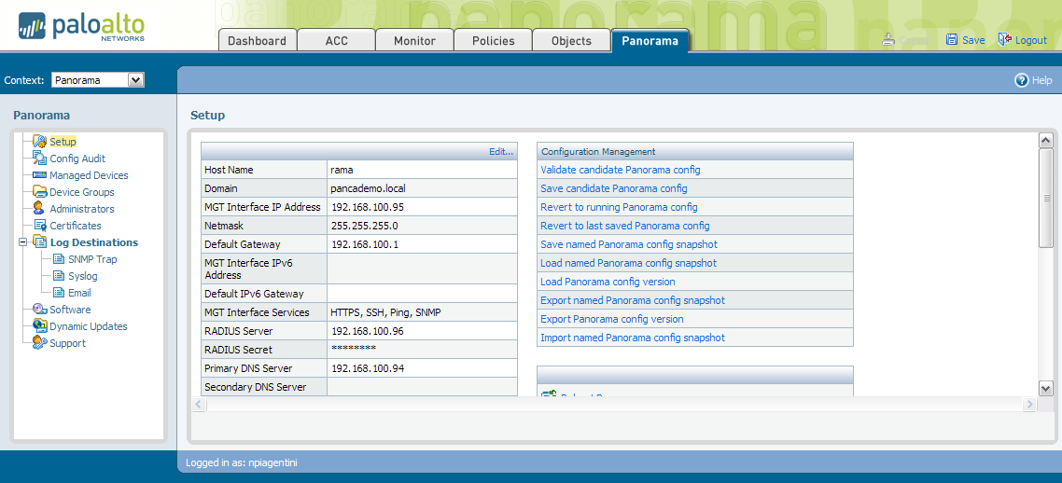
Panorama Interface
Uses similar interface to devices
“Panorama” tab provides management options for Panorama
Notes:
In the Panorama web interface the “Panorama” tab takes the place of the firewalls “Networking” and “Device” tabs. The Panorama tab provides all the configuration options for the central manager. The context pull down in the upper left corner of the interface allows the administrator to select specific firewalls to manage.

Slide 59
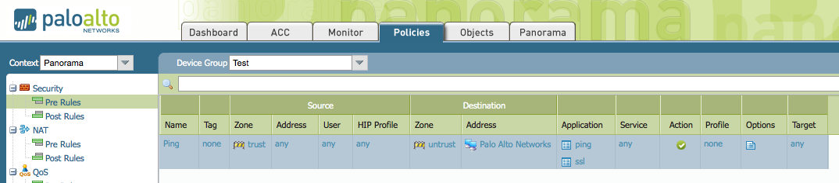
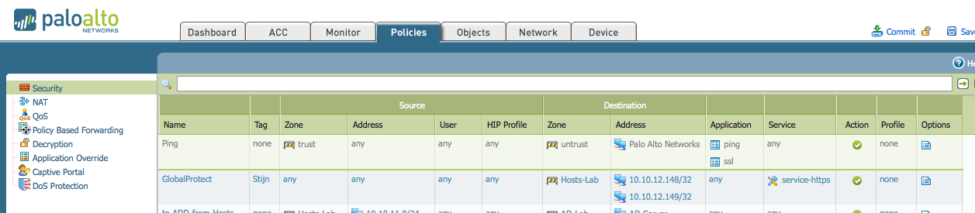
Panorama Interface
Panorama
Device

Slide 60
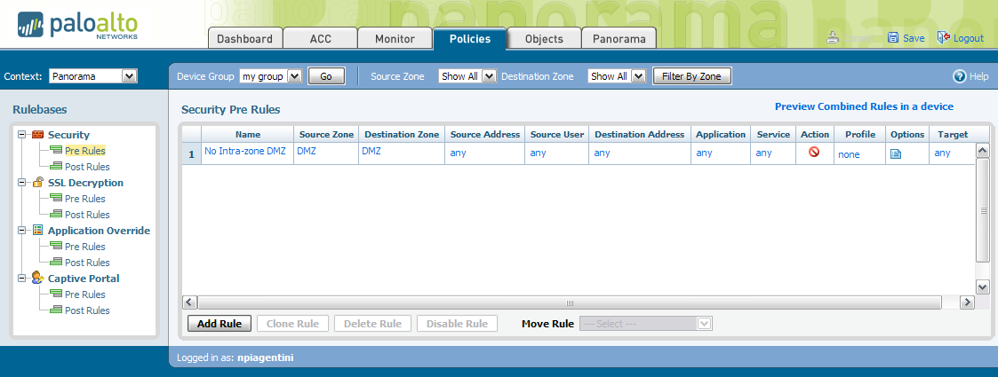
Shared Policy
Rules can be added before or after device rules
Rules can be targeted to be installed on specific devices

Slide 61
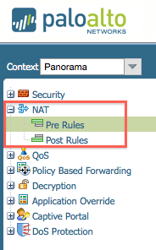
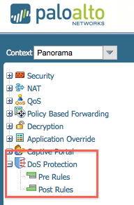
Panorama Full Rule Sharing

Slide 62
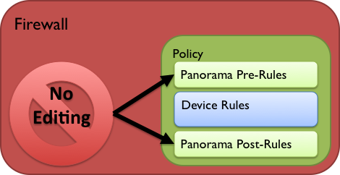
Shared Policy
Shared Rules
Panorama Policy rulebases are tied to Device Groups
No concept of global rules which apply to all managed devices
Pre/Post-rules cannot be edited inside firewall once pushed
  This is true even when in device specific context inside Panorama

Slide 63
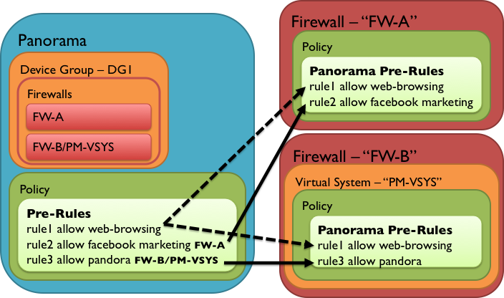
Component : Shared Policy
Targets
Rules can be “targeted” to individual devices
    Targets can be negated

Slide 64
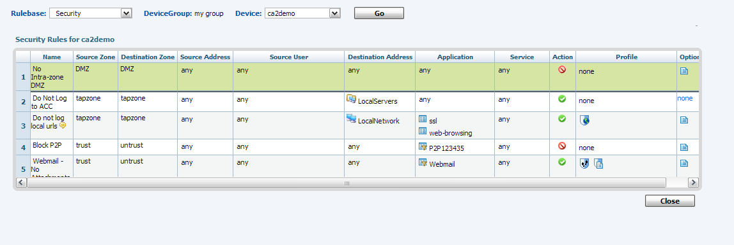
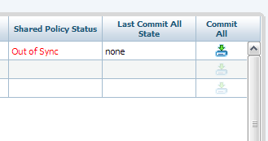
View and Commit
View combined policy for any device
Push and Commit device from Panorama managed devices view
Notes:
The resultant set of rules can be viewed for any firewall under management. Global pre and post rules will be colored olive while the local firewall rules will be white.
From the Managed devices view, specific firewalls and virtual systems can have global policy loaded and committed centrally.

Slide 65

Implementation : Comprehensive Config Audit
4.0 allows “Comprehensive Config Audit”
  Running vs. Candidate config on both Panorama and firewall
    Can be run on entire device group
Can help to avoid collisions or partially configured device commit
  Will indicate if device candidate config exists pre-Commit All

Slide 66
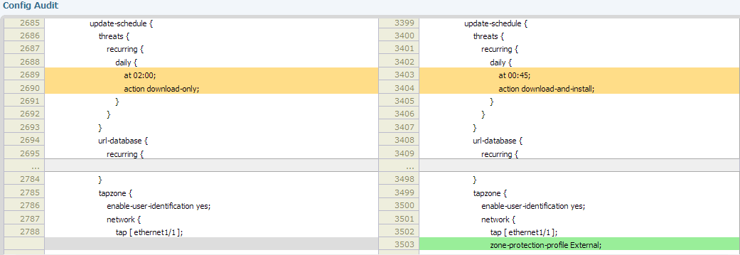
Configuration Auditing
The diff of the files is displayed
Color codes changes
Notes:
Under the device tab there is a config audit option. This option allows the administrator to select two configurations and compare them. The configurations can be the current running config, any named configuration file or any committed configuration as referenced by date/time.
The results of the comparison are displayed in the interface. The user has the option of comparing the entirety of each config file, or just the portions that differ. If choosing less then the entire file, the user can specify how many lines of context around the differences should be displayed.
In the example above we are comparing a committed configuration from the past with the current candidate configuration. We have chosen to show only 5 lines of context around differences. We can see in the slide that the update schedule for threats has been changed and a zone protection profile has been added to the “tapzone”.

Slide 67

Panorama Software Deployment
Managed Firewalls download content from Panorama
PANOS
Agents
Firewall
Content
Firewall
Panorama downloads Software from the Internet
  Content
  PANOS
  Agents
  SSL VPN client
Panorama
Firewall
Firewall

Slide 68
PA-5000 Series: Preview of the Fastest
Next-Generation Firewall

Slide 69


PA-5000 Series
A picture is worth a thousand words…
RJ45 Ports
SFP Ports
SFP+ Ports
Hot Swap Fan Tray
Dual AC/DC Hot Swap Supplies
Dual 2.5 SSD with Raid 1
Note: Systems ship with
single,120GB SSD

Slide 70
Introducing the PA-5000 Series
High performance Next Gen Firewall
3 Models, up to 20Gbps throughput, 10Gbps threat
 | PA-4020 | PA-4050 | PA-4060 | PA-5020 | PA-5050 | PA-5060
Threat Gbps | 2 | 5 | 5 | 2 | 5 | 10
Firewall Gbps | 2 | 10 | 10 | 5 | 10 | 20
Mpps | 5 | 5 | 5 | 13 | 13 | 13
CPS | 60K | 60K | 60K | 120K | 120K | 120K
SSL/VPN Gbps | 1 | 2 | 2 | 2 | 4 | 4
IPSec Tunnels | 2K | 4K | 4K | 2K | 4K | 8K
Sessions | 500K | 2M | 2M | 1M | 2M | 4M
Ethernet | 16xRJ45 8xSFP | 16xRJ45 8xSFP | 4xXFP 4xSFP | 12xRJ45 8xSFP | 12xRJ45 8xSFP 4xSFP+ | 12xRJ45 8xSFP 4xSFP+
Note: Performance testing and verification are under way….

Slide 71
PA-5000 Series Architecture
Highly available mgmt
High speed logging and route update
Dual hard drives
Signature Match HW Engine
Stream-based uniform sig. match
Vulnerability exploits (IPS), virus, spyware, CC#, SSN, and more
Signature Match
RAM
Signature Match
RAM
RAM
RAM
40+ processors
30+ GB of RAM
Separate high speed data and
control planes
20 Gbps firewall throughput
10 Gbps threat prevention throughput
4 Million concurrent sessions
RAM
RAM
RAM
RAM
Quad-core
CPU
RAM
10Gbps
10Gbps
RAM
HDD
CPU
1
CPU
2
...
CPU
12
RAM
CPU
1
CPU
2
...
CPU
12
RAM
CPU
1
CPU
2
...
CPU
12
RAM
HDD
RAM
RAM
RAM
Control Plane
SSL
IPSec
De-Compress.
SSL
IPSec
De-Compress.
SSL
IPSec
De-Compress.
80 Gbps switch fabric interconnect
20 Gbps QoS engine
Security Processors
High density parallel processing for flexible security functionality
Hardware-acceleration for standardized complex functions (SSL, IPSec, decompression)
20Gbps
Flow
control
Route, ARP, MAC lookup
NAT
Network Processor
20 Gbps front-end network processing
Hardware accelerated per-packet route lookup, MAC lookup and NAT
QoS
Switch
Fabric
Switch Fabric
Data Plane
Notes:
71
71
71
03/05/07

Slide 72

PA-5000 Series Control Plane
Significantly more powerful control plane compared to PA-4000 Series systems
Quad core Intel Xeon (2.3Ghz) + 4GB memory
Dual, externally removable, 120GB or 240GB SSD storage
Quad-core mgmt
High speed logging and route update
+
Core 1
Core 2
RAM
Core 3
Core 4
RAM
Note: Base systems ship with
a single, 120GB SSD drive.
Control Plane

Slide 73
PA-5000 Series Data Plane
DP0
Switch
Fabric
FPGA
Fast
Path
CPU
1
CPU
2
...
CPU
12
RAM
RAM
SSL
IPSec
De-Compress.
Signature Match
HW Engines
Flow
control
DP1
SFP+ x 4
CPU
1
CPU
2
...
CPU
12
RAM
Signature Match
RAM
Switch
Fabric
QoS
Route, ARP, MAC lookup
RAM
RAM
SSL
IPSec
De-Compress.
RAM
SFP x 4
RAM
RJ45 x 12
NAT
DP2
CPU
1
CPU
2
...
CPU
12
RAM
Signature Match
RAM
RAM
RAM
SSL
IPSec
De-Compress.
RAM
RAM
PA-5060 Only
Notes:
73
73
73
03/05/07

Slide 74
PA-5000 Series Basic Packet Flow
First Packet
1. Packet received
2. FPGA lookup, no match, sent to DP0
DP0 performs L2-4 session setup
3. Packet forwarded to a DP
DP0
CPU
1
CPU
2
...
CPU
12
RAM
RAM
SSL
IPSec
De-Compress.
Signature Match
HW Engines
2
1
Flow
control
3
DP1
SFP+ x 4
CPU
1
CPU
2
CPU
12
RAM
4
Signature Match
RAM
Switch
Fabric
QoS
5
...
Route, ARP, MAC lookup
RAM
RAM
6
SSL
IPSec
De-Compress.
RAM
SFP x 4
RAM
RJ45 x 12
NAT
DP2
CPU
1
CPU
2
...
CPU
12
RAM
Signature Match
RAM
4. Signature match, if necessary
5. FPGA Session Table Updated
6. Packet forwarded out of system
RAM
RAM
SSL
IPSec
De-Compress.
RAM
RAM
Notes:
74
74
74
03/05/07

Slide 75
PA-5000 Series Basic Packet Flow
2-N Packets (requiring inspection)
1. Packet received
2. FPGA lookup, match, sent to DP1
3. Signature match, if necessary
4. Packet forwarded out of system
DP0
CPU
1
CPU
2
...
CPU
12
RAM
RAM
SSL
IPSec
De-Compress.
Signature Match
HW Engines
1
Flow
control
2
DP1
3
SFP+ x 4
CPU
1
CPU
2
...
CPU
12
RAM
Signature Match
RAM
Switch
Fabric
QoS
Route, ARP, MAC lookup
RAM
RAM
SSL
IPSec
De-Compress.
RAM
SFP x 4
4
RAM
RJ45 x 12
NAT
DP2
CPU
1
CPU
2
...
CPU
12
RAM
Signature Match
RAM
RAM
RAM
SSL
IPSec
De-Compress.
RAM
RAM
Notes:
75
75
75
03/05/07

Slide 76
PA-5000 Series Basic Packet Flow
2-N Packets (Fast Path)
1. Packet received
FPGA lookup, match
Packet processed by FPGA
2. Packet forwarded out of system
DP0
CPU
1
CPU
2
...
CPU
12
RAM
RAM
SSL
IPSec
De-Compress.
Signature Match
HW Engines
1
Flow
control
DP1
SFP+ x 4
CPU
1
CPU
2
...
CPU
12
RAM
Signature Match
RAM
Switch
Fabric
QoS
Route, ARP, MAC lookup
RAM
RAM
2
SSL
IPSec
De-Compress.
RAM
SFP x 4
RAM
RJ45 x 12
NAT
DP2
CPU
1
CPU
2
...
CPU
12
RAM
Signature Match
RAM
RAM
RAM
SSL
IPSec
De-Compress.
RAM
RAM
Notes:
76
76
76
03/05/07

Slide 77
PA-5000 Series Basic Packet Flow
“Special Packets”
1. Packet received
2. FPGA lookup, match, sent to DP0
3. Packet forwarded out of system
DP0
CPU
1
CPU
2
...
CPU
12
RAM
RAM
SSL
IPSec
De-Compress.
Signature Match
HW Engines
2
1
Flow
control
3
DP1
SFP+ x 4
3
CPU
1
CPU
2
...
CPU
12
RAM
Signature Match
RAM
Switch
Fabric
QoS
Route, ARP, MAC lookup
RAM
RAM
SSL
IPSec
De-Compress.
RAM
SFP x 4
RAM
RJ45 x 12
NAT
DP2
CPU
1
CPU
2
...
CPU
12
RAM
Signature Match
RAM
The following types of sessions are always installed on DP0:
Tunnel sessions;
Predict sessions;
Host-bound sessions;
Non TCP/UDP sessions;
RAM
RAM
SSL
IPSec
De-Compress.
RAM
RAM
Notes:
77
77
77
03/05/07

Slide 78


Scaling Horizontally
Sometimes one PA-5060 just isn’t enough!
EtherChannel Load Balancing (ECLB)
Aggregate Ethernet
or EtherChannel
interwebs
Relatively simple and cheap
Load Share up to 8 devices
1-arm connection to each FW
No state sync between FW’s
Use Src/Dst IP for LB hash
Depending on the switch, not perfect traffic distribution
Consider N+1 design to cover load during maintenance
L2/L3 Switch

Slide 79
Scaling Horizontally
Sometimes one PA-5060 just isn’t enough!
L3/L4 Load Balancers
interwebs
Can be costly and complex
More control over flows
Can scale >8 devices
No state sync between FW’s
Consider N+1 design to cover load during maintenance
L3/L4 load balancers
huge ip
L3/L4 load balancers
huge ip
corp net

Slide 80
GlobalProtect™
Securing Users and Data in an Always Connected World

Slide 81









Introducing GlobalProtect
Users never go “off-network” regardless of location
All firewalls work together to provide “cloud” of network security
How it works:
  Small agent determines network location (on or off the enterprise network)
  If off-network, the agent automatically connects the laptop to the nearest firewall via SSL VPN
  Agent submits host information profile (patch level, asset type, disk encryption, and more) to the gateway
  Gateway enforces security policy using App-ID, User-ID, Content-ID AND host information profile

Slide 82






A Modern Architecture for Enterprise Network Security
malware
exploits
botnets
Establishes a logical perimeter that is not bound to physical limitations
Users receive the same depth and quality of protection both inside and out
Security work performed by purpose-built firewalls, not end-user laptops
Unified visibility, compliance and reporting

Slide 83







GlobalProtect Topology
Portal
Gateway
Gateway
Gateway
1
4
3
2
Client
Client attempts SSL connection to Portal to retrieve latest configuration
Client does reverse DNS lookup per configuration to determine whether on or off network (e.g. lookup 10.10.10.10 and see if it resolves to internal.paloalto.local)
If external, client attempts to connect to all external gateways via SSL and then uses one with quickest response
SSL or IPSec tunnel is established and default routes inserted to direct all traffic through the tunnel for policy control and threat scanning
Gateway
© 2011 Palo Alto Networks. Proprietary and Confidential.
83

Slide 84

Global Protect

Slide 85

Global Protect

Slide 86

Global Protect

Slide 87

Global Protect

Slide 88

Global Protect

Slide 89

Global Protect

Slide 90
PAN-OS 4.0: A Significant Milestone

Slide 91
PAN-OS 4.0
App-ID
  Custom App-IDs for unknown protocols
  App and threats stats collection
  SSH tunneling control (for port forwarding control)
  6,000 custom App-IDs
User-ID
  Windows 2003 64-bit, Windows 2008 32- and 64-bit Terminal Server support; XenApp 6 support
  Client certificates for captive portal
  Authentication sequence flow
  Strip x-forwarded-for header
  Destination port in captive portal rules
Threat Prevention & Data Filtering
Behavior-based botnet C&C detection
PDF virus scanning
Drive by download protection
Hold-down time scan detection
Time attribute for IPS and custom signatures
DoS protection rulebase
URL Filtering
Container page filtering, logging, and reporting
Seamless URL activation
“Full” URL logging
Manual URL DB uploads (weekly)

Slide 92


Threat updates 4.0
Bot-net detection
  Advanced heuristics to detect botnets
  Collates info from Traffic, Threat, URL logs to identify potential infected hosts
  Reports generated daily with suspected hosts and confidence level
  Uses unknown-tcp/udp, IRC and HTTP traffic(malware, recently registered, etc to identify.

Slide 93
PAN-OS Nice
Networking
  Active/Active HA
  HA enhancements (link failover, next-hop gateway for HA1, more)
  IPv6 L2/L3 basic support
  DNS proxy
  DoS source/dest IP session limiting
  VSYS resource control (# rules, tunnels, more)
  Country-based policies
  Overlapping IP support (across multiple VRs)
  VR to VR routing
  Virtual System as destination of PBF rule
  Untagged subinterfaces
  TCP MSS adjustment
NetConnect SSL-VPN
  Password expiration notification
  Mac OS support (released w/ PAN-OS 3.1.4)
GlobalProtect™*
  Windows XP, Vista, 7 support (32- and 64-bit support)
  Host profiling
  Single sign-on
* Requires optional GlobalProtect device license

Slide 94
PAN-OS 4.0
New UI Architecture
  Streamline policy management workflow
  Rule tagging, drag-n-drop, quick rule editing, object value visibility, filtering, and more
Panorama
Extended config sharing (all rulebases, objects & profiles shared to device)
Dynamic log storage via NFS
Panorama HA
UAR from Panorama
Exportable config backups
Comprehensive config audit
Management
FQDN-based address objects
Configurable log storage by log type
Configurable event/log format (including CEF for ArcSight)
Configuration transactions
SNMPv3 support
Extended reporting for VSYS admins (scheduler, UAR, summary reports, email forwarding)
PCAP configuration in UI

Slide 95
Q&A

Slide 96
Thank you

Slide 97
Thank You

