Slide 1
Palo Alto Networks
Markus Laaksonen
mlaaksonen@paloaltonetworks.com

Slide 2




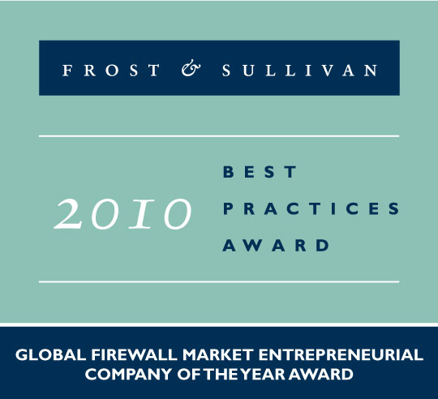


About Palo Alto Networks
Palo Alto Networks is the Network Security Company
World-class team with strong security and networking experience
  Founded in 2005 by security visionary Nir Zuk
  Top-tier investors
Builds next-generation firewalls that identify / control 1300+ applications
  Restores the firewall as the core of the enterprise network security infrastructure
  Innovations: App-ID™, User-ID™, Content-ID™
Global footprint: 3,500+ customers in 70+ countries, 24/7 support

Slide 3










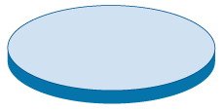

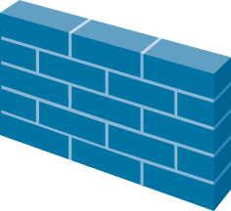
Technology Sprawl & Creep Are Not The Answer
Internet
“More stuff” doesn’t solve the problem
Firewall “helpers” have limited view of traffic
Complex and costly to buy and maintain
Putting all of this in the same box is just slow

Slide 4
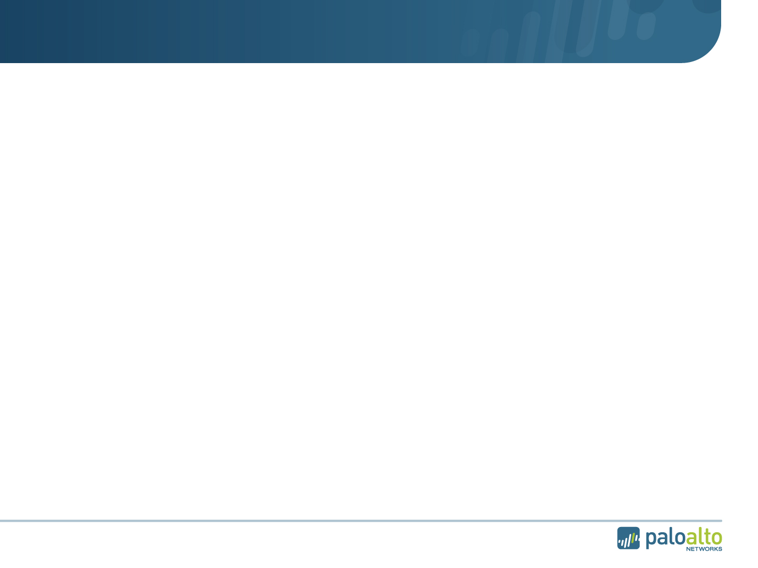
Traditional Multi-Pass Architectures are Slow
IPS Policy
AV Policy
URL Filtering Policy
IPS Signatures
AV Signatures
Firewall Policy
HTTP Decoder
IPS Decoder
AV Decoder & Proxy
Port/Protocol-based ID
Port/Protocol-based ID
Port/Protocol-based ID
Port/Protocol-based ID
L2/L3 Networking, HA, Config Management, Reporting
L2/L3 Networking, HA, Config Management, Reporting
L2/L3 Networking, HA, Config Management, Reporting
L2/L3 Networking, HA, Config Management, Reporting

Slide 5










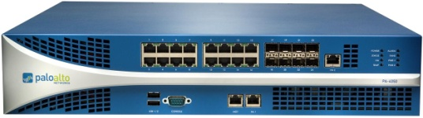

The Right Answer: Make the Firewall Do Its Job
New Requirements for the Firewall
1. Identify applications regardless of port, protocol, evasive tactic or SSL
2. Identify users regardless of IP address
3. Protect in real-time against threats embedded across applications
4. Fine-grained visibility and policy control over application access / functionality
5. Multi-gigabit, in-line deployment with no performance degradation

Slide 6
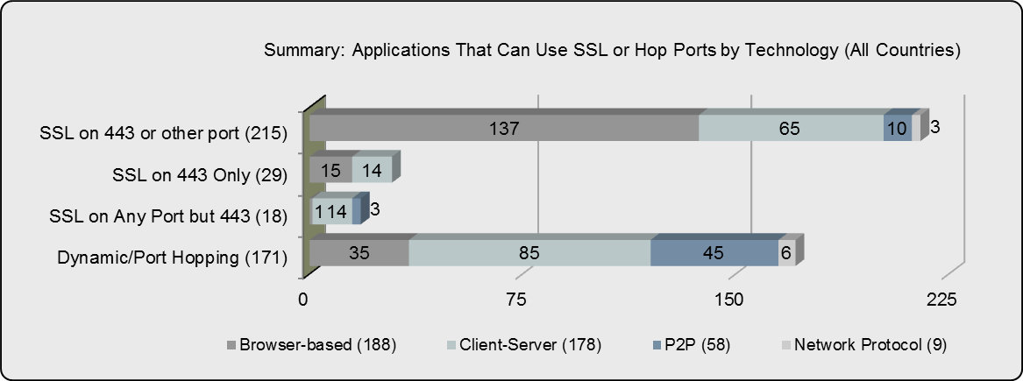
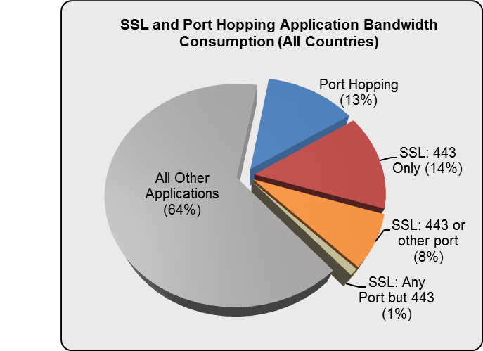
Application Usage Report
Hidden application traffic
41% of the applications (433) found can use SSL or hop ports
Consuming roughly 36% of overall bandwidth
Only 43% use the browser
Notes:
Applications that CAN use ssl most often do so to encrypt the interaction. The key word here is CAN, since we do not know if it is enabled or not, a feature many applications have.
Most people think of SSL and equate it to port 443, which is only partially true; recall that SSL on 443 is HTTPs, typically meant for browser-based interaction.
SSL can actually be used on any port, it is dependent on how the developer implements it. We looked at SSL on 443, SSL not on 443 and SSL on any port.
We also looked at the applications that can port hop.
The results were surprising: 41% of the applications chewing 36% of the bandwidth fall into these definitions. This was very surprising.
What surprises us a bit more was that 43% are using the browser, a number we felt was lower than what it should have been, given the high numbers in the other categories.
Why it matters: Most organizations are blind to not only how much SSL is on their network, they are unable to do anything with it/do anything about it.

Slide 7
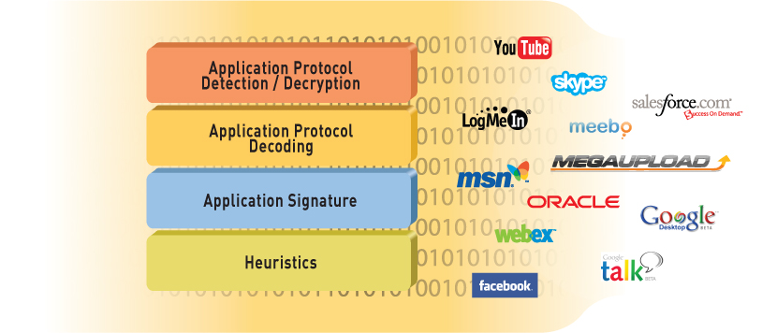
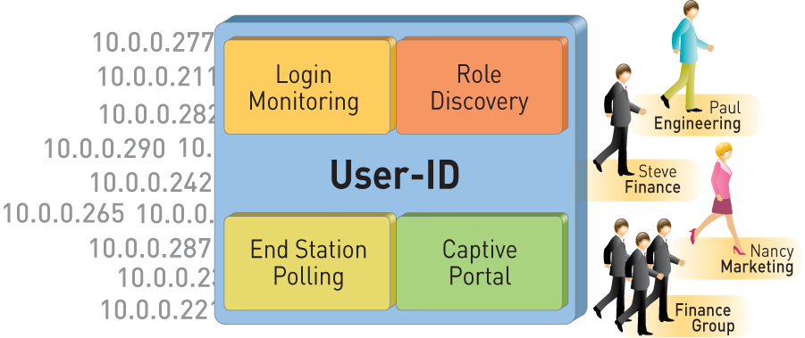
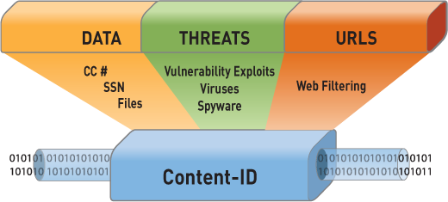
Identification Technologies Transform the Firewall
App-ID™
Identify the application
User-ID™
Identify the user
Content-ID™
Scan the content

Slide 8
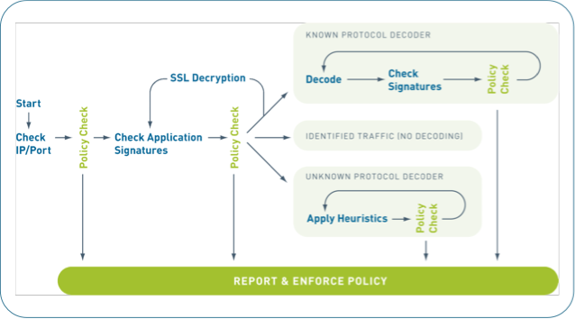

App-ID is Fundamentally Different
Always on, always the first action
Built-in intelligence
Sees all traffic across all ports
Scalable and extensible
Much more than just a signature….
© 2010 Palo Alto Networks. Proprietary and Confidential.
Page
Notes:
App-ID is smart = it automatically uses what ever mechanisms required to ID the traffic
App-ID is always on = no need to set policies on what to look for (outside of any-any-allow)
App-ID sees all traffic across all ports = no need to configure which port to look at for each application
App-ID is scalable = can add, new ID mechanisms to address changes in application landscape

Slide 9
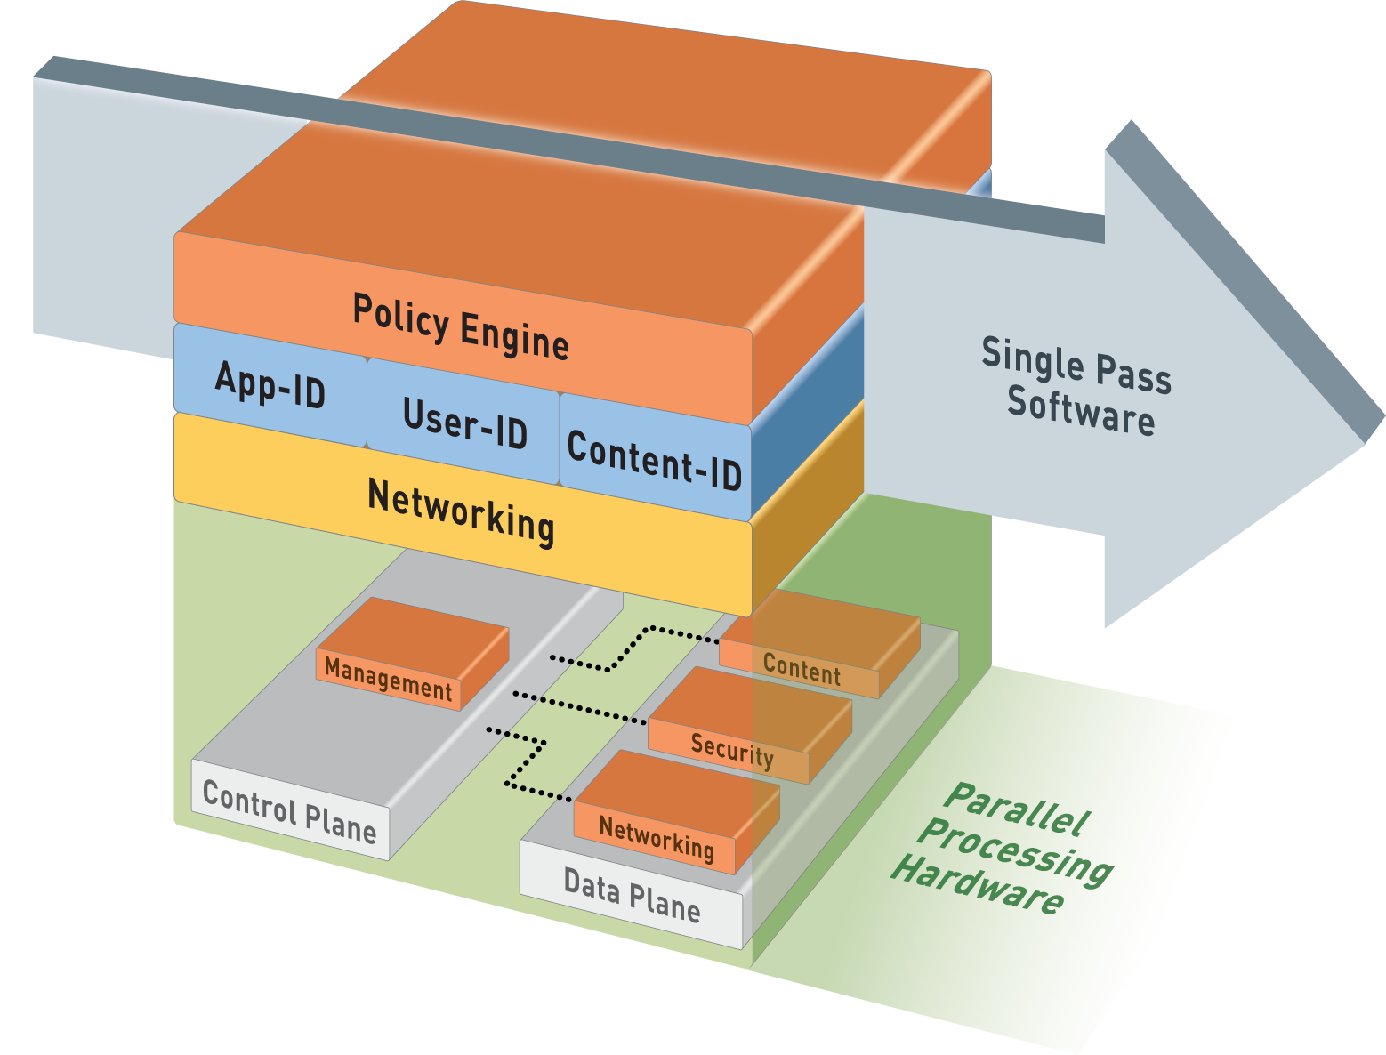
Single-Pass Parallel Processing™ (SP3) Architecture
Single Pass
Operations once per packet
  Traffic classification (app identification)
  User/group mapping
  Content scanning – threats, URLs, confidential data
One policy
Parallel Processing
Function-specific parallel processing hardware engines
Separate data/control planes
Up to 10Gbps, Low Latency

Slide 10





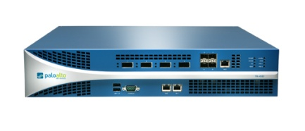


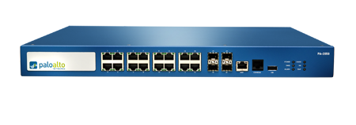
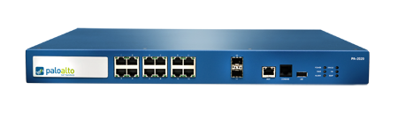
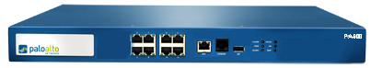
PAN-OS Core Firewall Features
Visibility and control of applications, users and content complement core firewall features
PA-5060
Strong networking foundation
  Dynamic routing (BGP, OSPF, RIPv2)
  Tap mode – connect to SPAN port
  Virtual wire (“Layer 1”) for true transparent in-line deployment
  L2/L3 switching foundation
  Policy-based forwarding
VPN
  Site-to-site IPSec VPN
  SSL VPN
QoS traffic shaping
  Max/guaranteed and priority
  By user, app, interface, zone, & more
  Real-time bandwidth monitor
Zone-based architecture
  All interfaces assigned to security zones for policy enforcement
High Availability
  Active/active, active/passive
  Configuration and session synchronization
  Path, link, and HA monitoring
Virtual Systems
  Establish multiple virtual firewalls in a single device (PA-5000, PA-4000, and PA-2000 Series)
Simple, flexible management
  CLI, Web, Panorama, SNMP, Syslog
PA-5050
PA-5020
PA-4060
PA-4050
PA-4020
PA-2050
PA-2020
PA-500
Notes:
10
10

Slide 11

Palo Alto Networks Next-Gen Firewalls
PA-5060
20 Gbps FW/10 Gbps threat prevention/4,000,000 sessions
4 SFP+ (10 Gig), 8 SFP (1 Gig), 12 copper gigabit
PA-5050
10 Gbps FW/5 Gbps threat prevention/2,000,000 sessions
4 SFP+ (10 Gig), 8 SFP (1 Gig), 12 copper gigabit
PA-5020
5 Gbps FW/2 Gbps threat prevention/1,000,000 sessions
8 SFP, 12 copper gigabit
PA-4060
10 Gbps FW/5 Gbps threat prevention/2,000,000 sessions
4 XFP (10 Gig), 4 SFP (1 Gig)
PA-4050
10 Gbps FW/5 Gbps threat prevention/2,000,000 sessions
8 SFP, 16 copper gigabit
PA-4020
2 Gbps FW/2 Gbps threat prevention/500,000 sessions
8 SFP, 16 copper gigabit
PA-2050
1 Gbps FW/500 Mbps threat prevention/250,000 sessions
4 SFP, 16 copper gigabit
PA-2020
500 Mbps FW/200 Mbps threat prevention/125,000 sessions
2 SFP, 12 copper gigabit
PA-500
250 Mbps FW/100 Mbps threat prevention/50,000 sessions
8 copper gigabit
Notes:
11

Slide 12
Purpose-Built Architecture: PA-4000 Series
RAM
RAM
Signature Match HW Engine
Palo Alto Networks’ uniform signatures
Vulnerability exploits (IPS), virus, spyware, CC#, SSN, and other signatures
Signature Match
Dedicated Control Plane
Highly available mgmt
High speed logging and route updates
RAM
RAM
10Gbps
RAM
CPU
1
CPU
2
CPU
3
. .
CPU
16
RAM
Multi-Core Security Processor
High density processing for flexible security functionality
Hardware-acceleration for standardized complex functions (SSL, IPSec, decompression)
Dual-core
CPU
RAM
RAM
HDD
SSL
IPSec
De-Compression
10Gbps
Route, ARP, MAC lookup
10 Gig Network Processor
Front-end network processing offloads security processors
Hardware accelerated QoS, route lookup, MAC lookup and NAT
QoS
NAT
Control Plane
Data Plane

Slide 13









Flexible Deployment Options
Visibility
Transparent In-Line
Firewall Replacement
Application, user and content visibility without inline deployment
IPS with app visibility & control
Consolidation of IPS & URL filtering
Firewall replacement with app visibility & control
Firewall + IPS
Firewall + IPS + URL filtering

Slide 14
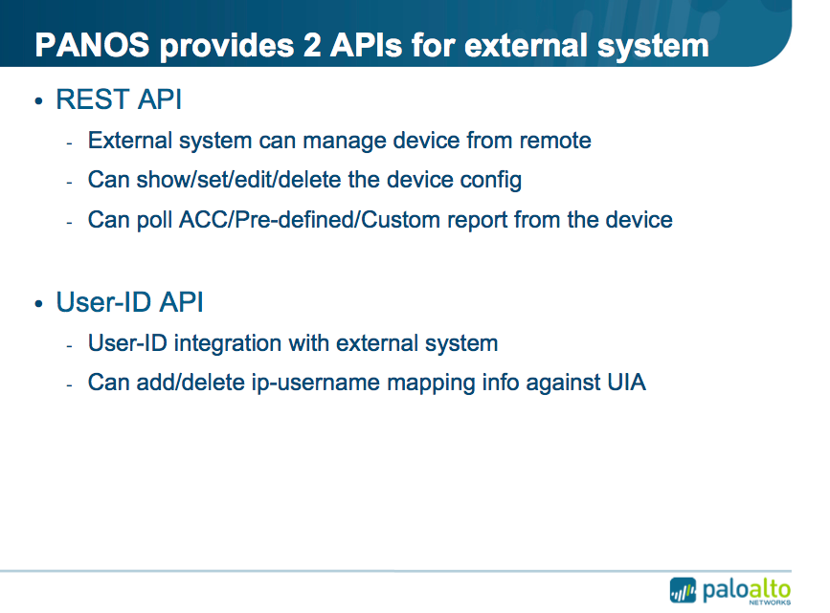

Slide 15
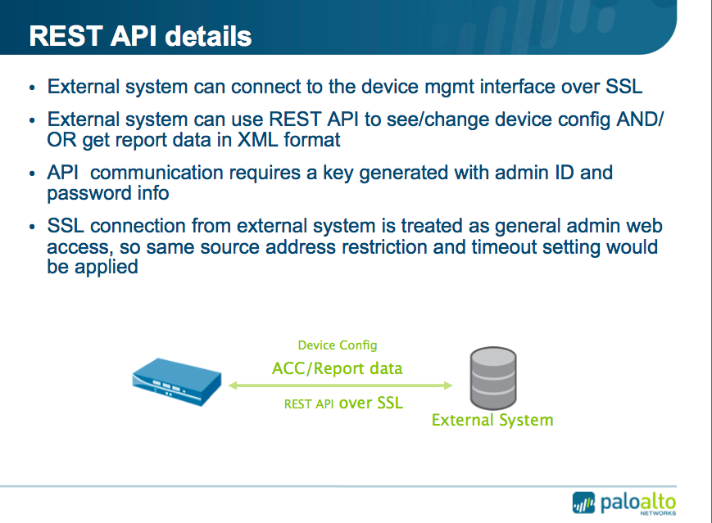

Slide 16
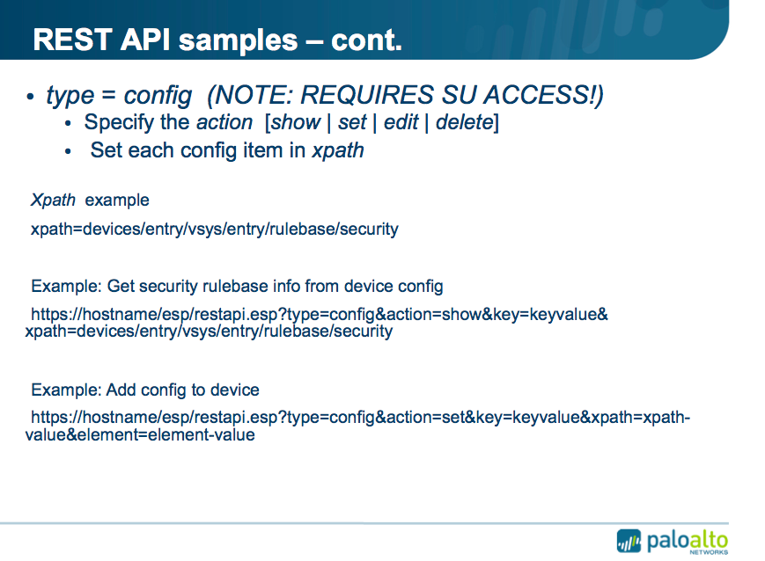

Slide 17
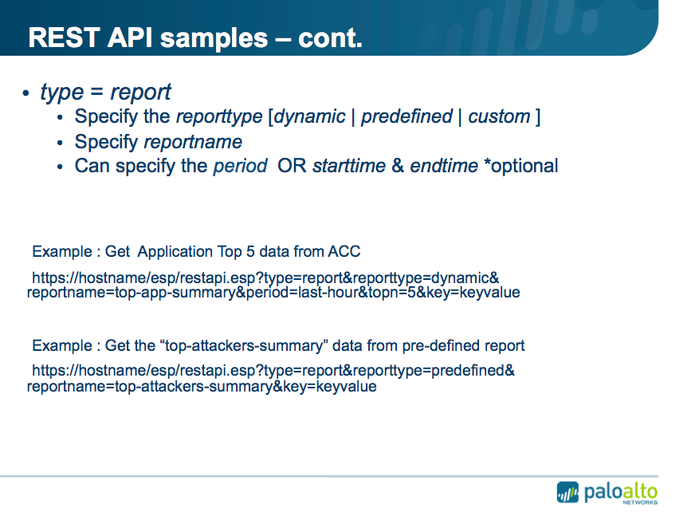

Slide 18
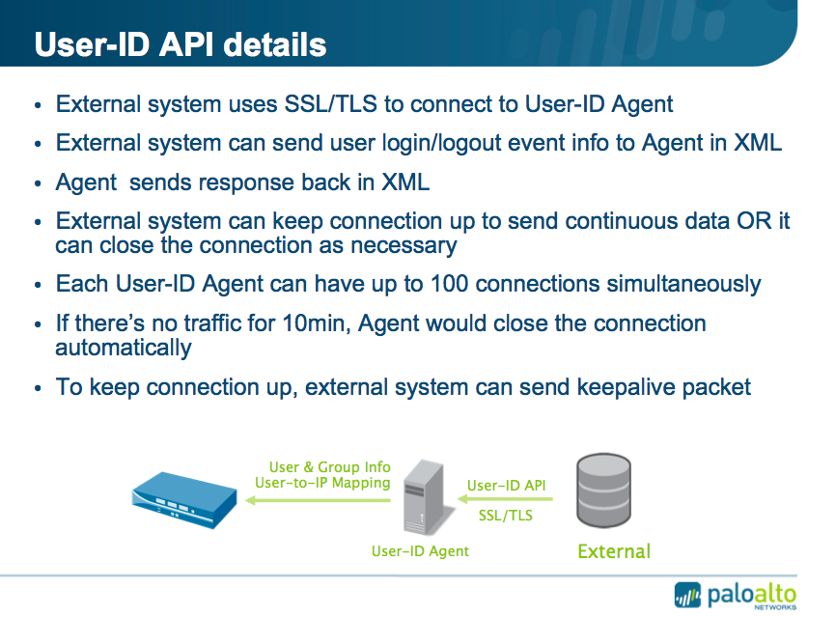

Slide 19
User-ID XML API use case:
Virtualization Security Visibility

Slide 20
The Situation Today: Islands of Management
VM Management
Network Management
Workloads
Networks
Gap
No data synchronization
No visibility across functions
Manual, error-prone
Policies
Security Management

Slide 21
Palo Alto Networks Eliminates the Gap
VM Management
Network Management
Workloads
Networks
Palo Alto Networks VM-ID
Cross-functional visibility & Control
Real-time
Fully automated
Policies
Security Management

Slide 22
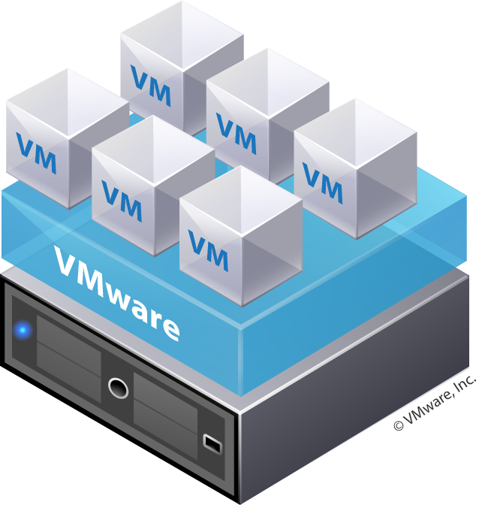
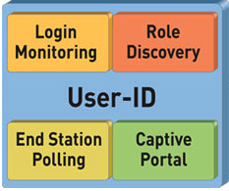
VM-ID vSphere Polling
vSphere
vSphere
1. User-ID Agent Polls vCenter or ESX(i)
2. Agent Publishes VM Mapping
3. VM Visibility in ACC
4. Dynamic VM Adds/Moves auto-sync
Binds VM->IP
Report on VM and User->VM Activity
vCenter

Slide 23
GlobalProtect™
Securing Users and Data in an Always Connected World

Slide 24







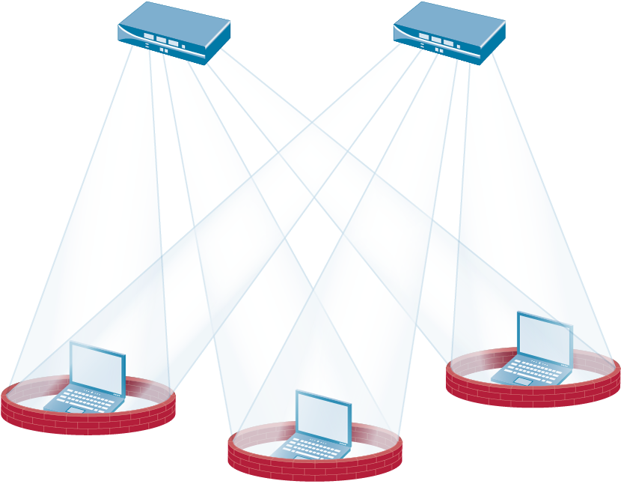
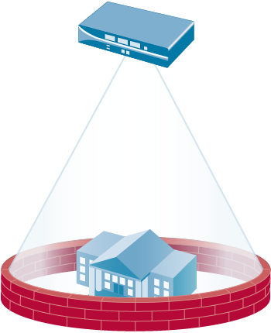
Introducing GlobalProtect
Users never go “off-network” regardless of location
All firewalls work together to provide “cloud” of network security
How it works:
  Small agent determines network location (on or off the enterprise network)
  If off-network, the agent automatically connects the laptop to the nearest firewall via SSL VPN
  Agent submits host information profile (patch level, asset type, disk encryption, and more) to the gateway
  Gateway enforces security policy using App-ID, User-ID, Content-ID AND host information profile

Slide 25





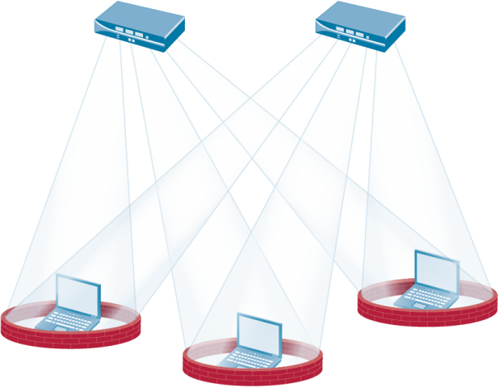
A Modern Architecture for Enterprise Network Security
malware
exploits
botnets
Establishes a logical perimeter that is not bound to physical limitations
Users receive the same depth and quality of protection both inside and out
Security work performed by purpose-built firewalls, not end-user laptops
Unified visibility, compliance and reporting

Slide 26







GlobalProtect Topology
Portal
Gateway
Gateway
Gateway
1
4
3
2
Client
Client attempts SSL connection to Portal to retrieve latest configuration
Client does reverse DNS lookup per configuration to determine whether on or off network (e.g. lookup 10.10.10.10 and see if it resolves to internal.paloalto.local)
If external, client attempts to connect to all external gateways via SSL and then uses one with quickest response
SSL or IPSec tunnel is established and default routes inserted to direct all traffic through the tunnel for policy control and threat scanning
Gateway
© 2011 Palo Alto Networks. Proprietary and Confidential.
26

Slide 27
Thank You

