Slide 1
Next Generation Network Security
Carlos Heller
System Engineering

Slide 2
Topics
About Palo Alto Networks Problems?
Current security situation
Proof!

Slide 3




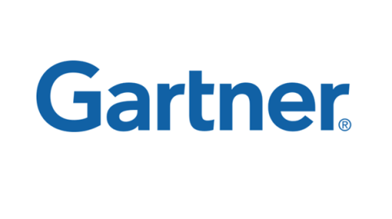
About Palo Alto Networks
Founded in 2005 by security visionaries and engineers from Checkpoint, NetScreen, Juniper Networks, McAfee, Blue Coat, Cisco, …
Build innovative Next Generation Firewalls that control more than 1000 applications, users & data carried by them
Backed by $65 Million in venture capital from leading Silicon Valley investors including Sequoia Capital, Greylock Partners, Globespan Capital Partners, …
Global footprint with over 2500 customers, we are passionate about customer satisfaction and deliver 24/7 global support and have presence in 50+ countries
Independent recognition from analysts like Gartner
Notes:
3
3
Get requirements from them to write FR about Carrier Features ( SS7, Megaco, Voice, MMS, SMS, GTP, Sigtran)
Additional ips planed next year
Cisco driven at the moment and minded
Business case must fit to
Looking for ideas
Unique sellling points
Send out ISS Repot, send Gartner, whoite paper for AV streaming functionality,
What about ISSU on roadmap.
What about reverse proxy examples.
White paper about datacencter security
What is the b-case for them
Competetive against fortinet ( Forti carrier)
ANTI VIRUS FUNCTIONALITY senden

Slide 4

















































































Over 2500 Organizations Trust Palo Alto Networks
Health Care
Financial Services
Government
Media / Entertainment / Retail
Education
Service Providers / Services
Mfg / High Tech / Energy

Slide 5
The current security situation

Slide 6
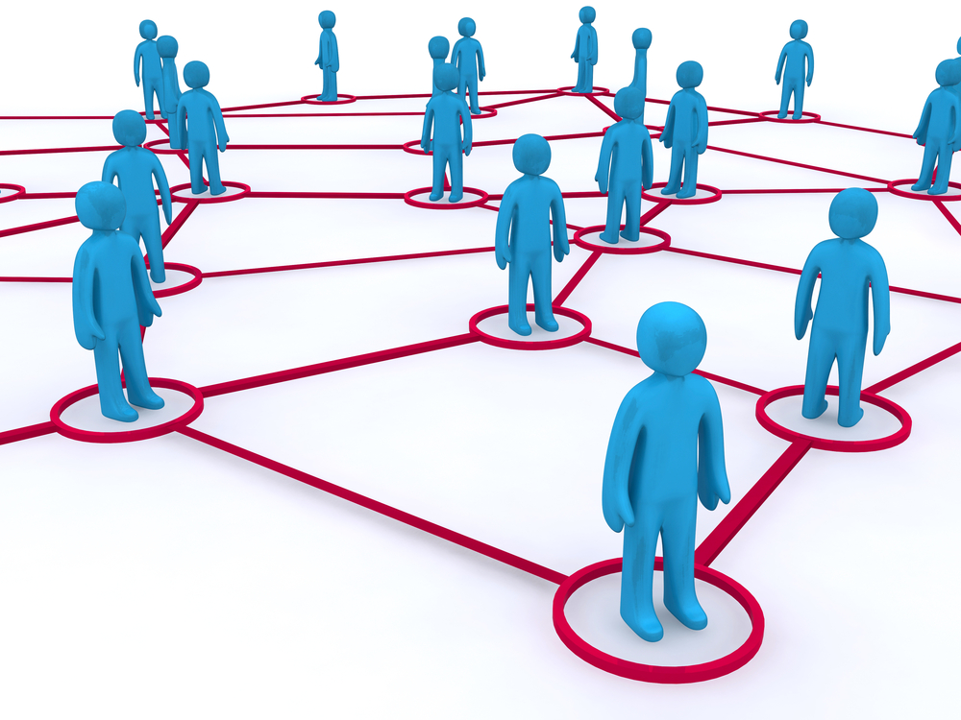
Why Do You Need a NGFW?
The Social Enterprise 2.0

Slide 7
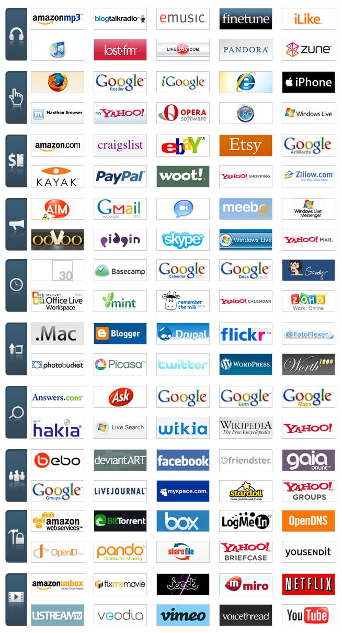

Enterprise 2.0 Applications Take Many Forms
As you can see, no space left for security ;-)

Slide 8
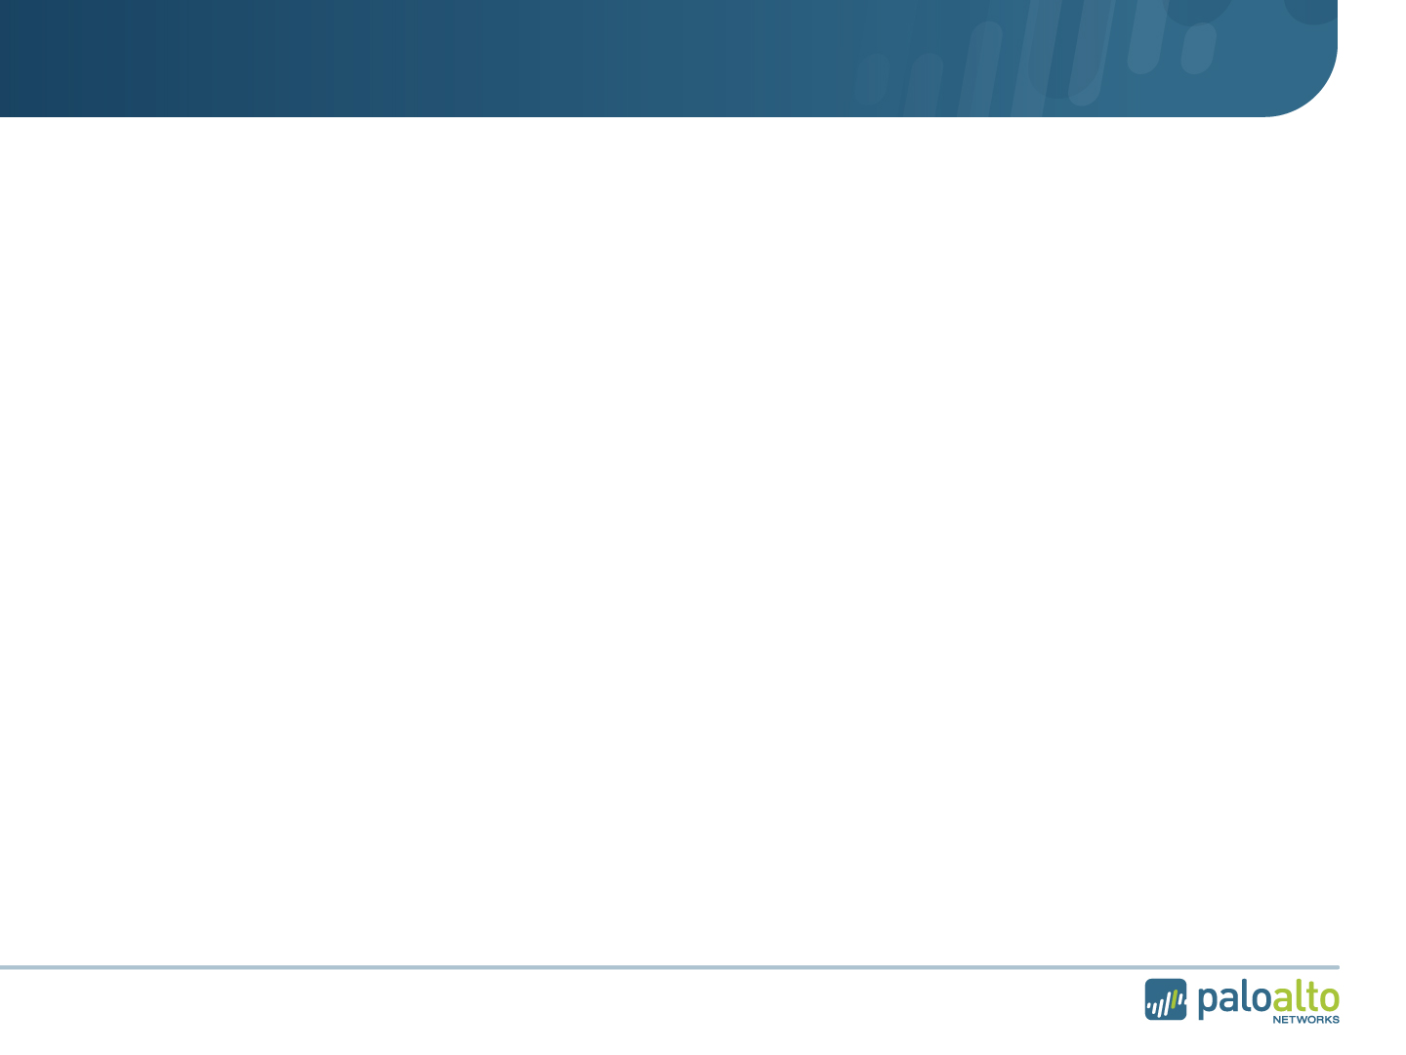

















Security v2.0: Stateful Inspection
Traditional Applications
DNS
Gopher
SMTP
HTTP
Dynamic Applications
FTP
RPC
Java/RMI
Multimedia
Background
Innovation created Check Point in 1994
Used state table to fix packet filter shortcomings
Classified traffic based on port numbers but in the context of a flow
Challenge
Cannot identify Evasive Applications
Embedded throughout existing security products
Impossible to retroactively fix
Evasive Applications
Encrypted
Web 2.0
P2P
Instant Messenger
Skype
Music
Games
Desktop Applications
Spyware
Crimeware
Internet

Slide 9
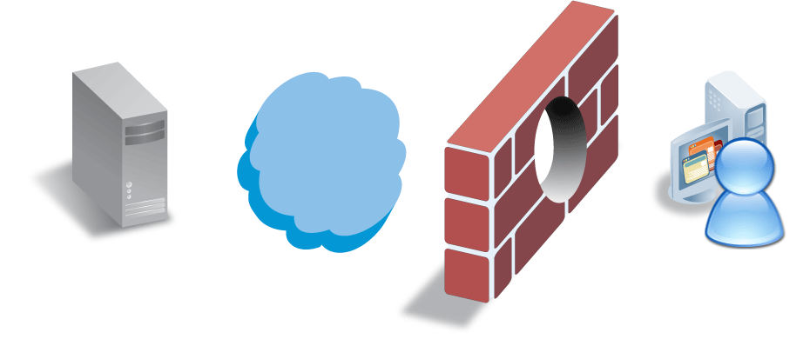
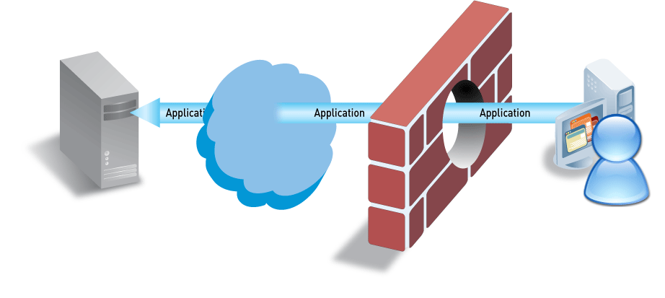
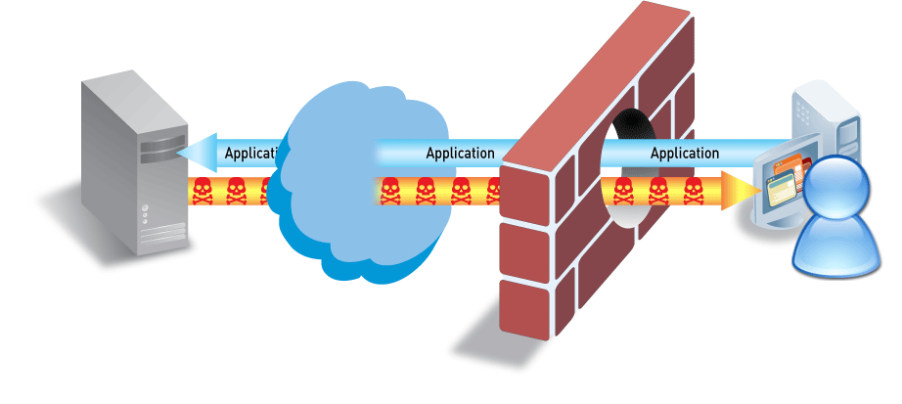
Applications Carry Risk & and are targets
Applications can be “threats”
(P2P file sharing, tunneling applications, anonymizers, media/video, …)
  SANS Top 20 Threats – majority are application-level threats
  Applications & application-level threats result in major breaches – Pfizer, VA, US Army

Slide 10
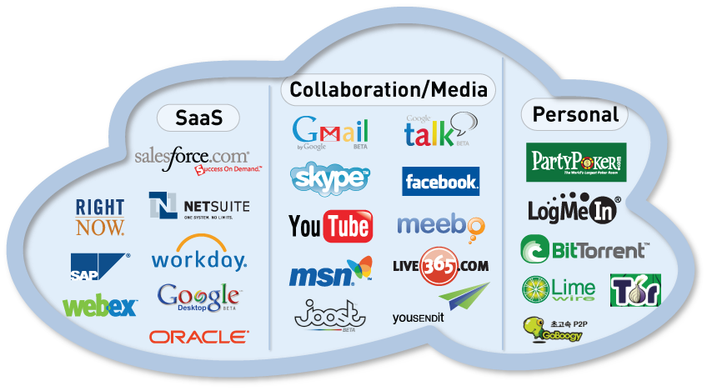
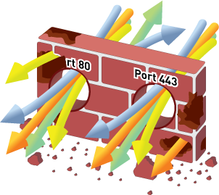
Applications Have Changed – Firewalls nor Firewall Helpers Have
Firewalls should see and control applications, users, and threats . . .
. . . but they only show you ports, protocols, and IP addresses – all meaningless!
Need to Restore Visibility, Control & Security in the Firewall
Notes:
10
10
10

Slide 11

Question to the audience!
Why are Skype, Facebook, Google, Ultraserve and others behaving like they do ?
Because users behave silly !
.They click links they shouldn’t
..They install Software they shouldn’t
...they are curious
Because the current Security Infrastructure can’t stop them !
..traditional Firewalls are blind to this
…the Infrastructure technology is years older then the applications are
Because it makes they Application successful !
.the application receives attention
..the application spreads even faster
…the application generates revenue

Slide 12

Your Control with a traditional Firewall + IPS
You only can hit what you understand & see !
You are only in a reactive mode…..!!

Slide 13
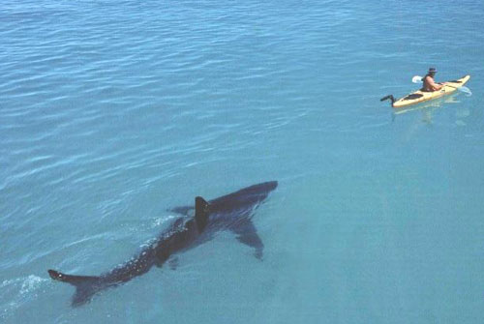
What You Need To Know
Driven by new generation of addicted Internet users – smarter than you?
Full, unrestricted ac`cess to everything on the Internet is a right.
They’re creating a giant social system - collaboration, group knowledge, …
Not waiting around for IT support or endorsement – IT is irrelevant!
Conclusion: Lots of Rewards but tremendous Risk!
Notes:
Inernet coming in; enterprise apps moving out. Users right in the middle.
Hard to define/manage a hard boundary
users also in the middle of personal/professional life – internet is part of both
How do you control boundary there?
Your challenge – minimize risks/max rewards

Slide 14


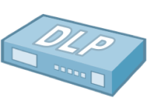




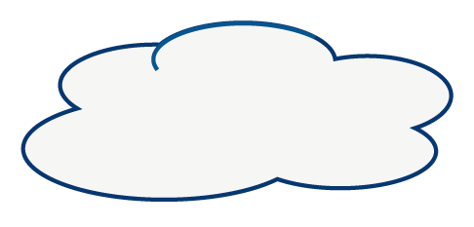


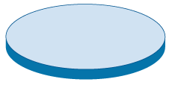

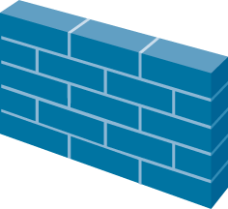
Sprawl Is Not The Answer
Internet
“More stuff” doesn’t solve the problem
Firewall “helpers” have limited view of traffic
Complex and costly to buy and maintain
Putting all of this in the same box is just slow
Page 14 |
© 2009 Palo Alto Networks. Proprietary and Confidential.

Slide 15
Why Existing Solutions Don’t Work
Traditional old fashioned firewalls
  Doesn’t uniquely identify applications
  All traffic on port 80/443 looks the same
IPS
  Limited visibility
  Doesn’t allow for safe enablement
URL Filtering
  Incomplete view of traffic
  Can be easily circumvented by proxies
Others
  Incomplete solution – do not identify or classify broad set of E2.0 applications

Slide 16























What You See…with non-firewalls
What You See with With a NG-Firewall

Slide 17
What are the key differences ?

Slide 18
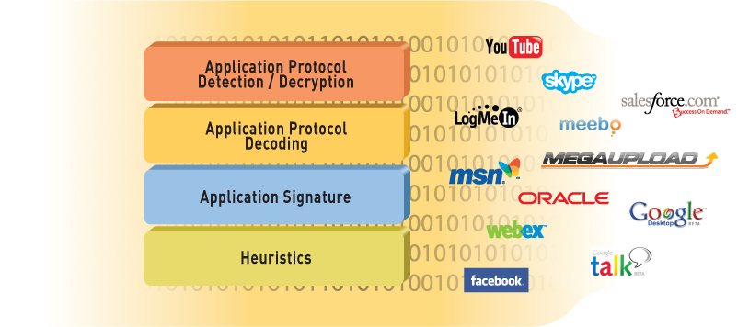
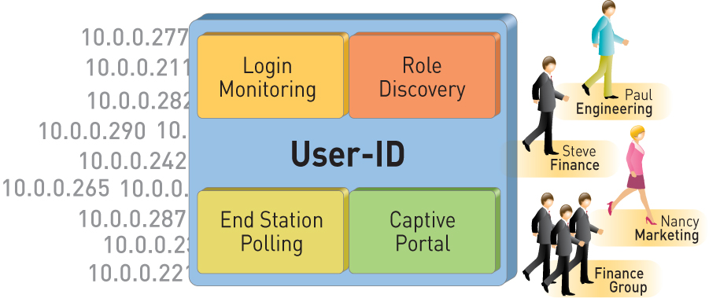
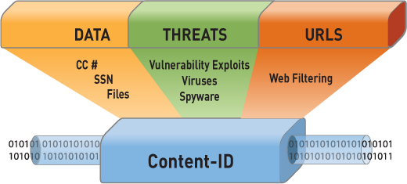
Unique Technologies Transform the Firewall
App-ID
Identify the application
User-ID
Identify the user
Content-ID
Scan the content
Notes:
18
18

Slide 19
App-ID is Fundamentally Different
Always on, always the first action
Built-in intelligence
Sees all traffic across all ports
Scalable and extensible
Much more than just a signature….
Notes:
App-ID is smart = it automatically uses what ever mechanisms required to ID the traffic
App-ID is always on = no need to set policies on what to look for (outside of any-any-allow)
App-ID sees all traffic across all ports = no need to configure which port to look at for each application
App-ID is scalable = can add, new ID mechanisms to address changes in application landscape

Slide 20
Fundamental Differences: User-ID & Content-ID
User-ID
Content-ID
User data is pervasive –
  Single click visibility into who is using the application (ACC)
  3 click addition of user info in a policy
  Report on, investigate application usage, threat propagation
None of the competitors are as pervasive, nor as easy to use
Seamlessly integrated – app intelligence is shared
Compliments application control – block the unwanted, scan the allowed
Single pass scanning minimizes performance hit and latency

Slide 21
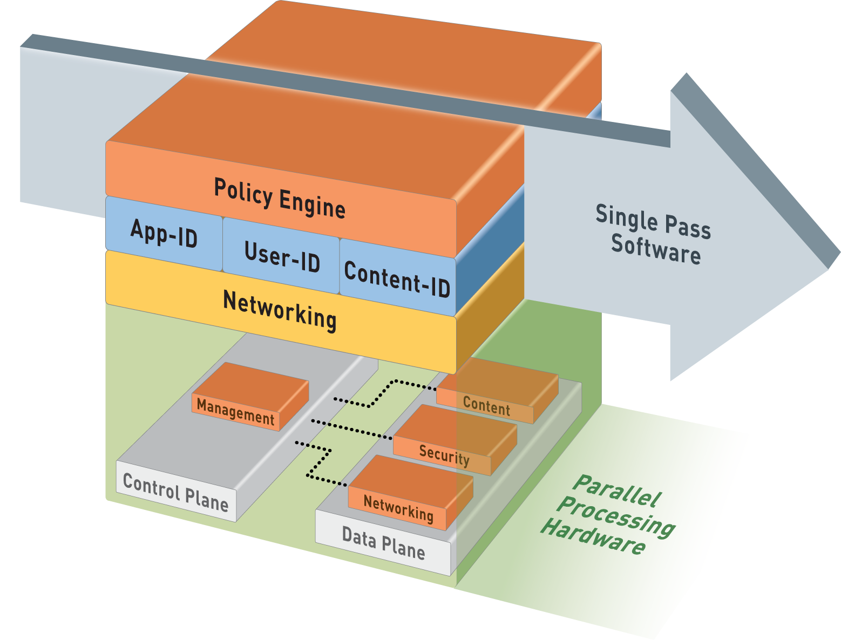
Single-Pass Parallel Processing (SP3) Architecture
Single Pass
Operations once per packet
  Traffic classification (app identification)
  User/group mapping
  Content scanning – threats, URLs, confidential data
One policy
Parallel Processing
Function-specific hardware engines
Separate data/control planes
Up to 10Gbps, Low Latency
Notes:
21
21

Slide 22






Your Control With A Palo Alto Networks NGFW
© 2010 Palo Alto Networks. Proprietary and Confidential.

Slide 23
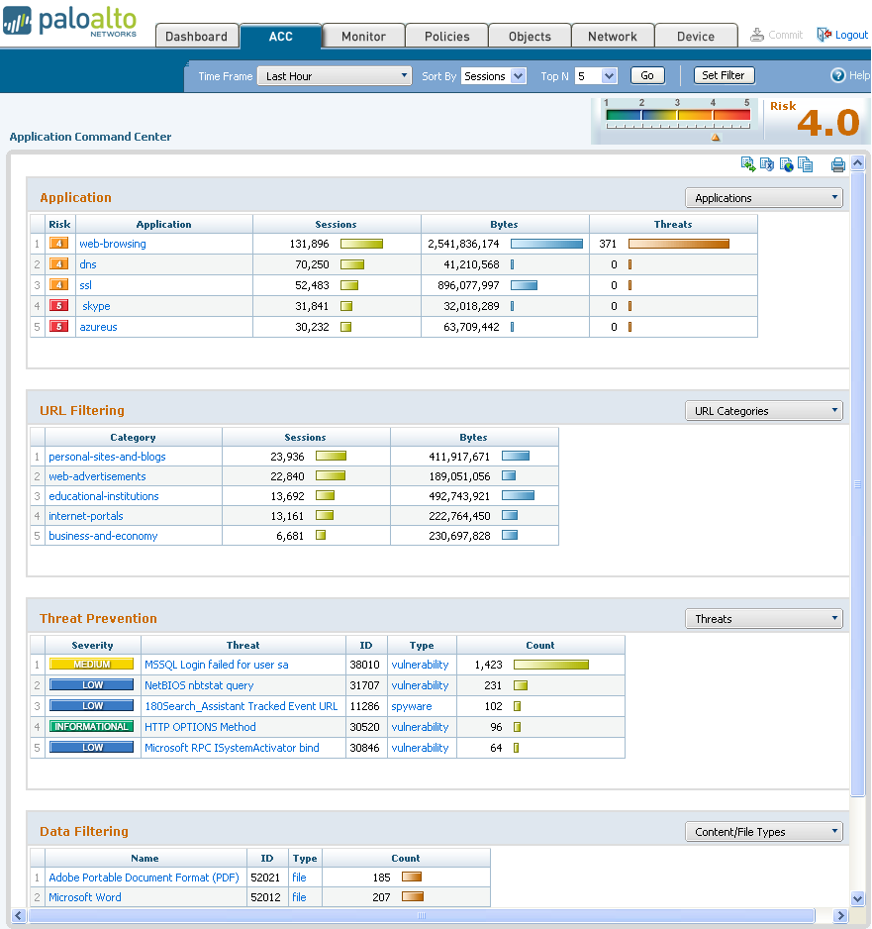
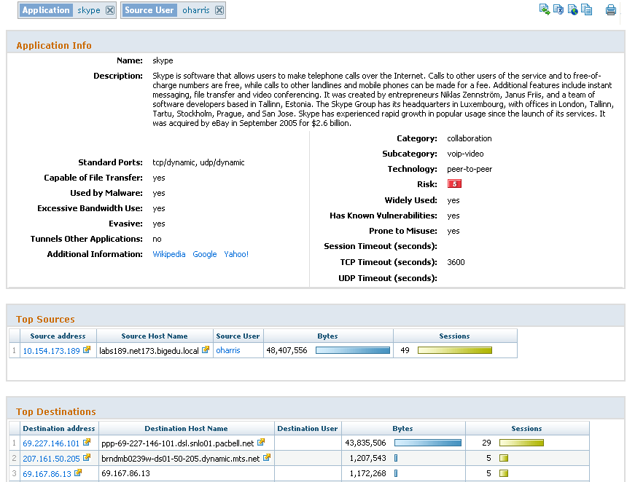
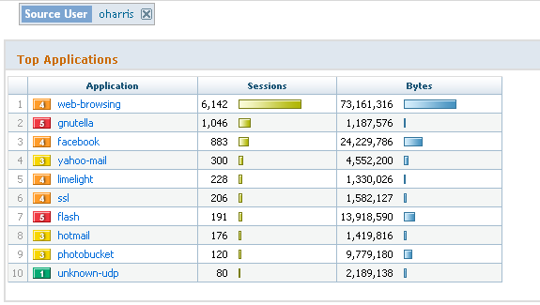
Visibility into Application, Users & Content
Application Command Center (ACC)
  View applications, URLs, threats, data filtering activity
Mine ACC data, adding/removing filters as needed to achieve desired result
Filter on Skype
Filter on Skype
and user harris
Remove Skype to
expand view of harris

Slide 24
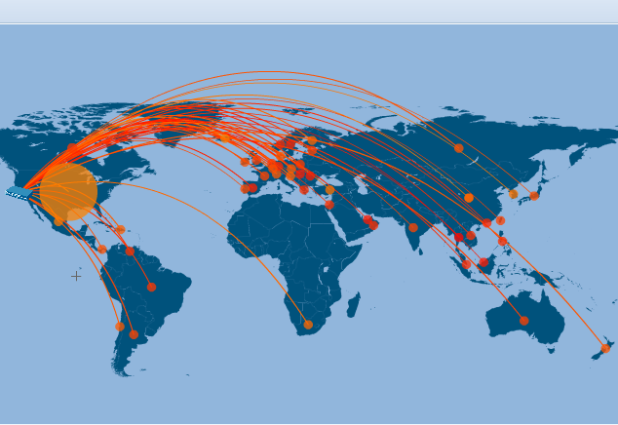
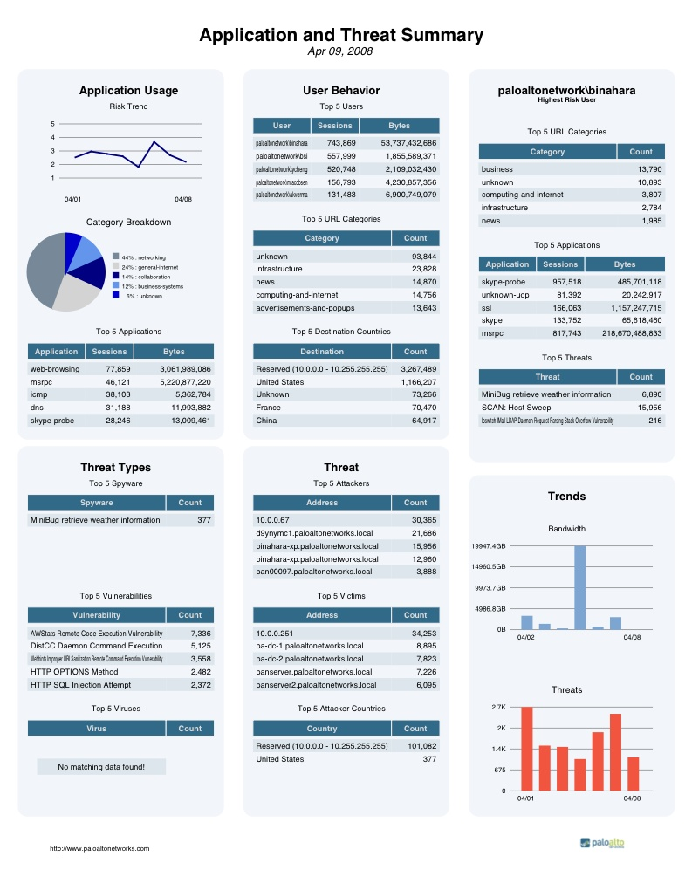
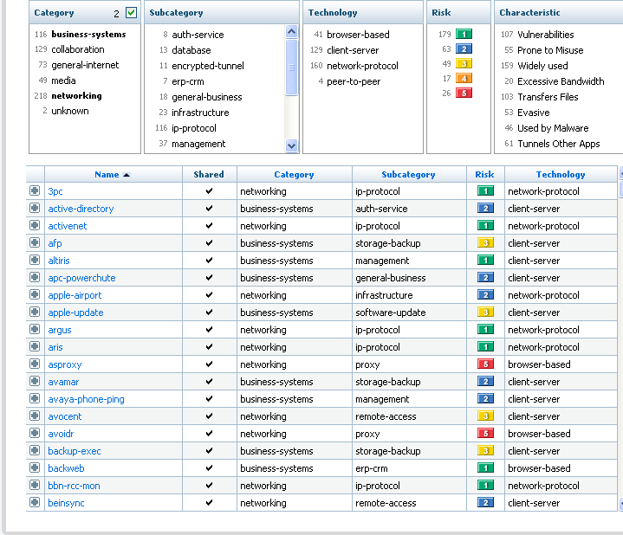
Enables Visibility Into Applications, Users, and Content
© 2008 Palo Alto Networks. Proprietary and Confidential.
Page 24 |
© 2008 Palo Alto Networks. Proprietary and Confidential.
Page 24 |
Notes:
24
24

Slide 25



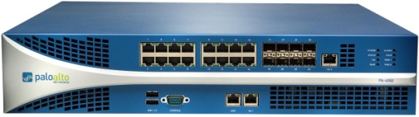

The Right Answer: Make the Firewall Do Its Job
New Requirements for the Firewall
1. Identify applications regardless of port, protocol, evasive tactic or SSL
2. Identify users regardless of IP address
3. Protect in real-time against threats embedded across applications
4. Fine-grained visibility and policy control over application access / functionality
5. Multi-gigabit, in-line deployment with no performance degradation

Slide 26
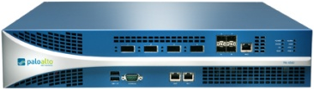


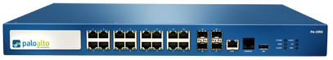
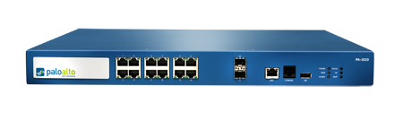
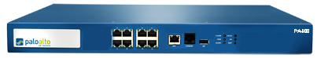
A True Firewall: PAN-OS Features
Strong networking foundation
  Dynamic routing (OSPF, RIPv2)
  Site-to-site IPSec VPN
  SSL VPN for remote access
  Tap mode – connect to SPAN port
  Virtual wire (“Layer 1”) for true transparent in-line deployment
  L2/L3 switching foundation
QoS traffic shaping
  Max/guaranteed and priority
  By user, app, interface, zone, and more
Zone-based architecture
  All interfaces assigned to security zones for policy enforcement
High Availability
  Active / passive
  Configuration and session synchronization
  Path, link, and HA monitoring
Virtual Systems
  Establish multiple virtual firewalls in a single device (PA-4000 Series only)
Simple, flexible management
  CLI, Web, Panorama, SNMP, Syslog
10Gbps; 5Gbps threat prevention (XFP interfaces)
PA-4060
10Gbps; 5Gbps threat prevention
PA-4050
2Gbps; 2Gbps threat prevention
PA-4020
1Gbps; 500Mbps threat prevention
PA-2050
500Mbps; 200Mbps threat prevention
PA-2020
250Mbps; 100Mbps threat prevention
PA-500
Notes:
26
26

Slide 27
Addresses Three Key Business Problems
Identify and Control Applications
  Visibility of 4000+ applications, regardless of port, protocol, encryption, or evasive tactic
  Fine-grained control over applications (allow, deny, limit, scan, shape)
  Addresses the key deficiencies of legacy firewall infrastructure
Prevent Threats
- Stop a variety of threats – exploits (by vulnerability), viruses, spyware
- Stop leaks of confidential data (e.g., credit card #, social security #
- Stream-based engine ensures high performance
- Enforce acceptable use policies on users for general web site browsing
Simplify Security Infrastructure
- Put the firewall at the center of the network security infrastructure
- Reduce complexity in architecture and operations

Slide 28
Security needs to be flexible!
Global Protect!

Slide 29









GlobalProtect: Complete Security Coverage Solution
Consistent policy applied to all enterprise traffic:
Users protected from threats off-network, plus application and content usage controls
User profile incorporated into consistent enterprise security enforcement
Enterprises gain same level of control of SaaS applications as when previously hosted internally
Users
Headquarters
Branch Office
Hotel
Home
Consistent Security

Slide 30
The Proof!

Slide 31

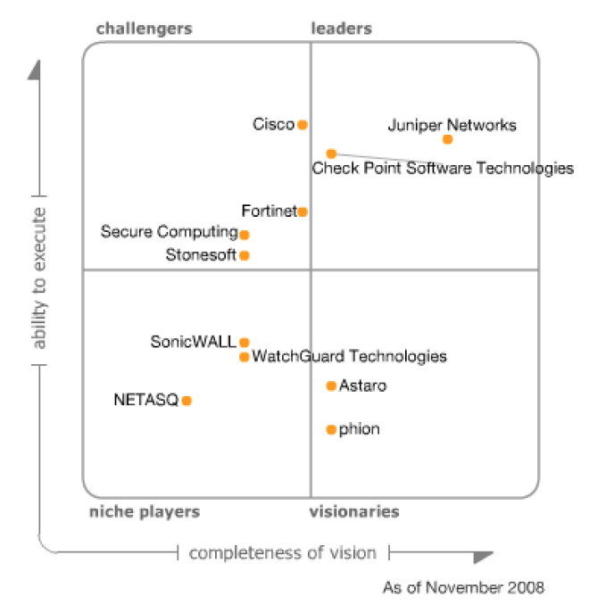
2010 Magic Quadrant for Enterprise Network Firewalls
Cisco
Juniper Networks
Fortinet
McAfee
Check Point Software Technologies
ability to execute
Stonesoft
Palo Alto Networks
SonicWALL
WatchGuard
NETASQ
phion
Astaro
3Com/H3C
niche players
visionaries
completeness of vision
As of March 2010
Source: Gartner

Slide 32

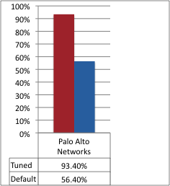
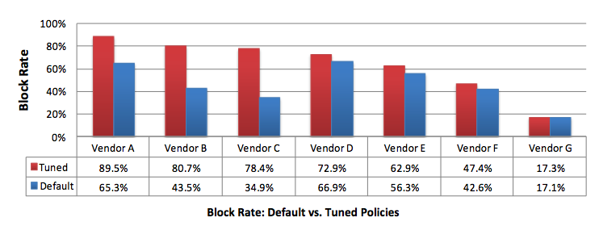
Proven IPS Quality
Summary of NSS Labs results
Standalone Test
Q3 2010
NSS Group Test
Q4 2009
Read the full Palo Alto Networks Report here
Get more information on the 2009 Group Test here

Slide 33
Thank You

Slide 34

App-ID
Page 29 |
Page 29 |
© 2009 Palo Alto Networks. Proprietary and Confidential
© 2007 Palo Alto Networks. Proprietary and Confidential

Slide 35







What is an Application?
GMail
GTalk
Google Calendar
iGoogle
Siebel CRM
eMule
UltraSurf
Notes:
The term “application” is not an industry accepted definition like “session” or “packet”. Applications can be delivered through a web browser, a client server model or a de-centralized peer to peer design. In the terms of Palo Alto Network firewalls an Application is a specific program or feature that can be detected, monitored and blocked if necessary.
When a user loads the iGoogle home page, depending on what widgets have been added, the single page may hold multiple “Applications”. While a traditional firewall, proxy or web filtering device would see this as a singe site / session, Palo Alto would see this as multiple applications.
Applications will include business tools and services, which will need to be allowed, as well as entertainment or personal services which may need to be blocked.

Slide 36
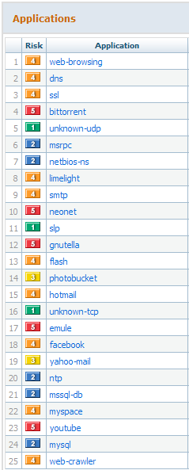
Traditional Systems Cover Portions of the Problem
Some port-based apps caught by firewalls (when well-behaved)
Some web-based apps caught by URL filtering or proxy
Some evasive apps caught by IPS
None give a comprehensive view of what is going on in the network
Notes:
One of the strengths of the ACC is that it provides a single location for viewing multiple types of applications. It is important to note that the total for “web-browsing” does not include the sessions and packets for web based applications such as Facebook. They are two different applications. Web-browsing represents all access to html pages that are not identified as another application.
Traditional solutions use multiple devices and policy sets to control applications based on how the application is delivered.
Port Based firewalls control static port based applications
Proxy and Web Filtering solutions attempt to control web based applications.
IPS systems try and detect port hopping or evasive applications.
Each system generates it’s own reports and none provide the overall view of the network traffic.

Slide 37
App-ID: Comprehensive Application Visibility
Policy-based control more than 900 applications distributed across five categories and 25 sub-categories
Balanced mix of business, internet and networking applications and networking protocols
3 - 5 new applications added weekly
App override and custom HTTP applications help address internal applications

Slide 38




Application Identification
Engine detects initial application regardless of port and protocol – decrypts SSL if necessary
Engine decodes protocol in order to apply additional application signatures as well as to detect vulnerabilities, viruses, spyware, and sensitive information
Engine checks applicable signatures to see if a more specific application is tunneling over the base protocol or application
If no match is found heuristics are applied to detect application that use proprietary encryption and port hopping

Slide 39




Application Examples
 |  | Tunneled App Example | SSL Example | Heuristic Example
 |  | Detect SMTP protocol | Decrypt SSL and discover internal HTTP protocol | ???
 |  | Decode SMTP protocol fields | Decode HTTP protocol fields | ???
 |  | Apply signatures to detect HOSProxy | Apply signatures to detect Meebo | ???
 |  |  |  | Skype, Ultrasurf, eMule, Bitorrent

Slide 40
User-ID

Slide 41
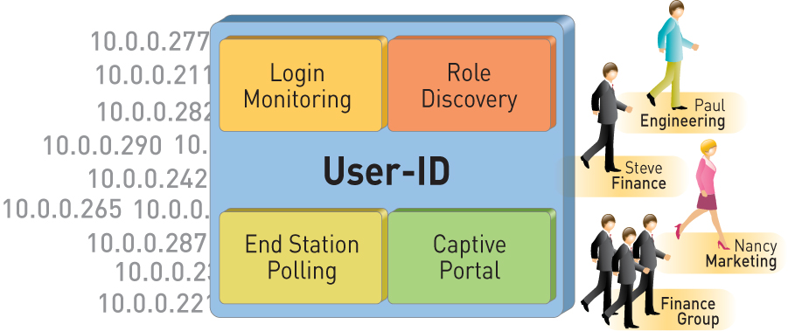
User-ID: Enterprise Directory Integration
Users no longer defined solely by IP address
  Leverage existing Active Directory infrastructure without complex agent rollout
  Identify Citrix users and tie policies to user and group, not just the IP address
Understand user application and threat behavior based on actual AD username, not just IP
Manage and enforce policy based on user and/or AD group
Investigate security incidents, generate custom reports
Notes:
Unobtrusive deployment: Unlike traditional firewalls that require re-authentication, the Palo Alto Networks agent works seamlessly
No change to the Active Directory (AD) server or the user PCs
The user identification agent is deployed on a windows workstation or on the AD server
Multiple agents can be deployed; one agent can communicate with multiple devices

Slide 42

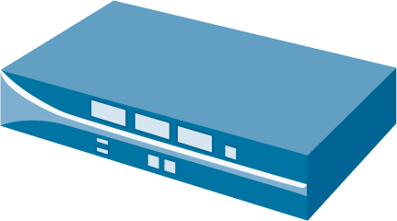




User-ID Mechanism
Agent provides access to user and group information to the firewalls
When a user logon occurs, agent detects this and sends user to IP mapping to firewall
Agent will periodically poll end stations to determine if user has moved
Correlated user information is available in ACC, logs, and reports
User and/or group information can be used in policy
User Identification Agent
Security Logs
Domain Controller
User & Group Info
User-to-IP Mapping
NetBIOS Probe
Logon
Corporate Users

Slide 43
Content-ID

Slide 44
Content-ID: Real-Time Content Scanning
Detect and block a wide range of threats, limit unauthorized data transfer and control non-work related web surfing
Stream-based, not file-based, for real-time performance
  Uniform signature engine scans for broad range of threats in single pass
  Vulnerability exploits (IPS), viruses, and spyware (both downloads and phone-home)
Block transfer of sensitive data and file transfers by type
  Looks for CC # and SSN patterns
  Looks into file to determine type – not extension based
Web filtering enabled via fully integrated URL database
  Local 20M URL database (76 categories) maximizes performance (1,000’s URLs/sec)
  Dynamic DB adapts to local, regional, or industry focused surfing patterns

Slide 45
Content-ID Uses Stream-Based Scanning
 | File-based Scanning | Stream-based Scanning
ID Content
ID Content
Buffer File
Scan Content
Scan File
Deliver Content
Deliver Content
Time
Time
Stream-based, not file-based, for real-time performance
  Dynamic reassembly
Uniform signature engine scans for broad range of threats in single pass
Threat detection covers vulnerability exploits (IPS), virus, and spyware (both downloads and phone-home)

Slide 46
Microsoft Security Bulletins
Active member in MAPP (Microsoft Active Protections Program)
  Receive early access to Microsoft vulnerability info
Close working relationship with Microsoft
  Threat researchers closely collaborating with Microsoft on new ways to research vulnerabilities
Responsible for discovering 17 Microsoft vulnerabilities over the last 18 months
  7 Critical and 2 Important severity already published
  8 Microsoft vulnerabilities are currently pending
Notes:
We have a close working relationship with Microsoft relative to vulnerabilities and other malware. We have been credited for discovery of 9 vulnerabilities within the last 18 months or so with even more vulnerabilities pending. We were part of the initial group of companies invited to participate in the Microsoft Active Protection Program. We are under strict NDA relative to MAPP, so details of what Microsoft provides and the timeframe may not be discussed. But it is safe to say that prior to any Microsoft security bulletin, Palo Alto Networks receives vulnerability information from Microsoft prior to the public release. What that means for our customers is timely updates (same day as Microsoft’s public release) to Microsoft related security issues.

