Slide 1


Data on the Edge:
Protecting Your Vital Information
Raivis Kalnins
Technical consultant @ headTechnology Baltics Ltd
Value Added Distributor
Stallion Autumn Seminar,
11th November 2009 in Tallinn

Slide 2




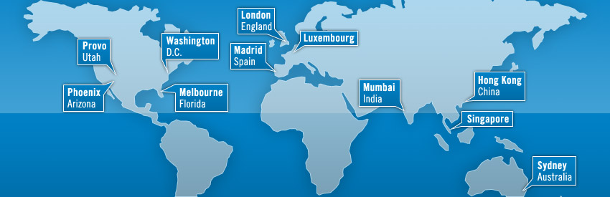
Lumension Business card

Slide 3












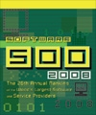



Awards & Certifications
Leading global security management company, providing unified protection and control of all enterprise endpoints.
  Ranked #14 on Inc. 500 list of fast growing companies
  Ranked #1 for Patch and Remediation for 4 consecutive years
  Ranked #1 Application and Device Control
  Over 5,100 customers and 15 million nodes deployed worldwide
Award-Winning, Industry Recognized and Certified

Slide 4




















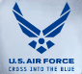









































Industries and sectors
Education
Financial
Government/ Military
Health Care
Manufacturing
Miscellaneous
Services
Transportation/Utilities
Dolphin Drilling
Media
Legal
Charities
Bishop’s Stortford
College

Slide 5













Global partners

Slide 6
Data Theft - A complex task?

Slide 7
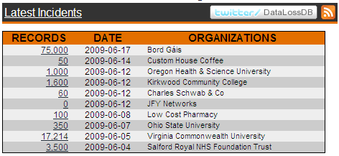
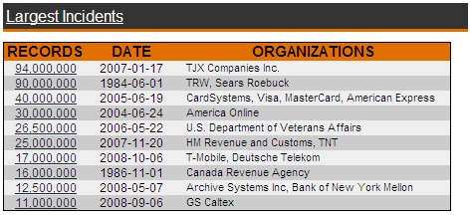
Data Theft – A complex task?
www.datalossdb.org

Slide 8
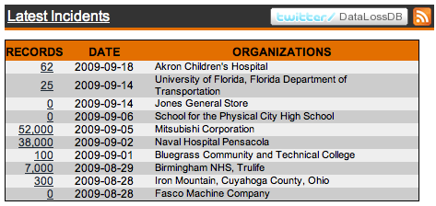
Incident sources
Inside - Accidental
Stolen Documents
Stolen Documents
Inside -Unknown
Lost Tape

Slide 9

Data Theft by Company Insider for Financial Gain
Boeing Employee Charged With Stealing 320,000 Sensitive Files
July 11, 2007
A disgruntled Boeing employee was charged Tuesday with 16 counts of computer trespass for allegedly stealing more than 320,000 company files over the course of more than two years and leaking them to The Seattle Times.
Boeing estimated that if only a portion of the stolen documents were given to competitors, it could cost the company between $5-$15 billion.
The employee used his "unfettered access to Boeing systems" to download large amounts of data from information stores he had no legitimate reason for accessing. He allegedly transferred the information to a thumb drive and then removed it from company property.

Slide 10
Data Theft – A complex task?
1. None of the incidents
required special knowledge
2. All of the incidents related to endpoints

Slide 11
Incident sources
Stolen / lost records in 2007
Stolen / lost records in 2008
(source: datalossdb.org)

Slide 12
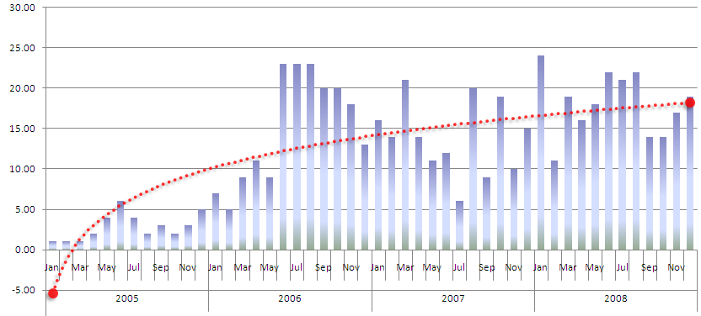
Lost / stolen devices in the last 4 years
Lost / Stolen Devices
N. of Records on Lost / Stolen Devices
(Source: datalossdb.org)

Slide 13
Social Engineering the USB way
Security Audit at a credit union
(Source: http://www.darkreading.com)
Step 1
Prepare 20 USB drives with a trojan horse that gathers critical data (such as user account information) from the PC it is connected to and sends it by email
Step 2
Drop these USB drives within the accomodations of the company
Step 3
Wait 3 days ...
Result
15 out of 20 drives have been used by employees, critical data from their PC‘s has been exposed

Slide 14
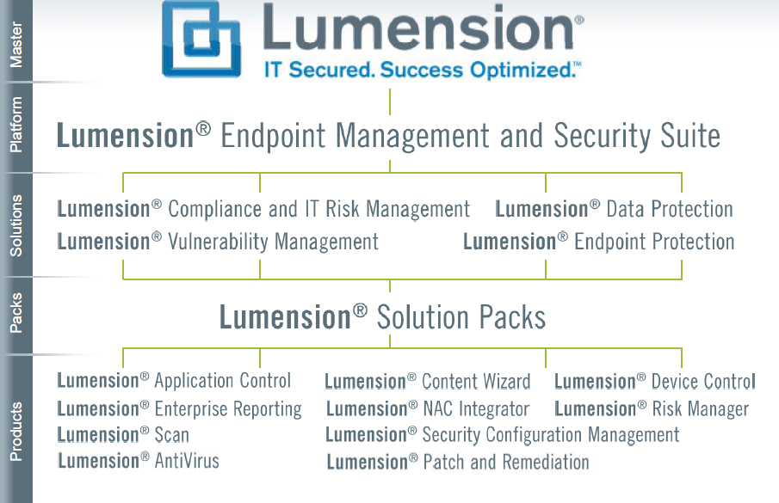
Lumension Brands
AntiVirus

Slide 15
Lumension Device Control

Slide 16





Product Operation – Device Control
Directory Service
Users
User Groups
Identify
Devices
Create
Whitelist
Assign Access
Attributes
Predefined Classes
Specific Brand / Type
Devices
Unique Device
CD / DVD ROMS
MODEMS
REMOVABLE MEDIA
USB PRINTERS
etc...

Slide 17





How Device Control works
User
Kernel Driver
Device White List
Device Access Request
Known Device Check
Known Device?
Device Policies
Users, Groups,
Machines,
Device Classes and
Access Attributes
Authorization?
Device Access

Slide 18
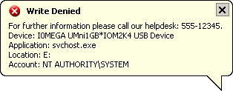
How Device Control works
User
Kernel Driver
Device White List
Device Access Request
Known Device Check
Known Device?
Device Policies
Users, Groups,
Machines,
Device Classes and
Access Attributes
Authorization?
No Access

Slide 19
How Device Control works
User
Kernel Driver
Device White List
Device Access Request
Known Device Check
Known Device?
No Access
Device Policies
Users, Groups,
Machines,
Device Classes and
Access Attributes

Slide 20





Implementing Device Control
Requirement Gathering
Security Requirements
Operational Implications
Sales
Use Memory Keys
Only with encryption
Audit of copied data
Standard rule for sales to use memory keys with decentralized encryption and shadowing
Wireless Network
Only outside corporate network
Offline rule for notebooks with wireless cards
Marketing
Usage of digital cameras
Only during business hours
No misuse as data storage
Time-based rule for digital camera usage, with filter on image data (JPG, GIF, BMP)
Usage of CD‘s / DVD‘s
Only specific media
Explicit assignment of specific media

Slide 21



Implementing Device Control
Requirement Gathering
Security Requirements
Operational Implications
Front Desk
Badge printing
Deny usage of any other device
Machine-based „Lockdown“, standard rule for local printer
Support Dept.
Usage of customer devices
Prevent data loss (custromer data / internal data)
Standard rule for Read Only-access to customer devices
Production server
Maximum stability
Deny any device usage
Machine-based „Lockdown“

Slide 22
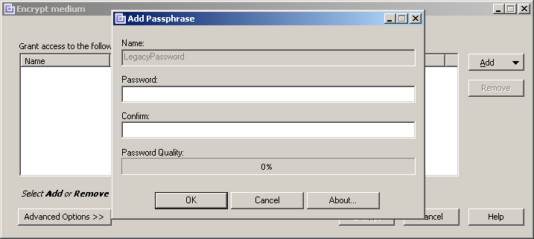
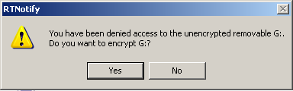
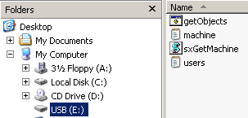
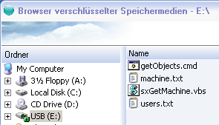
Encryption with Device Control
1) Administrator creates encryption rule
2) User plugs in memory key
3) Transparent encryption on corporate
computers
4) Volume Browser tool on stick for
3rd party computers

Slide 23

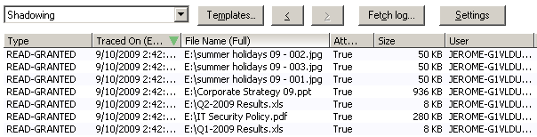
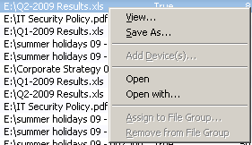
Patented Shadowing with Device Control
Configured with a few clicks…
Detailed central reporting
Direct file access

Slide 24
Access Attributes
Read and / or Write
Scheduled Access
  From 08:00h to 18:00h Monday to Friday
Temporary Access
  For the next 15 minutes
  Starting next Monday, for 2 days
Online / Offline
  Assign permissions when no network connection is present, all device classes supported
Quota Management
  Limit copied data to 100 MB / day
Encryption enforcement
  Access is granted only if medium has been encrypted (decentralized encryption) with password recovery option
File Type Filtering
  Limit the access to specific file types

Slide 25
Attributes can be allocated to...
A complete device class
  All USB Printers
A device sub class
  USB printer HP 7575, CD/DVD Nec 3520A
A unique device based on
  Encryption
  serial number
Specific CD‘s / DVD‘s
Specific Bus (USB, IrDa, Firewire...)
Groups of devices

Slide 26
Security Features
Kernel Driver
  Invisible (no task manager process)
  Fast (no performance loss)
  Compatible (no conflict with other software)
Encryption of devices with AES
  AES 256 = market standard
  Fast and transparent within the network
  Strong password enforcement for usage outside the corporate network
Client / Server Traffic
  Private/Public key mechanism
  Impossible to tamper with
  Easily generated and deployed

Slide 27
Security Features
Client Hardening
  Even a local administrator cannot uninstall the client
Prevention from Keyloggers
Removable Media Encryption
  Assign any removable media to any user and then encrypt the media. Encrypted device is accessible only by the user who owns the access rights on the removable media
Offline Protection
  Local copy of the latest devices access permission list stored on the disconnected workstation or laptop

Slide 28
Auditing & Logging
User Actions Logging
  Read Denied / Write denied
  Device entered / Medium inserted
  Open API for 3rd party reporting tools
Shadowing of all copied data
  Level 1: shows File Name and attributes of copied data
  Level 2: Captures and retains full copy of data written to extenal device or read from such a device
Administrator Auditing
  Keeps track of all policy changes made by SDC admins

Slide 29
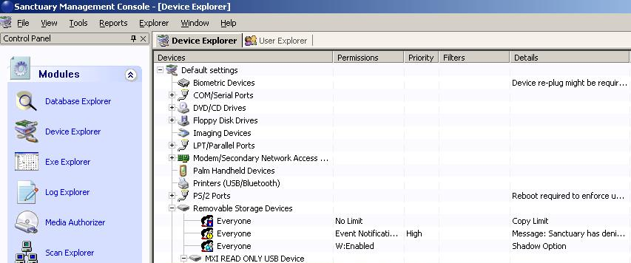
Lumension Device Control
Enables only authorized removable (peripheral) devices to connect to network, laptop, thin client, laptop and desktop
Reduces risk of data theft, data leakage and malware introduction via unauthorized removable media
Assures and proves compliance with the landslide of regulations governing privacy and accountability

Slide 30
DEMO

Slide 31
Thank You

