Slide 1
Application Usage and Threat Report – Global Findings
February 2013

Slide 2
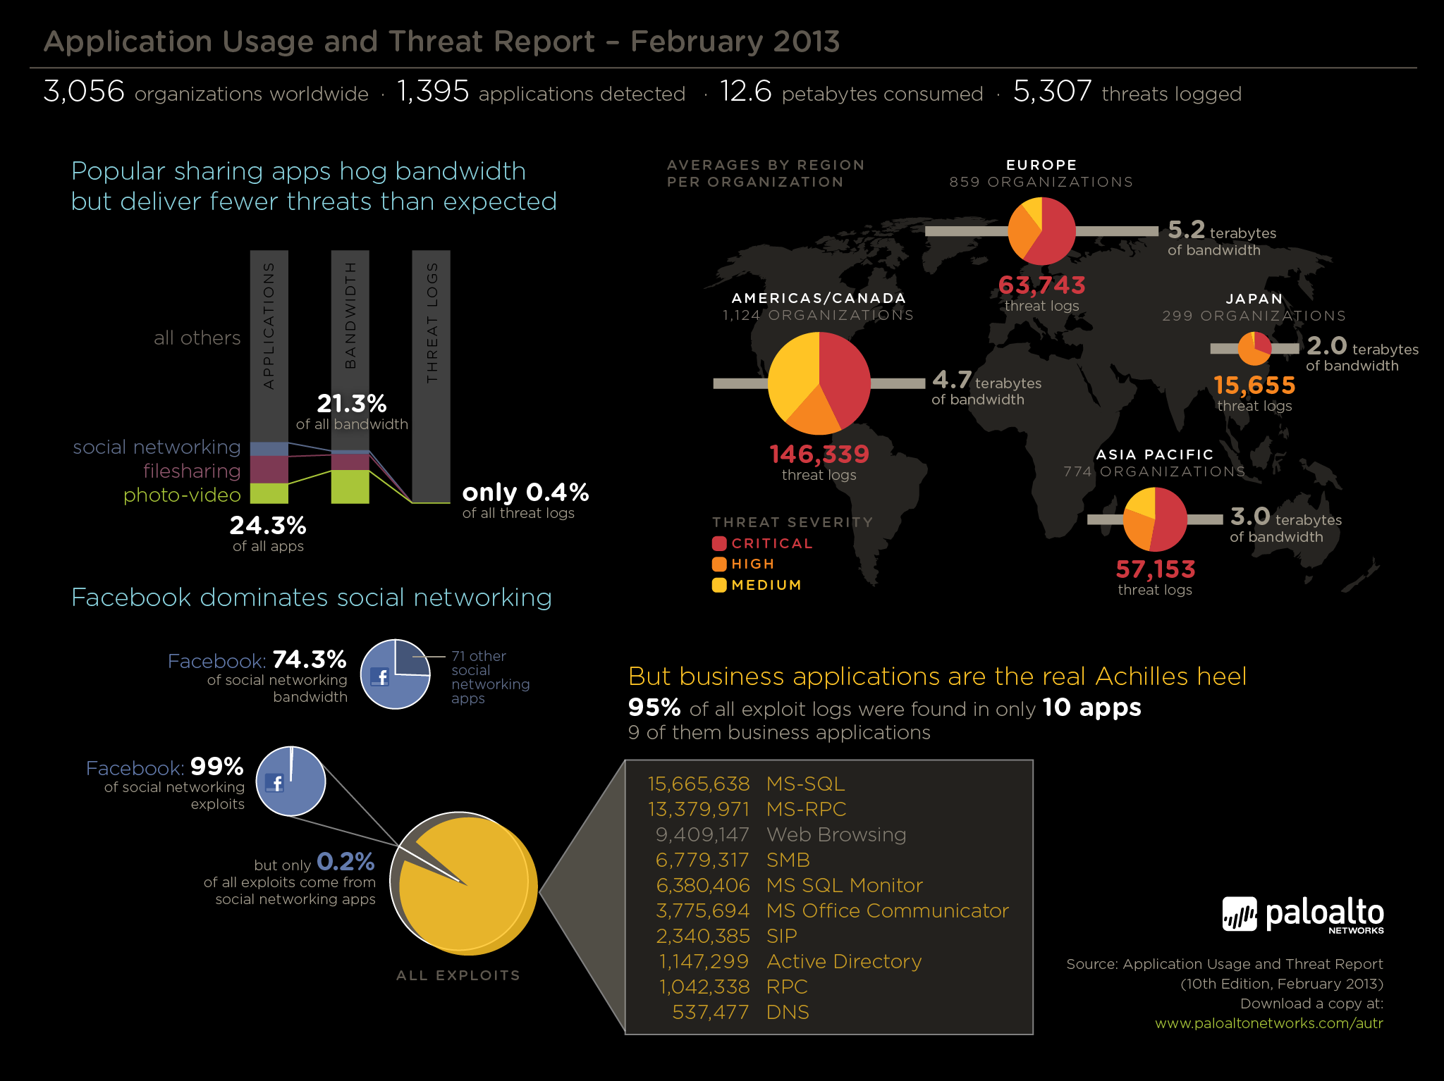

Slide 3
Key Findings
Analyzed three groups of applications on more than 3,000 networks – personal use, business use and custom or unknown
When does 25% + 20% =0.4%?
25% of the applications, 20% of the bandwidth, only 0.4% of the threat logs
Social networking exploit logs outnumber malware logs by a ratio of 49:1
Facebook-apps = #1 volume leader in exploit logs viewed within social networking
Crunchy on the outside, tender on the inside
10 applications were responsible for 97% of all exploit logs observed
Nine of them are internal applications – they accounted for 82% of the exploit logs
Custom/Unknown traffic epitomizes the 80%-20% rule
7 applications were responsible for 99.99% of the malware logs observed
Custom or unknown traffic was the #1 volume leader = 53% or malware logs, but only 2% of overall traffic
Hiding in plain sight
26% of the applications found can use SSL- many use non-standard ports; 86 of never touch tcp/443
Notes:
When does 25% + 20% =0.4%? When it’s the applications everybody uses introduce fewer threats than expected
Collectively, social networking, filesharing and photo-video applications represented 25% of the applications (339) and 20% of total bandwidth (890,000+ 2hr high-definition movie downloads), but only 0.4% of all threat logs observed.
Exploit logs outnumber malware logs by a ratio of 49:1
Facebook-apps = #1 volume leader in exploit logs viewed within social networking
Crunchy on the outside, tender on the inside - Exploits continue to target enterprise’s most valued assets – the internal ones
97% of all exploit logs were found in ten applications; nine of them applications are internal/infrastructure applications (databases, active directory, RPC, etc.) and they accounted for 82% of the exploit logs
Custom/Unknown traffic epitomizes the 80%-20% rule - Malware relies heavily on custom applications
99.99% of all malware logs were found in only seven (out of 1,395) applications with custom/unknown-UDP representing the highest volume at 55%.
Custom or unknown traffic was the #1 volume leader = 53% or malware logs - but only 2% of overall traffic
26% of the applications (356) use SSL in some way shape or form; these applications represent roughly 10% of total bandwidth.
SSL by itself represented 5% of total bandwidth, 7% of all sessions and the second highest number of malware logs – primarily command and control traffic.
85 of the 356 applications that use SSL, never use port 443, nor do they use SSL defined ports (37 hop ports, 28 use tcp/80, 20 use ports other than tcp/443).

Slide 4
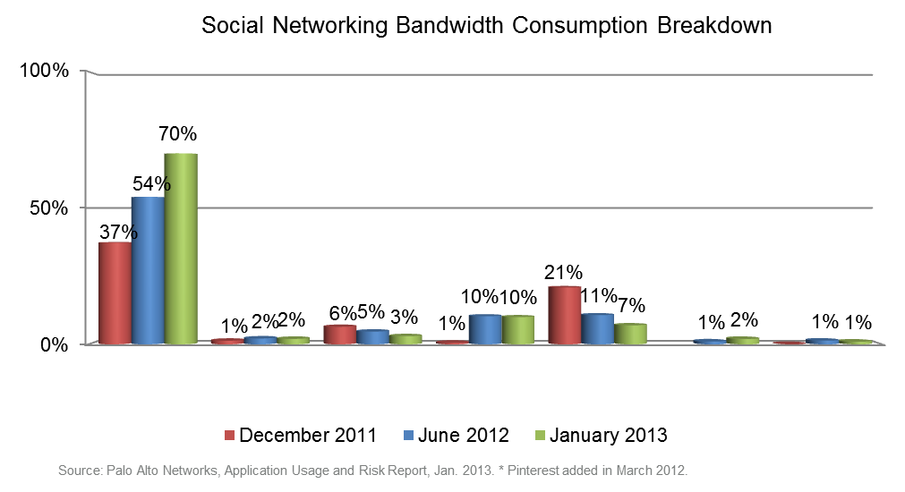
Facebook Domination Continues
Facebook
Facebook- posting
Facebook- social plugin
Tumblr
Twitter
Pinterest*
Google+
Four Facebook functions = 75% of all social networking bandwidth
How will the other 70 social networking applications survive?
Notes:
The Facebook domination within social networking continues unabated, despite the emergence of new offerings and the re-emergence of older offerings.
75 different social network applications were found that consumed 1% of the total bandwidth; on average 17 variants were found on 92% of the 3,056 networks observed.
Tumblr: Tumblr maintained its position behind Facebook – it was detected in 85% of the organizations and it consumed 10% of the social networking bandwidth. From a business use case perspective, Tumblr currently still has fairly limited appeal. The data in this report was collected before the Tumblr worm outbreak in December 2012, and thus that event is not reflected in this report., It does however highlight the balance organizations will need to take when deciding whether or not to allow Tumblr usage.
Pinterest: Pinterest showed steady growth as more organizations add it to their social media applications (and as more users sign up). 85% of the participating organizations had Pinterest on their networks, up 5-fold from 15% in Spring 2012. Social networking bandwidth consumed by Pinterest doubled to 2%.
MySpace and Google+: Lost in the Facebook tidal wave is the re-emergence of MySpace and Google+. MySpace-browsing continues to be found in roughly 65% of the participating organizations when viewed in year-over-year comparisons. Google+ exhibited very little growth in terms of usage by enterprises, or by users while at work. The two data points that support this are that the frequency of use (85% of the organizations had at least one user) and the bandwidth consumption remains unchanged at 1% if all social networking bandwidth. Most of the usage would appear to be users checking updates since Google+ posting was found in only five organizations (out of 3,056), compared to 2,550 instances of Facebook-posting and 1,471 instances of LinkedIn-posting.

Slide 5
Social Networking Trends in Usage and Threats
75 social networking variants, average of 17 on 95% of the networks
Total bandwidth consumed = 2% (68,000 2Hr high-def movie downloads)
Unique threats observed (malware + exploits) = 117
Total threat logs viewed = 0.18%; Exploit logs outnumber malware logs: 49:1
Facebook-apps represent 97% of social networking exploit logs
Block Facebook-apps with a single rule – reduce risk, without impeding social media initiatives
Google + used in 65% of the organizations – no one is posting though; Google + posting found in only 5 organizations (out of 3.056)
Myspace continues to be found in 65% of the organizations; myspace posting = highest bytes/session within social networking
Notes:
Out of the 5,303 individual threats observed, 117 were found within social networking applications.
The total threat logs within social networking was surprisingly low - a mere 0.18% of all threat logs viewed. Within the social networking threats logs observed, the ratio of exploit to malware logs was 49:1.
Of the 75 social networking applications, four of the Facebook functions are identified separately, (Facebook-base, -apps, -posting, and social-plugins) allowing organizations to enable some, while disabling others. These four Facebook functions consumed 75% of all social networking bandwidth.
MySpace and Google+: Lost in the Facebook tidal wave is the re-emergence of MySpace and Google+. MySpace-browsing continues to be found in roughly 65% of the participating organizations when viewed in year-over-year comparisons. Google+ exhibited very little growth in terms of usage by enterprises, or by users while at work. The two data points that support this are that the frequency of use (85% of the organizations had at least one user) and the bandwidth consumption remains unchanged at 1% if all social networking bandwidth. Most of the usage would appear to be users checking updates since Google+ posting was found in only five organizations (out of 3,056), compared to 2,550 instances of Facebook-posting and 1,471 instances of LinkedIn-posting.
The Facebook-apps App-ID collectively identifies the many thousands of custom Facebook applications and widgets, many of which are designed for personal use. A quick scan of the list shows an emphasis on computer games, music, video, and travel applications – most of which will have limited business value to enterprises. Of the 75 social networking applications, Facebook-apps was detected in 74% of the participating organizations and displayed 97% of all social networking threat logs, the majority of which being a high severity HTTP cross-site scripting exploit. Separating exploits and malware within the social networking group, Facebook-apps represents 99% of the social networking exploit logs viewed.
The heavy presence of cross-site scripting attacks within Facebook-apps was of particular note. These attacks allow an attacker to deliver malicious input to an insecure web application, which in turn can then reflect malicious content to an unsuspecting user, who also uses the web application. These attacks are well known and web application developers spend significant effort to ensure their applications are not vulnerable. However, Facebook has a vast number of applications that are often developed by enthusiasts who may not appreciate the security consequences of their application. Even though such problems were not found to be common in Facebook apps, a small number of applications were responsible for a very large number of cross-site scripting attacks.

Slide 6
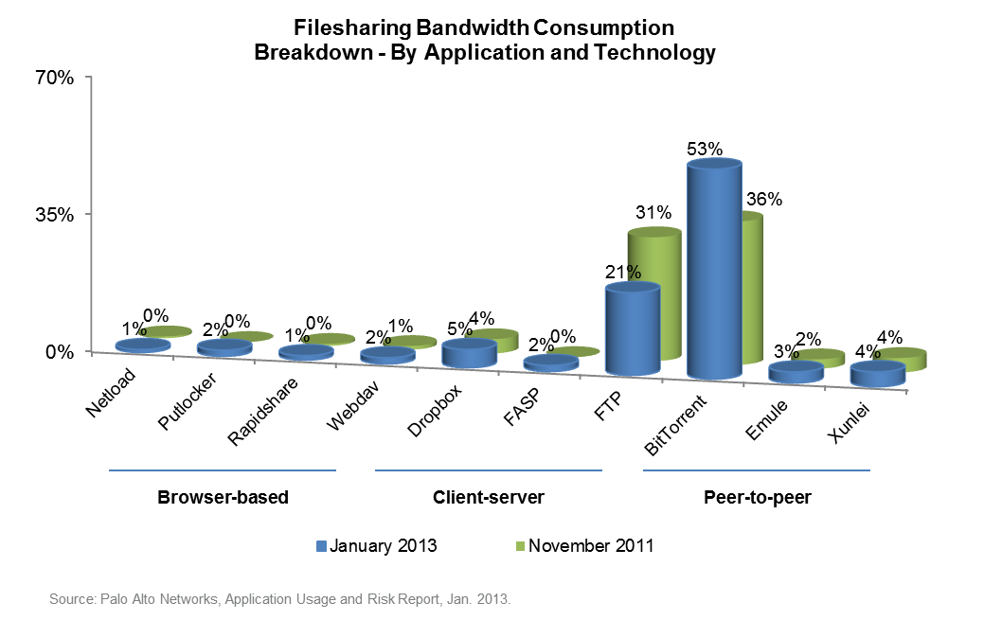
Filesharing Usage Diversifies
Bandwidth consumption diversifies, still dominated only by BitTorrent
152 filesharing applications = 6% of ALL bandwidth; BitTorrent = 3%
Notes:
In the past, the filesharing usage patterns were clearly delineated between those that use high amounts of bandwidth (peer-to-peer, client-server) and those that were used with high frequency (browser-based). Looking at the bandwidth consumed by the top-10 file sharing applications, the usage patterns seen in this dataset are spread more evenly across the three technologies. The largest contributor to the balancing of the three technologies is the migration of Dropbox from a browser-based application to a client-server application. The very early versions of Dropbox did not require a user to install a client upon registration – it does so now. Once the account is established, a user can then access their folders via a browser. This, combined with the steady growth of Dropbox, balances the technology breakdown of the top-10 file sharing applications.

Slide 7
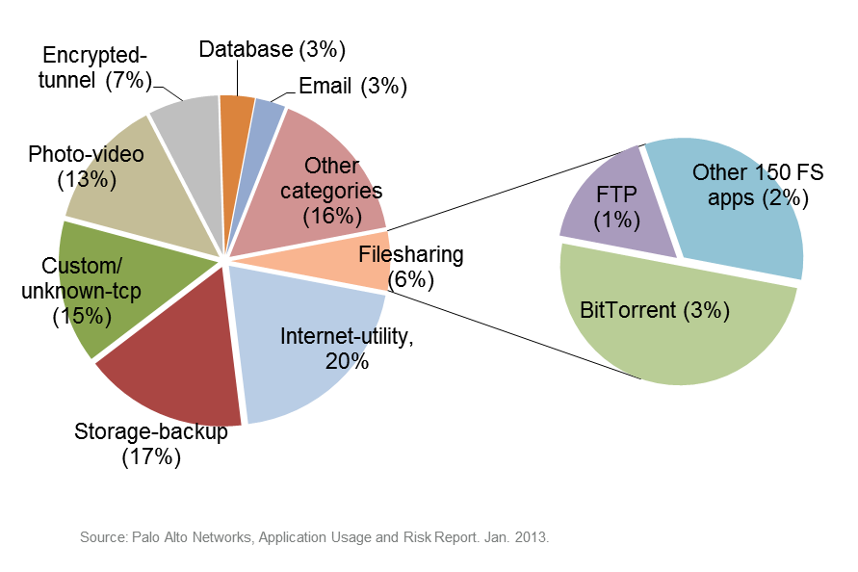
BitTorrent, Its Like Mint….You Can’t Get Rid of it
BitTorrent found 65% of the time, 3% of all bandwidth ~140,000 2Hr high-def movie downloads

Slide 8
Filesharing Trends in Usage and Threats
152 filesharing applications found: 42 C/S, 73 browser-based, 37 P2P
Average variants found per network: 6 C/S, 13 browser-based, and 5 p2p
Filesharing bandwidth consumption: 6% (6th highest), roughly 264,000 High def movie downloads
The top 10 filesharing = 3 P2P, 3 client/server, 4 browser-based.
92% of the filesharing bandwidth
98% of the respective threat logs observed
FTP and Webdav = highly targeted by exploits
Browser-based market gets more crowded
New offering from Kim Dotcom = Mega, will encrypt every file uploaded
EMC Syncplicity goes after Box.net
Notes:
File sharing applications displayed the 3rd highest volume of unique threats with 325 discovered across 38 of the 152 application variants. The majority of the unique threats found were exploits.
Browser-based filesharing: There were 153 threats detected within the twenty browser-based applications (out of 73 variants total) with WebDAV being the most heavily targeted with 98 of the (153) threats and 28% of all threat logs viewed. The most commonly detected threat was a high severity PHP remote file inclusion exploit.
Client-Server filesharing: Nine of the 37 client-server applications displayed 150 threats with FTP being the most heavily targeted based on unique threats (131) and logs viewed (64% of file sharing threat logs viewed). The most common threat found was a critical severity FTP evasion exploit.
Peer-to-peer filesharing: These applications used the most bandwidth but exhibited the fewest number of unique threats (22), possibly because some of them use proprietary encryption. Emule and Xunlei exhibited the highest volume of threat logs. Within emule, Win32.Conficker.C p2p, a critical severity malware threat, was the most commonly detected, while ZeroAccess.Gen [botnet] Command and Control Traffic, also a critical severity malware threat, was found in both emule and Xunlei. Overall, emule, Xunlei and BitTorrent were strongly associated with malware and accounted for the vast majority of malware logs in the file sharing category of applications.
Within file sharing applications, critical, high, or medium severity threat logs were observed in roughly 25% of the 152 variants observed. Interestingly, those that displayed the highest volume – FTP and WebDAV – are commonly used internally to enable the business. This indicates again that while personal use applications do indeed present organizations with business and security risks, protecting the internal variants is of equal or greater importance.

Slide 9
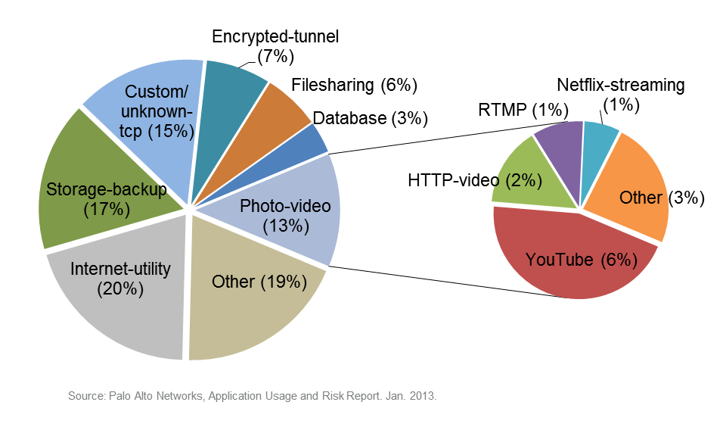
Photo-video Applications = 13% of Bandwidth
Photo-video consumed roughly 557,000 two-hour high definition movie downloads
Notes:
The use of video for business purposes is known and proven; it’s used for marketing promotions, lead generation, product announcements, training, and education to name just a few examples. For business purposes, the most common applications are YouTube and HTTP video, and perhaps Vimeo.
There were 112 (out of 1,395) photo-video applications found and they consumed 13% of all bandwidth – roughly the equivalent of 557,000 two-hour high definition movie downloads.
96% of the 3,056 networks analyzed had an average of 30 photo-video application variants on their network.. The question organizations should ask is this: what business value do Netflix-streaming and Hulu Networks have on their network?
Within the photo-video category, 92 unique threats were detected, ranking it the 10th highest in terms of total threats.
The voluminous bandwidth consumption differences between the top two video applications – YouTube and HTTP video – and the other 100+ variants is consistent within the threat logs observed. There were 25 unique threats found within YouTube and 12 unique threats within HTTP video. Collectively they represent 97% (52% and 45%) of all of all photo-video threat logs observed. This is interesting given that these applications accounted for similar numbers of threat logs, even though YouTube generated about 3 times as much traffic. Within the photo-video category, exploit logs outnumbered malware logs 12:1. Many of the exploits in this category targeted well-known buffer overflow attacks against vulnerable applications such as VUPlayer.

Slide 10
Photo-Video Trends in Usage and Threats
96% of the 3,056 networks had an average of 30 photo-video application variants on their network
What is the business use case for Netflix-streaming and Hulu Networks?
92 unique threats were detected, ranking it the 10th highest in terms of total threats
Photo video threat activity is low compared to other application subcategories
Notes:
Within the photo-video category, 92 unique threats were detected, ranking it the 10th highest in terms of total threats.
The voluminous bandwidth consumption differences between the top two video applications – YouTube and HTTP video – and the other 100+ variants is consistent within the threat logs observed. There were 25 unique threats found within YouTube and 12 unique threats within HTTP video. Collectively they represent 97% (52% and 45%) of all of all photo-video threat logs observed. This is interesting given that these applications accounted for similar numbers of threat logs, even though YouTube generated about 3 times as much traffic. Within the photo-video category, exploit logs outnumbered malware logs 12:1. Many of the exploits in this category targeted well-known buffer overflow attacks against vulnerable applications such as VUPlayer.

Slide 11
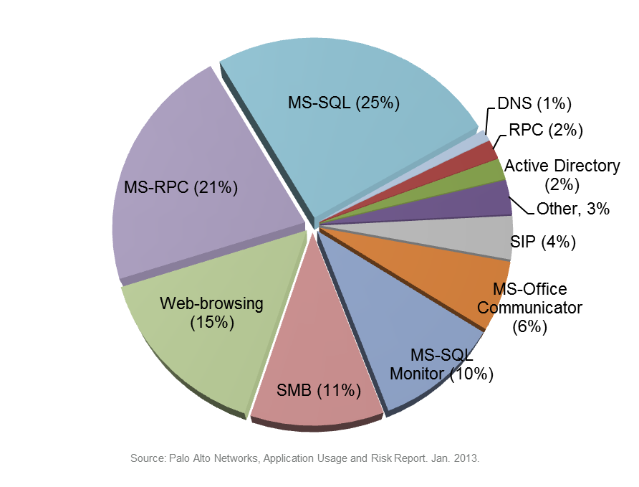
Exploits Target High Value Assets
10 out of 1,395 applications
2,016 unique exploits and ~60M exploit logs observed
9 business critical applications account for 82% of the threat logs
Notes:
In the previous section, the applications discussed were primarily Internet based and as such, the traffic will traverse the perimeter firewall and IPS as the first line of defense. The key finding was that the volume of threat logs viewed was relatively low when compared to the bandwidth, the frequency of use and the overall assumption that personal Internet applications represent the highest volume of risk. This finding implies that perimeter security efforts are “crunchy on the outside” effectively stopping some of the threats. Shifting the focus to internal applications, the findings show that security is “tender on the inside”, with 97% of the vulnerability exploit logs found in only 10 applications (out of 1,395 found). Nine of these applications are considered high-value assets; they are internal or infrastructure related applications that are integral to many business functions. This data indicates that the strategy of attacking critical resources from inside the network continues to become the rule and not the exception, and will force enterprises to monitor their internal traffic for threats in addition to the perimeter.

Slide 12
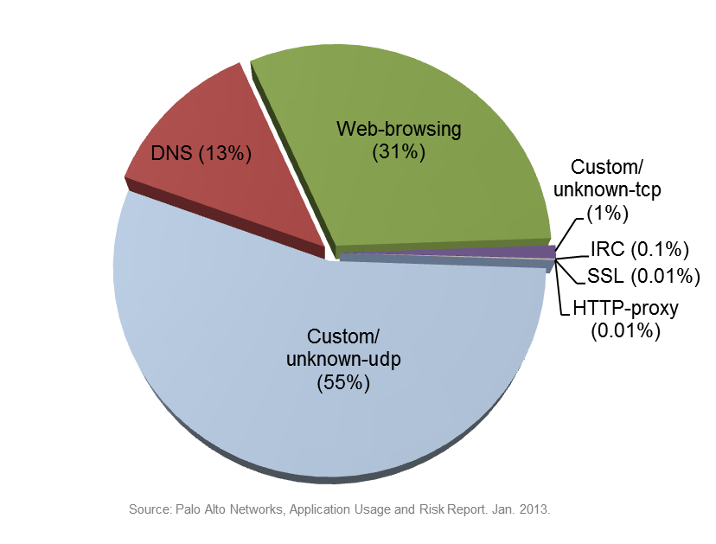
Malware Hides in Custom/Unknown Traffic
7 out of 1,395 applications
99.9% of ~204M malware logs observed
55% found in custom/unknown udp
Custom/unknown udp only 2% of all bandwidth
Notes:
Correlating threats with specific applications (or application features) allows security teams to directly see and control the risk in their networks. However, this full classification of traffic also has the often-unanticipated benefit of revealing custom or unknown application traffic on the network. Custom or unknown traffic is classified as either custom/unknown-TCP or custom/unknown-UDP, which allows organizations to quickly analyze and systematically manage the traffic and associated risk. Unknown or custom traffic exists on every network observed, typically in the range of 8-10% of all traffic; it can be an internal (custom) application, it can be a commercial application not yet identified, or it can be a threat (custom application). While small in volume, unknown/custom traffic is very high in risk – it epitomizes the 80%-20% rule – a high volume of risk from a low volume of traffic. Determining and then managing this small amount of high risk traffic is particularly significant for controlling threats as attackers and their malware will often customize existing applications and protocols to fit the attacker’s needs. The next section of this report provides the first analysis of how unknown or custom application traffic contributes to the risk facing an enterprise.

Slide 13
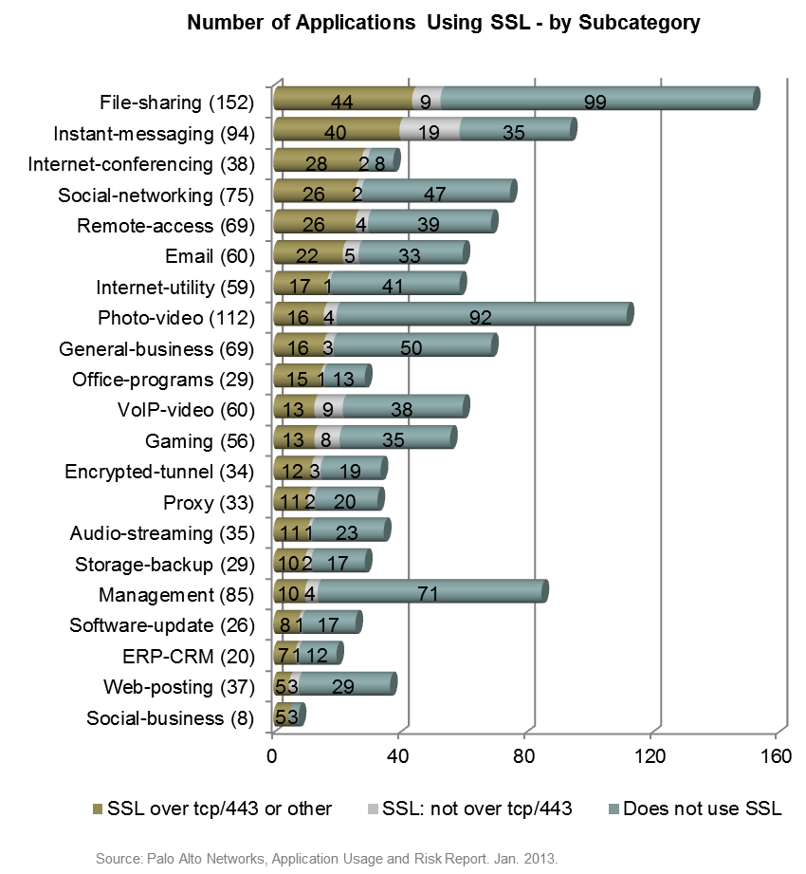
Hiding in Plain Sight
SSL masks application use, and potential threat activity
356 applications can use SSL in some way or another
37 hop ports, 28 use port 80, 20 use ports other than tcp/443
Notes:
Expanding the view beyond just SSL to the broader category of encrypted tunnel applications, there are generally two use cases: those that are endorsed by the organization and used for secure communications (e.g., SSH, SSL, IPSec, IKE, ESP, and Secure Access) and those that may not be endorsed and may be used to mask activity or evade controls (e.g., Hamachi, Tor, UltraSurf, and Freegate). The latter group of applications has little business value on most enterprise networks.
The figure below displays how frequently some of the more common encrypted tunnel applications were detected over the last three Application Usage and Risk Reports. The only application that increased in frequency of use was Freegate, an application that is described as an anti-censorship software for secure and fast Internet access.

Slide 14
Recommendations and Actions
Balance security and application access
Block BitTorrent – encourage alternatives
Apply QoS to video applications
Block Facebook-apps without impeding social media initiatives
Protect most valued assets
Isolate the internal applications; monitor for rogue application use (SSH, RDP, etc)
Allow specific users to access specific applications
Apply threat prevention
Systematically manage custom/unknown traffic
Identify internal applications
Submit packet capture for commercial applications
Apply threat prevention

