Slide 1
redefining privileged access management
Defense in Depth

Slide 2






Balabit at a glance
100+ PARTNERS
In 50+ countries
1500 CLIENTS
REFERENCES
25 Fortune 100 companies
More than 1 million installations
OFFICES
Budapest, New York, London, Paris, Munich, Moscow
TRACK RECORD
17 years in IT security
Notes:
Balabit is been in the IT security business for almost two decades. During this time, we have established local offices on a global scale. Like BP, NY, L, P, M and Mos.
25 organizations from our over 1500 (fifteen hundred) customers are in the fortune 100.
We also work with a partner network in regions we don’t have local representation.
And including our popular OS technology, we have over a million users for our products.

Slide 3

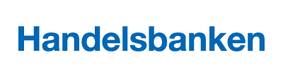
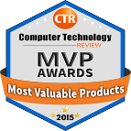












Balabit at a glance

Slide 4
the Privileged access Problem
81%
of hacking-related breaches leveraged either stolen and/or weak passwords
64%
of all the data breaches involved identity theft
3rd
Privilege misuse is the 3rd most prevalent cause of data breaches
Source: Verizon DBIR 2017;
Gemalto Breach Level Index

Slide 5


Why do we need something new
APTs, illegally acquired user credentials.
Have you ever heard about…
    Target?
Can you fully trust your colleagues?
Edward Snowden

Slide 6

Password management is only a first line of defense …
Password management does not defend against attackers with valid credentials
(malicious insiders,
APT attacks)
Balabit’s approach to Privileged Access Management:
Monitor and record every privileged session
Analytics to detect suspicious behavior and stop malicious activity
Real-time alerting
Fast Forensics

Slide 7









How balabit provides defense in depth
Security Information and Event Management
Anomaly Detection
Risk Scoring
Risk-based Alerts
Behavioral Biometrics
Privileged Account Analytics
Log
Management
No workflow changes
Central Access Point
Granular
Access control
Tamper-proof
Searchable Audit trails
Policy Violation
Alerts
Session Termination
No Agents
Servers
Routers
Privileged
Account
Privileged Session Management
Keys to the kingdom
Critical IT assets
Privileged Identity Management
Multifactor
Authentication
IT Service
Management

Slide 8
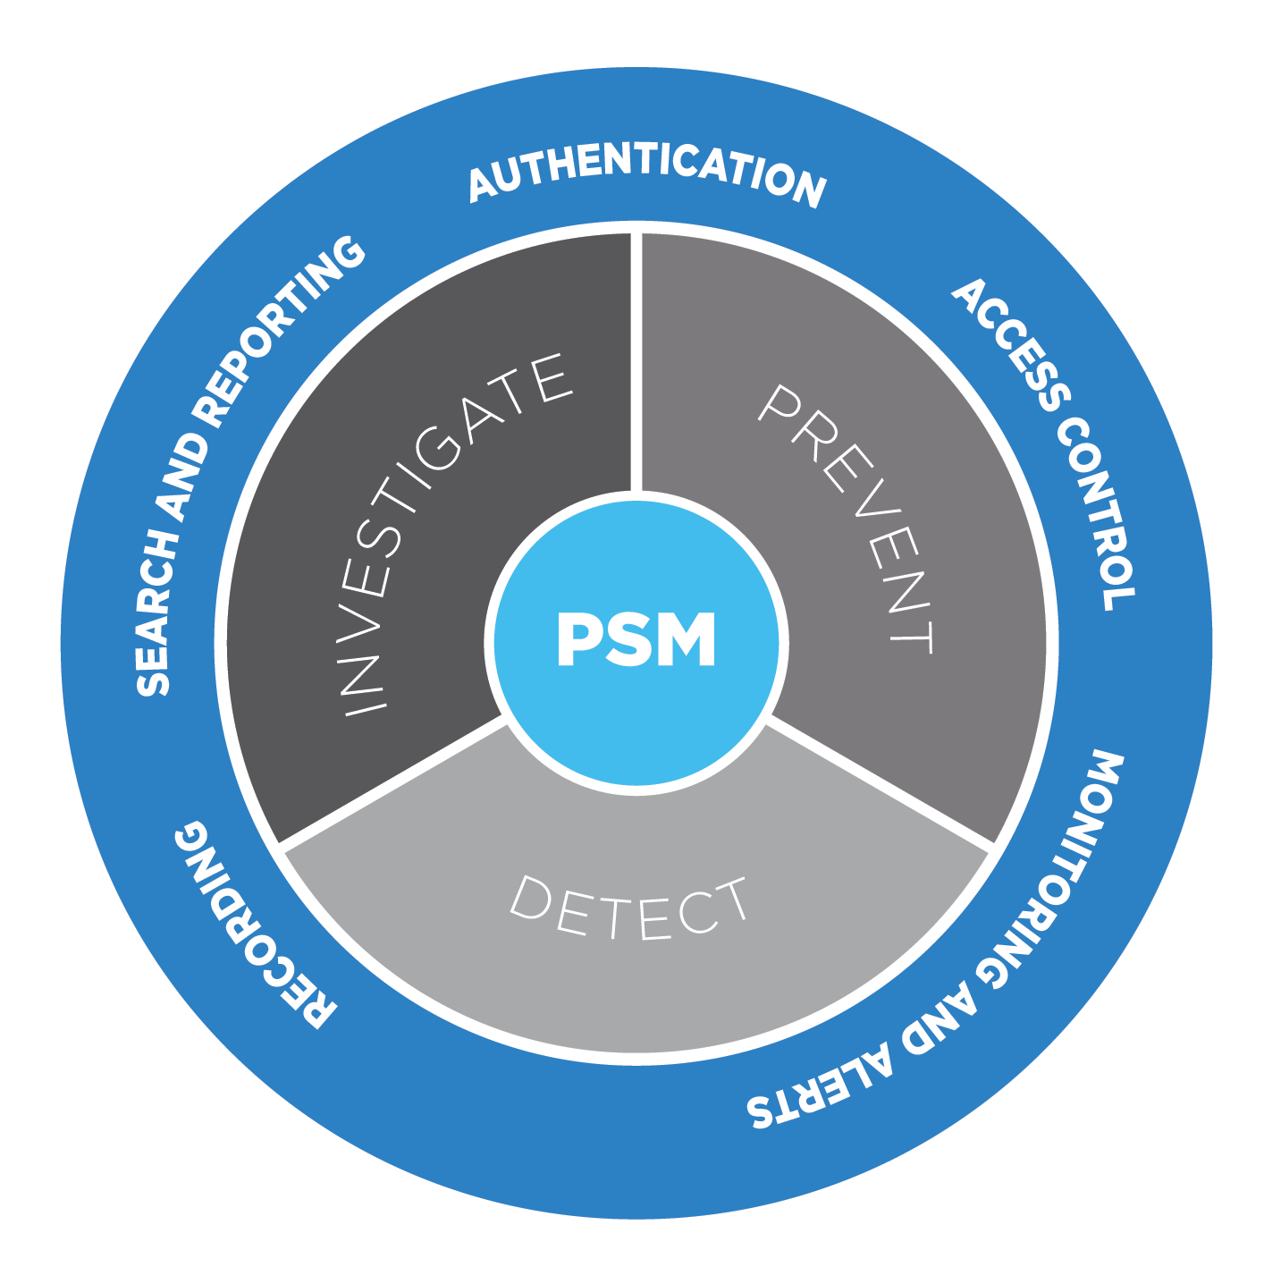
What is privileged session management?
Controls privileged access to remote servers
Records activities into movie-like audit trails
Monitors privileged sessions and send alerts in real-time
Reports actions for compliance and/or decision support reasons
Notes:
Privileged Session Management (SCB) is an activity monitoring appliance that controls access to remote servers, virtual desktops, or networking devices, and records the activities of the users accessing these systems. For example, it records as system administrators configure your database servers through SSH protocol, or your employees make transactions using thin-client applications in a Citrix environment. The recorded audit trails can be replayed like a movie to review the events exactly as they occurred. The content of the audit trails is indexed to make searching for events and automatic reporting possible. PSM is especially suited to supervise privileged-user access as mandated by many compliance requirements, like PCI-DSS. It helps you answer the question of who did what and when on your critical servers.

Slide 9
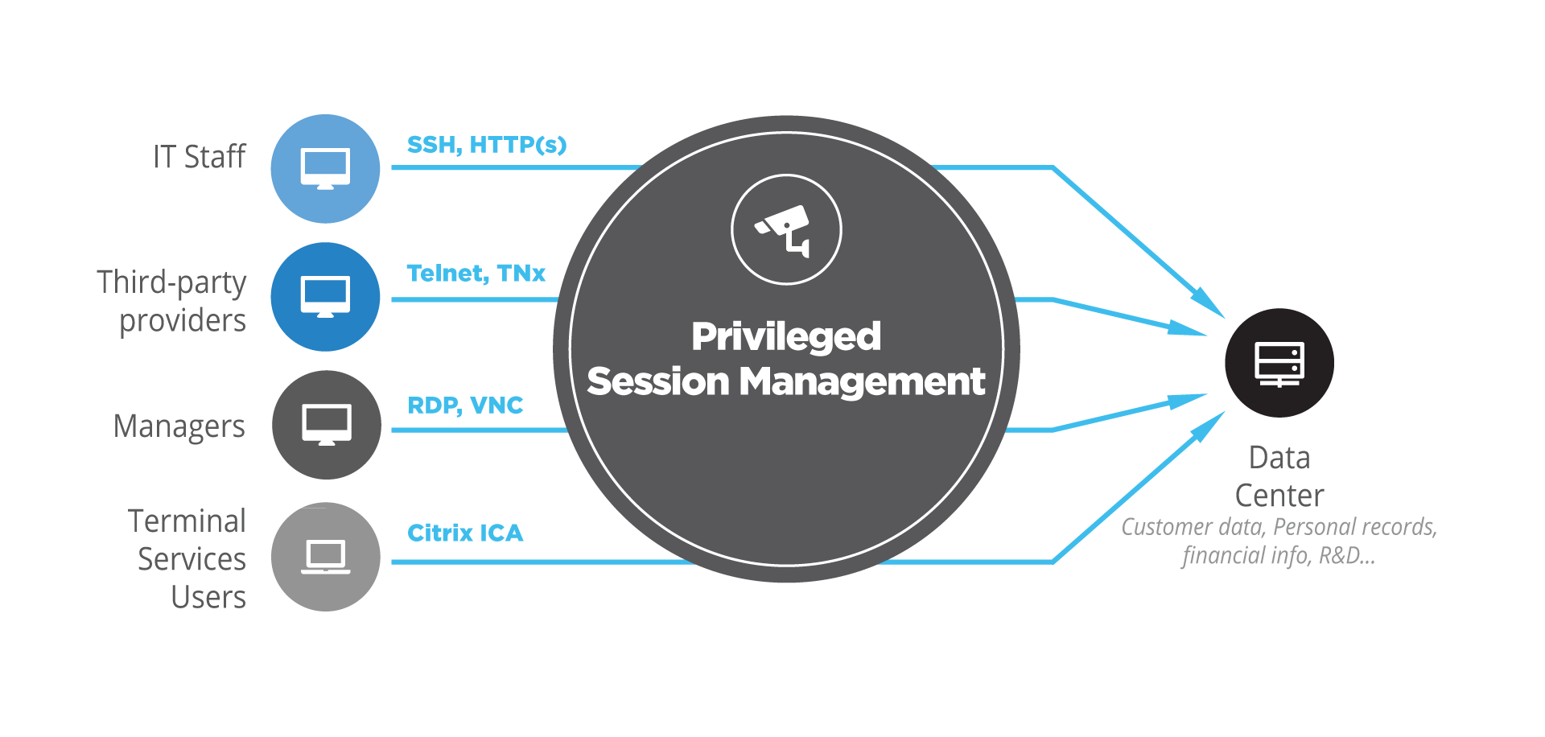
Turnkey, transparent auditing
Notes:
Privileged Session Management (SCB) is an activity monitoring appliance that controls access to remote servers, virtual desktops, or networking devices, and records the activities of the users accessing these systems. For example, it records as system administrators configure your database servers through SSH protocol, or your employees make transactions using thin-client applications in a Citrix environment. The recorded audit trails can be replayed like a movie to review the events exactly as they occurred. The content of the audit trails is indexed to make searching for events and automatic reporting possible. PSM is especially suited to supervise privileged-user access as mandated by many compliance requirements, like PCI-DSS. It helps you answer the question of who did what and when on your critical servers.

Slide 10
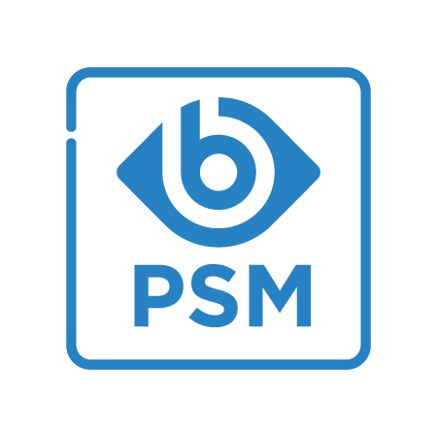
Key benefits of privileged session management
Central control point
Prevent and deter malicious activity
Fully forensic playback
Notes:
Central Control Point: Stay compliant by managing access to your critical IT assets with a centralized authentication and control point.
Prevent and Deter Malicious Activity: Monitor privileged user sessions in real-time, detect rogue behavior, accelerate incident response with session termination or alerts
Fully Forensic Playback: Discover a breach source through detailed session data and searchable, movie-like playback. Identify risks and vulnerabilities.

Slide 11


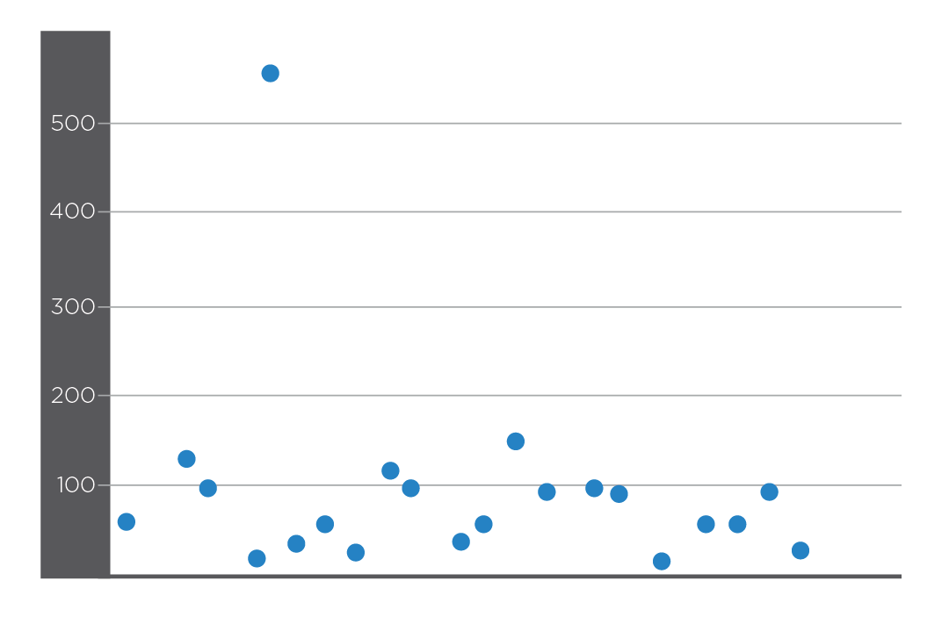

What does privileged account analytics do?
Steps of behavior analysis
Gather users’ digital footprints
Define what is normal, build user baselines
Identify unusual and risky events in real-time
Notes:
Before showing you all this in real life I think it’d be useful to say a few words about what’s happening under the hood.
The most important thing to realize is that when it comes to the mathematics of behavior analysis and outlier detection there’s no need to reinvent the wheel. There are algorithms out there that’s been proven to be effective through decades worth of usage in retail or financial fraud detection. The challenge is to apply the same mathematical principles in the domain of security analytics.
Blindspotter does not rely on a single algorithm rather utilizes several different ones to look at the data from different angles and combines their results. Here are some examples of the algorithms we use.
We have already showed the simplest of them: the technique of kernel density analysis is an ideal solution to find unusual times of activity.
The approach of frequent itemset mining is regularly used in retail: that’s how Amazon knows you are more likely to buy a sleeping bag along with the tent you’ve just put into your cart. Similar profiles can be built out of the digital activities of users in an enterprise.
Cluster analysis can be used to find peer groups based on behavior. Database admins tend to log on to the same servers and use similar commands, while, say, salespeople use different services in a very different way. Outlier activities not typical for a user’s group (like the sysadmin suddenly downloading data from Salesforce) can be detected this way.
Having more detailed information, such as screen contents as recorded by Shell Control Box allows us to apply traditional text analysis algorithms to the data. Just as text mining can detect plagiarism, such analytics can find suspicious behavior on a much deeper level than just pure metadata analysis.

Slide 12

Key benefits of privileged account analytics
Real-time threat detection
Distinguish friend from foe
Reduce alert noise
Notify or suspend
Notes:
Real-Time Threat Detection: Track and visualize user activity in your IT environment in real-time, without pre-defined correlation rules.
Distinguish friend from foe: Use keystroke and mouse data to detect threats and provide continuous authentication for legitimate users.
Reduce Alert Noise: Prioritize events based on user risk and deviation levels. Only investigate the most serious occurrences.
Notify or Suspend: Close down sessions that indicate a malicious presence and notify legitimate users of a potential breach.

Slide 13



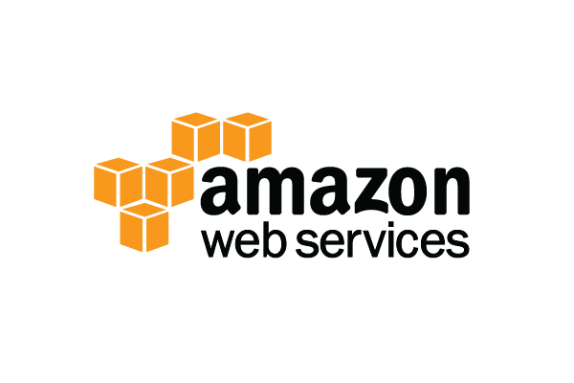





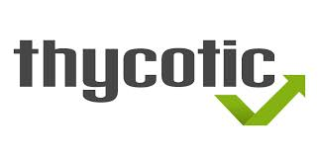








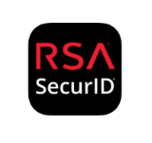
Seamless Enterprise Integration
IDENTITY MANAGEMENT
CLOUD
PASSWORD MANAGEMENT
WORKFLOW &
TICKETING SYSTEMS
MULTI-FACTOR AUTHENTICAION
SIEM
All registered and unregistered logos and trademarks used on this slide are the property of their respective owners. Balabit is not an authorized partner of CyberArk®. The technical interoperability with CyberArk® is based on CyberArk® Enterprise Password Vault® ver.7.20. The interoperability has not been endorsed or authorized by CyberArk®.

Slide 14


REFERENCES AND
CASE STUDIES

Slide 15
Protection against Privileged Identity Theft
Protection against Privileged Insider Threats
Faster Incident Response
Easier Compliance

Slide 16





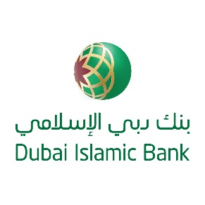










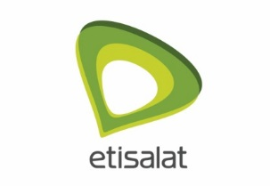
















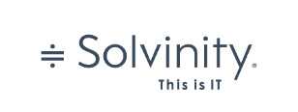


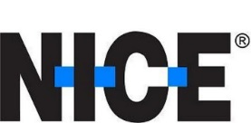





REFERENCES
Notes:
we have a wide range of customers across many different verticals

Slide 17

Internal and external security compliance at adobe
Challenge:
Comply to ISO 27001 and SOC2…
…on a low TCO.
Solution:
Proxy-based gateway architecture
MFA-support
LDAP integration
Notes:
The Challenge
The Adobe Experience Cloud business unit had several internal policy- and compliance-related security requirements, such as the ISO 27001 and SOC 2 reporting. Key requirements included multi-factor authentication (MFA) for accessing production systems and logging of all administrative sessions. So, mainly driven by TCO considerations, Adobe wanted to consolidate bastion hosts into a central access management gateway. For usability and manageability reasons, Adobe preferred a network-level solution that does not require installing agents on clients or servers. In addition, they needed a user-friendly solution that did not disrupt the daily workflow of system administrators.
The Solution
During the selection process, Adobe evaluated virtual terminal-based access management systems and other “all-in-one” privileged identity management (PIM) solutions as well. However, these solutions did not integrate well with Adobe’s existing identity management infrastructure and would have required significant changes in administrator workflows. When searching for alternatives, they found Balabit’s privileged user monitoring appliance, the Privileged Session Management (PSM, formerly known as Shell Control Box).
“We chose PSM because its proxy-based gateway architecture and the easy implementation were important for us. The MFA support, the integration with LDAP and the least disruption to workflows were additional advantages of the product. In addition, we got a great implementation support from Balabit’s pre-sales team.” – says Magleby.
After an initial Proof-of-Concept phase, Adobe created a test environment to conduct extensive testing and plan the implementation of PSM. The full rollout took a few weeks. In the beginning they ran Privileged Session Management in parallel with the existing bastion hosts and eventually decommissioned the old systems.
Adobe deployed three high availability PSM clusters in three locations. The clusters control SSH- and RDP-based access to Linux and Windows hosts located in multiple, geographically distributed datacenters and cloud-based environments. Today, PSMs are operational in Adobe’s production environment. They monitor hundreds of administrative users and help protect tens of thousands of hosts.
Third-party Integrations
Okta
The Privileged Session Management is integrated with identity management service Okta, which supports multi-factor authentication scenarios. Prior to establishing an SSH or RDP connection the PSM AA plugin framework invokes Okta Verify OTP (one-time password) or PUSH authentication. This allows Adobe to leverage an additional out-of-band factor (typically through the user’s registered smartphone) when authenticating the user. The additional factor is processed in-line with the connection setup, so users don’t have to go to an external application to process the additional factor. This results in an efficient end-user experience that is readily accepted by the users.
Splunk
PSM exports audit data for both SSH and RDP sessions and sends them directly into Splunk using the Splunk’s HTTP Event Collector. This allows Adobe to leverage Splunk as the aggregator for security-related log data from PSM as well as other applications, hosts and devices. Thus, they can use their existing SIEM tool for monitoring, correlating and investigating security events with additional critical information that PSM provides.
Benefits
The Privileged Session Management helped Adobe to meet compliance requirements for its Experience Cloud business unit by providing multi-factor authentication and auditing technology, a core component to gaining SOC2 compliance. Implementing a central, proxy-based access management gateway instead of distributed bastions helped streamline administrative tasks and decrease support tickets. The enforcement of a second-factor authentication and the availability of session recordings made access of high-risk users more secure.
“Balabit Privileged Session Management helps us meet a portion of our compliance and internal security requirements related to access management. Our administrative users readily accepted it as it is not disruptive to their existing workflows. PSM is a reliable and straightforward solution, which integrated seamlessly into our existing identity management system and is able to support our needs for both Linux and Windows server access. Implementation went very smoothly as it did not require any changes to our network or servers. We are happy with the benefits PSM has been able to provide, and the ease in which we were able to adopt it.” – concludes Magleby

Slide 18
Internal and external security compliance at adobe
3rd party integrations:
Okta
Splunk
Benefits:
More secure access of high-risk users
Streamline administrative tasks
Decrease support tickets
Notes:
The Challenge
The Adobe Experience Cloud business unit had several internal policy- and compliance-related security requirements, such as the ISO 27001 and SOC 2 reporting. Key requirements included multi-factor authentication (MFA) for accessing production systems and logging of all administrative sessions. So, mainly driven by TCO considerations, Adobe wanted to consolidate bastion hosts into a central access management gateway. For usability and manageability reasons, Adobe preferred a network-level solution that does not require installing agents on clients or servers. In addition, they needed a user-friendly solution that did not disrupt the daily workflow of system administrators.
The Solution
During the selection process, Adobe evaluated virtual terminal-based access management systems and other “all-in-one” privileged identity management (PIM) solutions as well. However, these solutions did not integrate well with Adobe’s existing identity management infrastructure and would have required significant changes in administrator workflows. When searching for alternatives, they found Balabit’s privileged user monitoring appliance, the Privileged Session Management (PSM, formerly known as Shell Control Box).
“We chose PSM because its proxy-based gateway architecture and the easy implementation were important for us. The MFA support, the integration with LDAP and the least disruption to workflows were additional advantages of the product. In addition, we got a great implementation support from Balabit’s pre-sales team.” – says Magleby.
After an initial Proof-of-Concept phase, Adobe created a test environment to conduct extensive testing and plan the implementation of PSM. The full rollout took a few weeks. In the beginning they ran Privileged Session Management in parallel with the existing bastion hosts and eventually decommissioned the old systems.
Adobe deployed three high availability PSM clusters in three locations. The clusters control SSH- and RDP-based access to Linux and Windows hosts located in multiple, geographically distributed datacenters and cloud-based environments. Today, PSMs are operational in Adobe’s production environment. They monitor hundreds of administrative users and help protect tens of thousands of hosts.
Third-party Integrations
Okta
The Privileged Session Management is integrated with identity management service Okta, which supports multi-factor authentication scenarios. Prior to establishing an SSH or RDP connection the PSM AA plugin framework invokes Okta Verify OTP (one-time password) or PUSH authentication. This allows Adobe to leverage an additional out-of-band factor (typically through the user’s registered smartphone) when authenticating the user. The additional factor is processed in-line with the connection setup, so users don’t have to go to an external application to process the additional factor. This results in an efficient end-user experience that is readily accepted by the users.
Splunk
PSM exports audit data for both SSH and RDP sessions and sends them directly into Splunk using the Splunk’s HTTP Event Collector. This allows Adobe to leverage Splunk as the aggregator for security-related log data from PSM as well as other applications, hosts and devices. Thus, they can use their existing SIEM tool for monitoring, correlating and investigating security events with additional critical information that PSM provides.
Benefits
The Privileged Session Management helped Adobe to meet compliance requirements for its Experience Cloud business unit by providing multi-factor authentication and auditing technology, a core component to gaining SOC2 compliance. Implementing a central, proxy-based access management gateway instead of distributed bastions helped streamline administrative tasks and decrease support tickets. The enforcement of a second-factor authentication and the availability of session recordings made access of high-risk users more secure.
“Balabit Privileged Session Management helps us meet a portion of our compliance and internal security requirements related to access management. Our administrative users readily accepted it as it is not disruptive to their existing workflows. PSM is a reliable and straightforward solution, which integrated seamlessly into our existing identity management system and is able to support our needs for both Linux and Windows server access. Implementation went very smoothly as it did not require any changes to our network or servers. We are happy with the benefits PSM has been able to provide, and the ease in which we were able to adopt it.” – concludes Magleby

Slide 19

Managing third-party access at Svenska Handelsbanken
Challenge:
Manage third-party access…
…in a safe way without compromising integrity of the sensitive data.
Solution:
Control the privileges of third-party administrators
Allow access only to specific servers
Audit user sessions
Notes:
The Challenge
Like many competitive banks, Svenska Handelsbanken’s IT environment is a mixed and complex environment that has grown organically since the 1970s. From a technology standpoint, it manages an infrastructure that ranges from mainframe legacy systems to a thin client infrastructure including 3,000 Windows servers. This is a common banking IT configuration borne of the evolution of technology and of the industry itself. Historically, the bank called on internal development for the majority of its IT requirements, following a traditional build-versus-buy strategy. In recent years, the balance between build and buy has changed, driven by cost efficiency targets. However, this created a new challenge for the bank’s IT unit. The bank follows strict information security guidelines that form the basis for IT governance and compliance to various local and international requirements. It now needed to review these to include guidelines and security measures for access from third-party service providers to the bank’s systems and information. It also required tools that would enable third parties access to the systems in a safe way without compromising integrity of the sensitive data. In late 2007, Svenska Handelsbanken investigated the market for logging tools and selected Balabit‘s Privileged Session Management.
The Solution
Following the proof of concept, the bank purchased a license for PSM to monitor up to 50 servers, based on the unique logging capabilities of the system. Implementation of the solution was swift and straightforward, with a 3 month rollout including full load and process testing. The system went live in the second quarter of 2008. PSM is implemented in a two-node high availability cluster configuration and the hardware is scalable to monitor up to 500 simultaneous connections. PSM cluster is installed in a firewall environment and Svenska Handelsbanken can thus control the privileges of each third-party administrator and allow them access to specific servers while having the possibility to audit the user sessions. The bank has been able to set process rules limiting access to sensitive data.
Benefits
The key benefits of PSM are in its unique audit and visualization of its logging function. The bank can review every login and commands made by third-party administrators in real time (ensuring additional supervision) but can also review historical activity for the purpose of audit (compliance or accident management). The task is enhanced by the visualization functions through a graphical exchange in which history is displayed in a movie form. These visualization interfaces and the real-time element of the auditing were crucial factors in Svenska Handelsbanken’s decision to select PSM.

Slide 20
Managing third-party access at Svenska Handelsbanken
Benefits:
Unique audit and visualization functions, including movie-like replay and real-time follow
Review of logins and commands of third-party administrators
Notes:
The Challenge
Like many competitive banks, Svenska Handelsbanken’s IT environment is a mixed and complex environment that has grown organically since the 1970s. From a technology standpoint, it manages an infrastructure that ranges from mainframe legacy systems to a thin client infrastructure including 3,000 Windows servers. This is a common banking IT configuration borne of the evolution of technology and of the industry itself. Historically, the bank called on internal development for the majority of its IT requirements, following a traditional build-versus-buy strategy. In recent years, the balance between build and buy has changed, driven by cost efficiency targets. However, this created a new challenge for the bank’s IT unit. The bank follows strict information security guidelines that form the basis for IT governance and compliance to various local and international requirements. It now needed to review these to include guidelines and security measures for access from third-party service providers to the bank’s systems and information. It also required tools that would enable third parties access to the systems in a safe way without compromising integrity of the sensitive data. In late 2007, Svenska Handelsbanken investigated the market for logging tools and selected Balabit‘s Privileged Session Management.
The Solution
Following the proof of concept, the bank purchased a license for PSM to monitor up to 50 servers, based on the unique logging capabilities of the system. Implementation of the solution was swift and straightforward, with a 3 month rollout including full load and process testing. The system went live in the second quarter of 2008. PSM is implemented in a two-node high availability cluster configuration and the hardware is scalable to monitor up to 500 simultaneous connections. PSM cluster is installed in a firewall environment and Svenska Handelsbanken can thus control the privileges of each third-party administrator and allow them access to specific servers while having the possibility to audit the user sessions. The bank has been able to set process rules limiting access to sensitive data.
Benefits
The key benefits of PSM are in its unique audit and visualization of its logging function. The bank can review every login and commands made by third-party administrators in real time (ensuring additional supervision) but can also review historical activity for the purpose of audit (compliance or accident management). The task is enhanced by the visualization functions through a graphical exchange in which history is displayed in a movie form. These visualization interfaces and the real-time element of the auditing were crucial factors in Svenska Handelsbanken’s decision to select PSM.

Slide 21

Security awareness-driven privileged session management
Challenge:
Bring the whole IT environment under supervision
Monitor all privileged user access to servers and other IT systems
Record administrators’ command executions and application launches
Provide tamper-proof, easily interpreted evidence for forensics investigations
Notes:
The Challenge
Thanks to regular audits and training programs, security awareness is strong at the State of Geneva: internal departments care about the security of their IT systems and data. They recognized that prevention of user-related incidents has pivotal importance from a data protection point of view. For this reason, the State of Geneva formulated a request to the DGSI to monitor the access of its IT staff. They wanted to have strong and detailed evidence of the IT Staff activities on the systems in case of security incidents.
Previous incident investigations were costly tasks: Identifying the root cause could take a lot of time and effort and had no guarantee of success. Determining whether an incident was caused by accidental human error, system malfunction, or malicious activity, was very difficult. Logs were not considered by the business as a reliable source of information, because the administrators could manipulate them. As a result, the DGSI started to search for a solution capable of meeting the following requirements:
bring the whole IT environment under supervision
monitor all privileged user access to servers and other IT systems
record administrators’ command executions and application launches
provide tamper-proof, easily interpreted evidence for forensics investigations
The Solution
During the vendor selection process, CyberArk, Wallix, Lieberman and Balabit products were all evaluated, but the DGSI chose Balabit’s Privileged Session Management (PSM) privileged user monitoring solution to gether with Lieberman Enterprise Random Password Manager (ERPM). “The secure storage of video records, the transparent operation and the smooth network integration were all important for us. But the decisive point was the fact that PSM was able to do Optical Character Recognition, not only on the titles of the windows, but on all content appearing on the screen of the users.” – explains the Project Manager, Direction Générale des Systèmes d’Informations, State of Geneva. Deployed in high availability configuration, the PSM was integrated with Lieberman’s password manager to control and record the access of 200 system administrators to almost 3000 hosts. Hosts include Linux and Windows servers, VMware and KVM virtual machines, and SUN Solaris and IBM AIX systems. The solution was integrated with Microsoft Active Directory, which makes authentication of Windows users easy, while the Lieberman password vault can manage the shared UNIX accounts.
The privileged access management system is in the early stage of productive operation – currently not all administrative traffic is controlled, but the final goal is to manage all superuser access at the organization. Management gradually limits direct access to the hosts, and permits access only by using the new gateway.
Benefits
The Privileged Session Management based architecture enforces a centralized access policy at the local government. The two-factor authentication (login + OTP) makes it
possible to reliably identify the real user behind a shared account. Knowing that PSM will monitor and record privileged activities in the systems, the business has a means to
investigate IT activities. On the other hand, the IT department is able to prove its non-malicious intention in the case of post-mortem incident investigations: they can replay the
tamper-proof video records anytime, which makes both parties confident. ”The new architecture pioneered a new working philosophy at the local government by introducing a centralized, controlled and monitored access to our critical systems, replacing an unsupervised, direct access in the past. “ – concludes the Project Manager.

Slide 22
Security awareness-driven privileged session management
Solution:
Control and record access of 200 sysadmins to 3000 hosts, including Linux, Windows servers, VMware, KVM, SUN Solaris & IBM AIX
Benefits:
PSM enforces a centralized access policy and 2FA
Replayable, tamper-proof video records
Notes:
The Challenge
Thanks to regular audits and training programs, security awareness is strong at the State of Geneva: internal departments care about the security of their IT systems and data. They recognized that prevention of user-related incidents has pivotal importance from a data protection point of view. For this reason, the State of Geneva formulated a request to the DGSI to monitor the access of its IT staff. They wanted to have strong and detailed evidence of the IT Staff activities on the systems in case of security incidents.
Previous incident investigations were costly tasks: Identifying the root cause could take a lot of time and effort and had no guarantee of success. Determining whether an incident was caused by accidental human error, system malfunction, or malicious activity, was very difficult. Logs were not considered by the business as a reliable source of information, because the administrators could manipulate them. As a result, the DGSI started to search for a solution capable of meeting the following requirements:
bring the whole IT environment under supervision
monitor all privileged user access to servers and other IT systems
record administrators’ command executions and application launches
provide tamper-proof, easily interpreted evidence for forensics investigations
The Solution
During the vendor selection process, CyberArk, Wallix, Lieberman and Balabit products were all evaluated, but the DGSI chose Balabit’s Privileged Session Management (PSM) privileged user monitoring solution together with Lieberman Enterprise Random Password Manager (ERPM). “The secure storage of video records, the transparent operation and the smooth network integration were all important for us. But the decisive point was the fact that PSM was able to do Optical Character Recognition, not only on the titles of the windows, but on all content appearing on the screen of the users.” – explains the Project Manager, Direction Générale des Systèmes d’Informations, State of Geneva. Deployed in high availability configuration, the PSM was integrated with Lieberman’s password manager to control and record the access of 200 system administrators to almost 3000 hosts. Hosts include Linux and Windows servers, VMware and KVM virtual machines, and SUN Solaris and IBM AIX systems. The solution was integrated with Microsoft Active Directory, which makes authentication of Windows users easy, while the Lieberman password vault can manage the shared UNIX accounts.
The privileged access management system is in the early stage of productive operation – currently not all administrative traffic is controlled, but the final goal is to manage all superuser access at the organization. Management gradually limits direct access to the hosts, and permits access only by using the new gateway.
Benefits
The Privileged Session Management based architecture enforces a centralized access policy at the local government. The two-factor authentication (login + OTP) makes it
possible to reliably identify the real user behind a shared account. Knowing that PSM will monitor and record privileged activities in the systems, the business has a means to
investigate IT activities. On the other hand, the IT department is able to prove its non-malicious intention in the case of post-mortem incident investigations: they can replay the
tamper-proof video records anytime, which makes both parties confident. ”The new architecture pioneered a new working philosophy at the local government by introducing a centralized, controlled and monitored access to our critical systems, replacing an unsupervised, direct access in the past. “ – concludes the Project Manager.

Slide 23

Compliance to local finance laws at Fiducia
Challenge:
Comply to BaFin MaRisk…
…with full audit of administrative access to private banking information
Solution:
SSH-auditing
RDP-auditing
Citrix ICA auditing
Notes:
The Challenge
In Germany, the Federal Financial Supervisory Authority (BaFin) has recently announced new regulations which have further extended the Minimum Requirements for Risk Management (MaRisk) for financial institutions. Among others, MaRisk requires full audit of administrative access to private banking information. To fulfill these strict requirements, Fiducia had to look for a solution capable to record all database access by system/database/security administrators and playback the records for forensic purposes in case there is suspicion of non-compliance. In addition, as the Fiducia data-center environment consists of approximately 8,000 UNIX and Linux servers, finding an adequately robust auditing solution was increasingly challenging. For a long time, the provider couldn’t find any competitive offering on the market. Finally, it discovered a solution that met its requirements, the Balabit Privileged Session Management (PSM).
The Solution
The provider involved its strategic system partner AS Computer Consulting & Service in the implementation project. The experts of Fiducia and AS Computer spent about five months to thoroughly test the Balabit PSM down to its tiniest pieces. “Finally, we chose the Balabit’s product as it was the only offering fulfilling our particular requirements and promised the development of a custom solution in competitive time frame and costs.” - explains Mr. Michael Fendt, System & Network Engineer of Fiducia IT AG. Fiducia started to use PSM in production in 2008. The integration of the PSM appliances has been smooth; the organizational integration of SSH auditing into administrative processes of Fiducia was more complex, however. Originally, they used the PSM for auditing only SSH administrative sessions, but later they extended its coverage for RDP-sessions. Recently, they’ve added Citrix ICA and TN3270 protocols to the list and started to evaluate the audit of encrypted TN3270 connections as well. (TN3270 is a Telnet protocol used to communicate with IBM mainframes.) Fiducia has continuously extended its PSM installed base since 2008. Currently, they use 2 High-Availability (HA) PSM clusters for the audit of internal employees, 1 additional cluster for the PCI DSS environment, and 2 HA clusters for auditing external customers’ connections.
Benefits
By implementing Balabit PSM, Fiducia is now capable to fulfill the relevant specifications of German finance laws and regulations. The provider has recently passed the audit of the supervising authority without negative comments. If needed, with PSM it is possible to fully review who, when, on which system exactly what kinds of changes have been made. In addition, FIDUCIA’s specific needs were also completed by Balabit by the development of a custom module within half a year. “Balabit is the first company in IT business, which provided a custom solution in promised time without any obvious faults. Even after 2 weeks of intensive testing we didn’t find any bugs in the pre-release. I never expected that at all.” - concludes Mr. Michael Fendt

Slide 24
Compliance to local finance laws at Fiducia
Benefits:
Fiducia became fully compliant to BaFin MaRisk
Notes:
The Challenge
In Germany, the Federal Financial Supervisory Authority (BaFin) has recently announced new regulations which have further extended the Minimum Requirements for Risk Management (MaRisk) for financial institutions. Among others, MaRisk requires full audit of administrative access to private banking information. To fulfill these strict requirements, Fiducia had to look for a solution capable to record all database access by system/database/security administrators and playback the records for forensic purposes in case there is suspicion of non-compliance. In addition, as the Fiducia data-center environment consists of approximately 8,000 UNIX and Linux servers, finding an adequately robust auditing solution was increasingly challenging. For a long time, the provider couldn’t find any competitive offering on the market. Finally, it discovered a solution that met its requirements, the Balabit Privileged Session Management (PSM).
The Solution
The provider involved its strategic system partner AS Computer Consulting & Service in the implementation project. The experts of Fiducia and AS Computer spent about five months to thoroughly test the Balabit PSM down to its tiniest pieces. “Finally, we chose the Balabit’s product as it was the only offering fulfilling our particular requirements and promised the development of a custom solution in competitive time frame and costs.” - explains Mr. Michael Fendt, System & Network Engineer of Fiducia IT AG. Fiducia started to use PSM in production in 2008. The integration of the PSM appliances has been smooth; the organizational int egration of SSH auditing into administrative processes of Fiducia was more complex, however. Originally, they used the PSM for auditing only SSH administrative sessions, but later they extended its coverage for RDP-sessions. Recently, they’ve added Citrix ICA and TN3270 protocols to the list and started to evaluate the audit of encrypted TN3270 connections as well. (TN3270 is a Telnet protocol used to communicate with IBM mainframes.) Fiducia has continuously extended its PSM installed base since 2008. Currently, they use 2 High-Availability (HA) PSM clusters for the audit of internal employees, 1 additional cluster for the PCI DSS environment, and 2 HA clusters for auditing external customers’ connections.
Benefits
By implementing Balabit PSM, Fiducia is now capable to fulfill the relevant specifications of German finance laws and regulations. The provider has recently passed the audit of the supervising authority without negative comments. If needed, with PSM it is possible to fully review who, when, on which system exactly what kinds of changes have been made. In addition, FIDUCIA’s specific needs were also completed by Balabit by the development of a custom module within half a year. “Balabit is the first company in IT business, which provided a custom solution in promised time without any obvious faults. Even after 2 weeks of intensive testing we didn’t find any bugs in the pre-release. I never expected that at all.” - concludes Mr. Michael Fendt

Slide 25
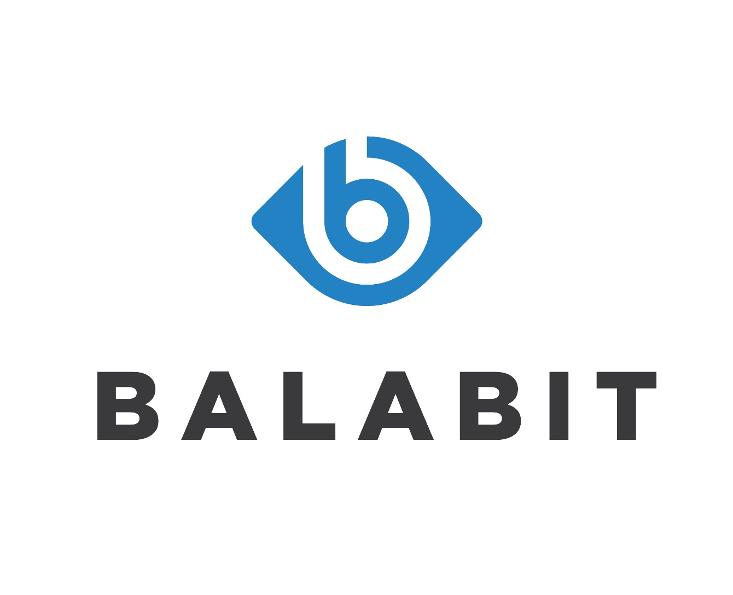
Why choose Balabit PAM?
Our proxy-based technology enables:
Fastest deployment time – no agents required
Most granular access control (command level policy enforcement)
Full text search of session content, not just metadata

Slide 26
WHY CHOOSE Balabit PAM?
Our proxy-based technology enables:
Real-time alerts
Real-time shadowing
No change to workflows
Behavioral biometrics
Automated session termination

Slide 27
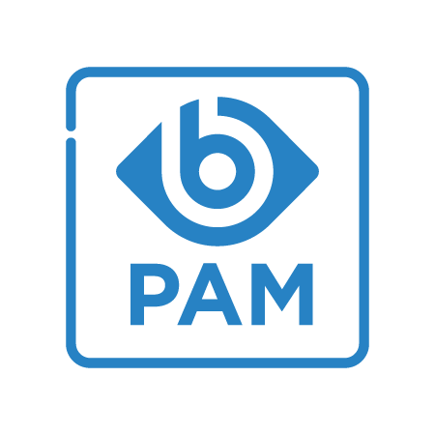
Licensing and implementation
Pricing based on the number of protected hosts
Provided as an appliance, or a virtual image (VMware, Hyper-V)
Cloud-ready (Microsoft Azure, Amazon Web Services)
3 support packages and 7/24 vendor support
Available add-ons:
  Privileged Account Analytics
  High Availability

